Slide 1
Awards & Honors
American Hemerocallis Society
2014 National Convention
Asheville, North Carolina
June 26 - 28, 2014
“Daylilies in the Land of the Sky”

Slide 2
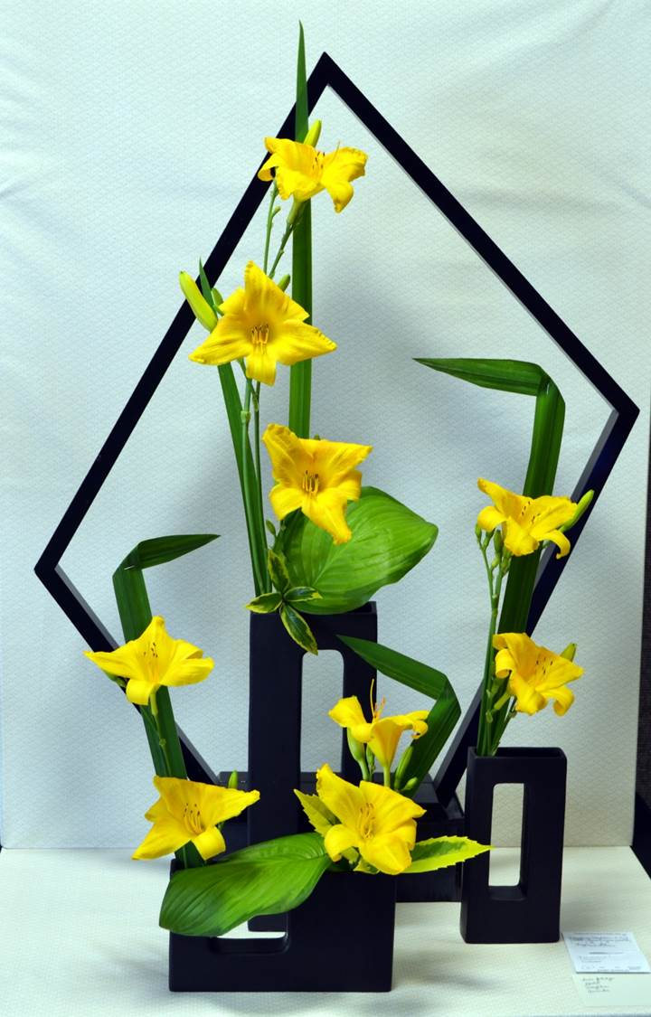
2013 Tri-color Medal
Frances Thrash,
Region 3
Theme: ‘Dazzling Daylilies’
Title: ‘Angles and Stars’

Slide 3
2013 Ophelia Taylor Horticulture Award

Slide 4
2014 AHS Photo & Video Awards
2014 Photography Committee: Andrea Weaver (KS), Chair; Oliver Billingslea (AL); Harry Gregory (KS) & Nikki Schmith (IL)
580 entries
No entries for the Sarah Sikes Sequence Award or the Youth Beginner division

Slide 5
Mildred Schlumpf Photography Awards
Sponsored by Region 6
Mildred Schlumpf served as the AHS Slide Librarian for many years.
In 1983, she won the
Helen Field Fischer Award.

Slide 6
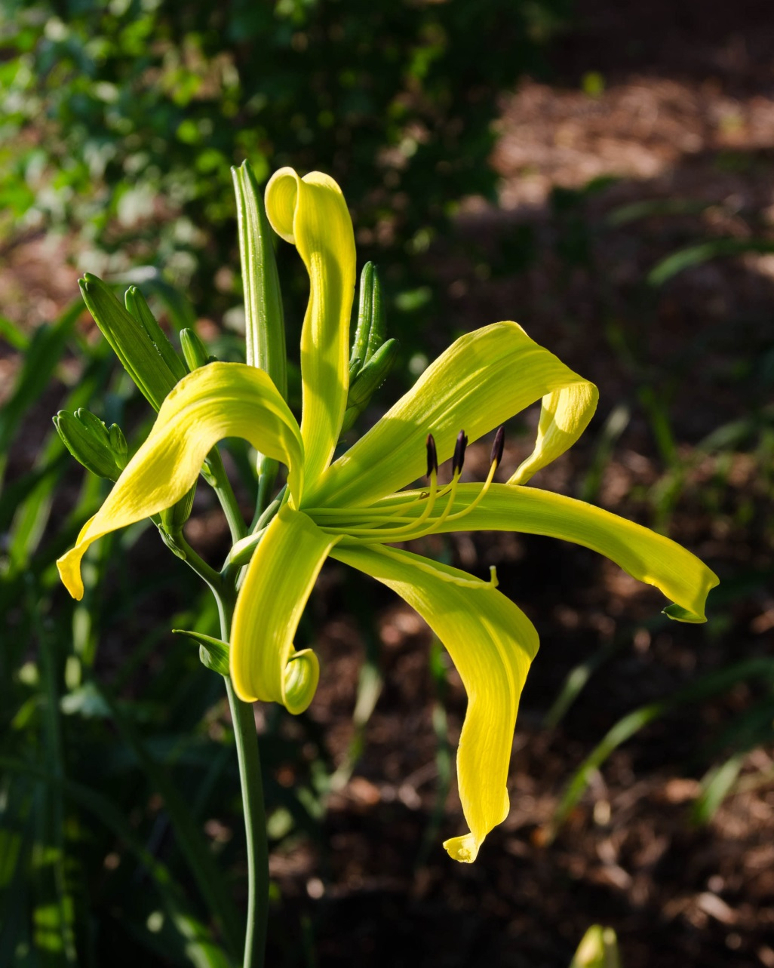
2014 Mildred Schlumpf Award Single Bloom Claude Carpenter, Region 5 ‘Green Inferno’

Slide 7
2014 Mildred Schlumpf Landscape Award Paul Owen, Region 15

Slide 8
2014 Multi-bloom Award Charles Harper, Region 2 ‘Jerry Nettles’

Slide 9
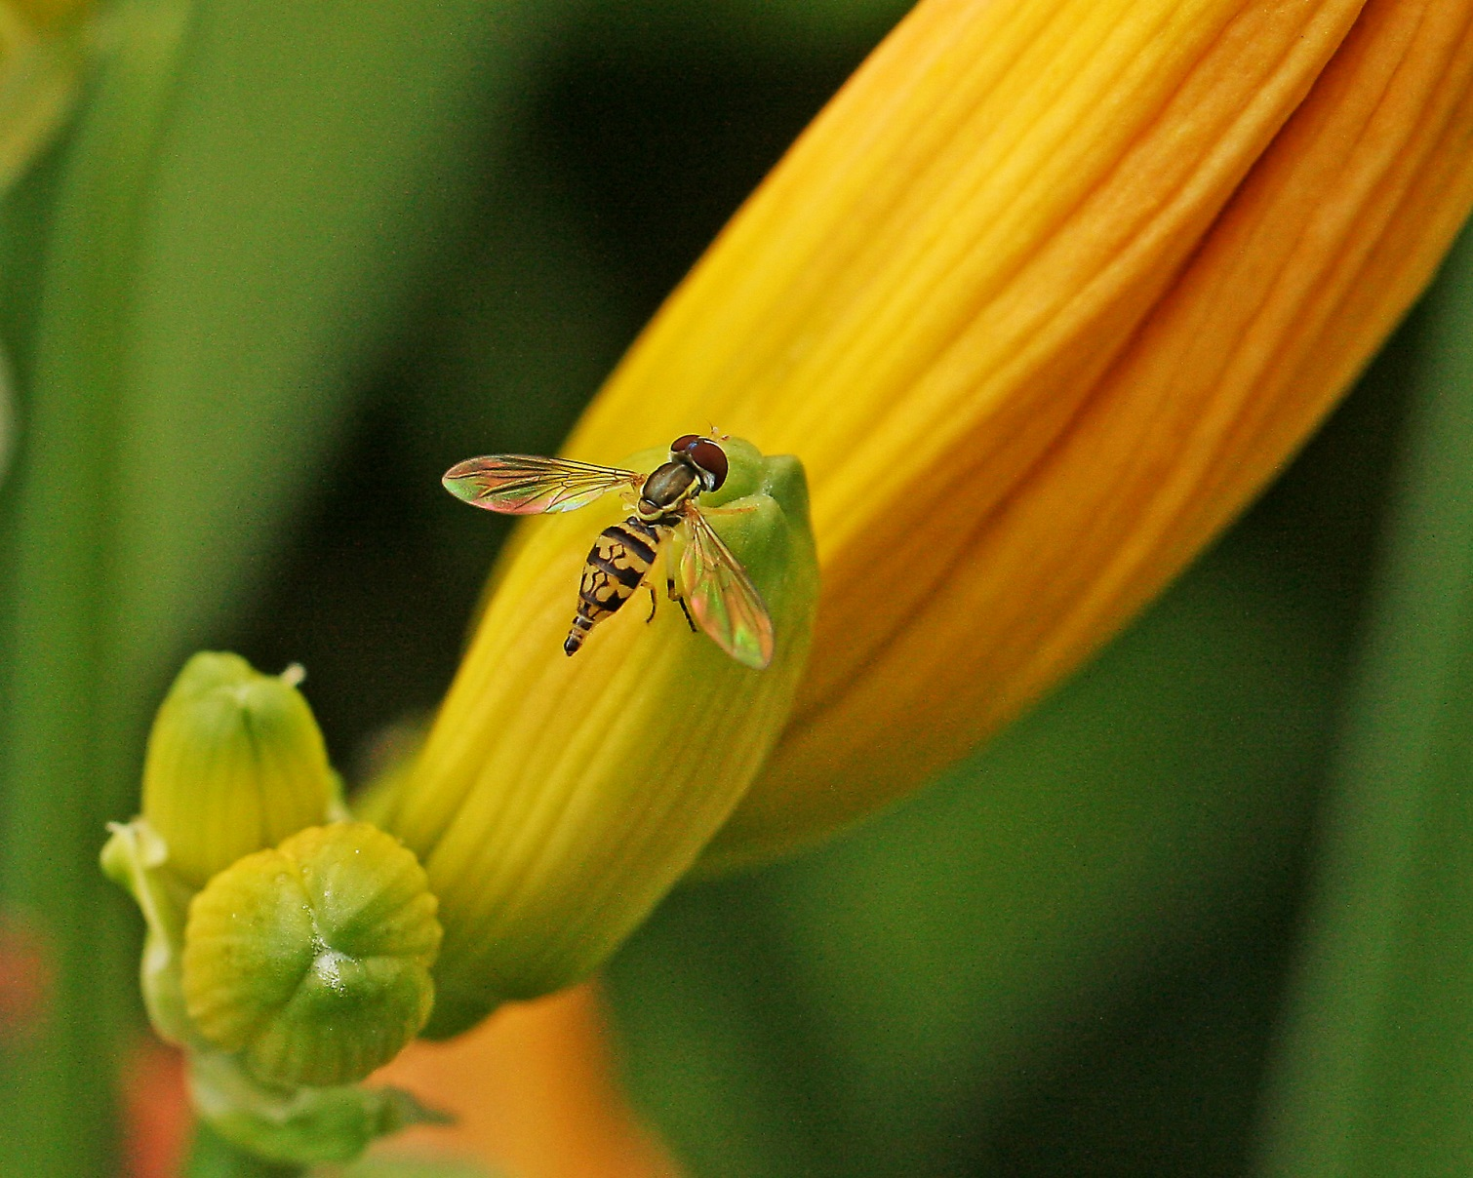
2014 Artistic Image Award John Stahl, Region 4 ‘Orangutan’

Slide 10
2014 Lazarus Memorial Award for best video recording
Shirley Farmer
by Charles Dorsey,
Region 2

Slide 11
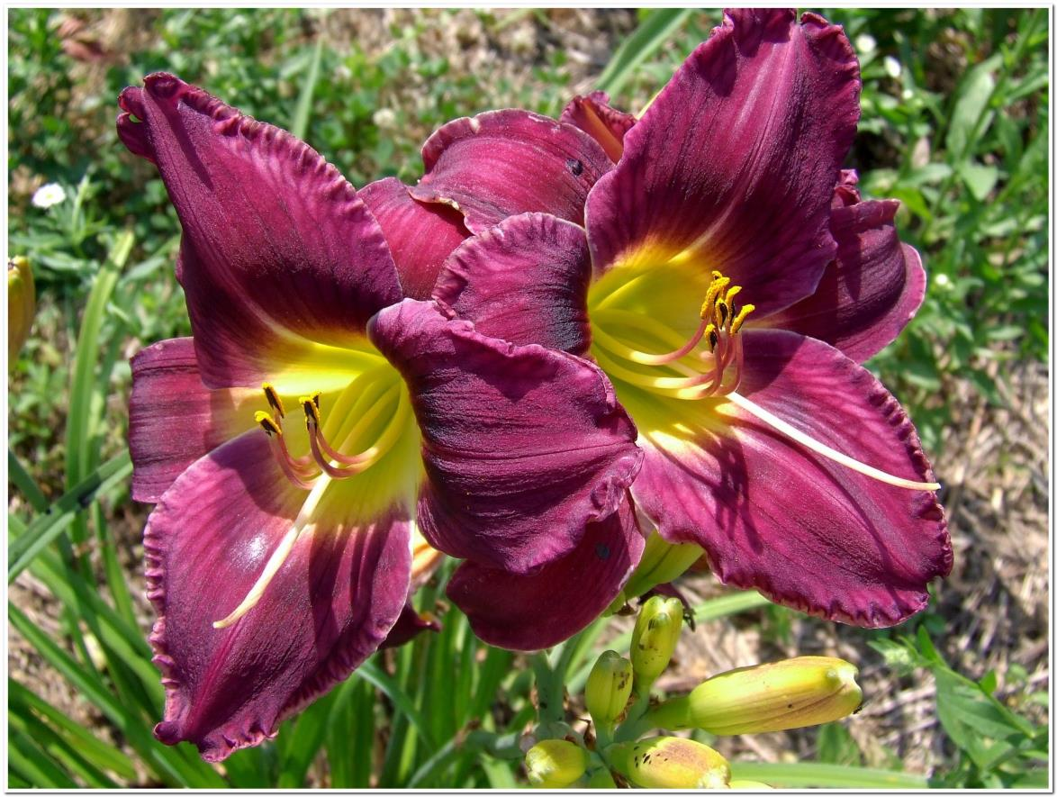
AHS Youth Photography Award Intermediate Division (ages 13-17)
Stephen Smith, Region 10
‘Brandywine Vampire Revenge’

Slide 12
2014 Youth Awards
AHS Bertie Ferris Scholarship
Christine Erin Stamile Youth Award

Slide 13
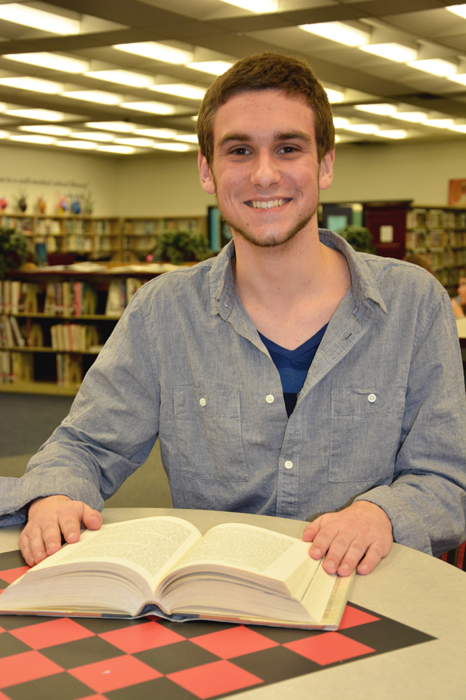
2014
Bertie Ferris Scholarship
Christopher Monschauer
Region 3

Slide 14
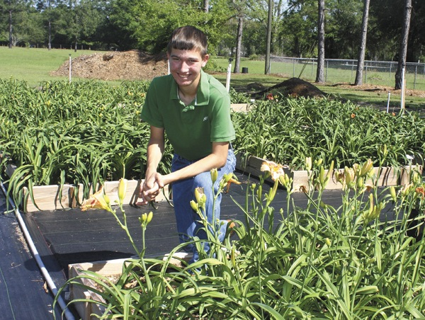
2014 Christine Erin Stamile Youth Award
Matthew Ridaught George, Region 12

Slide 15
2014
Mabel Matthews
Endowment Scholarship

Slide 16
Junior Citation Awards
Established in 1950 to focus attention on new cultivars that appear to have outstanding qualities and distinction.
Must receive a minimum of 10 votes from garden judges.

Slide 17
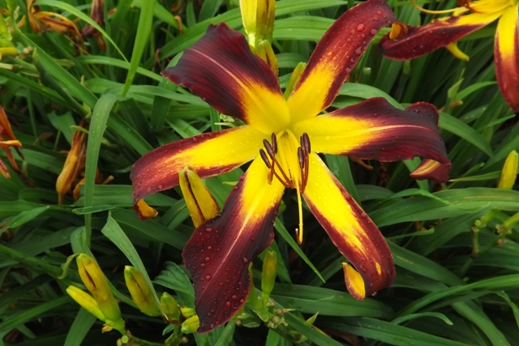
2013 Junior Citation
‘Chris DeLois’ (Bachman)
Image by Dan Bachman

Slide 18
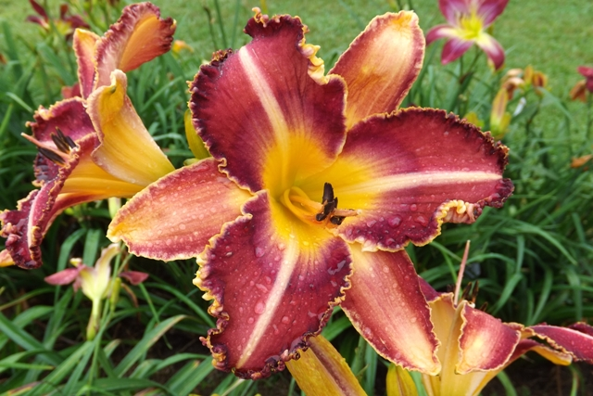
2013 Junior Citation
‘Take the A Train’ (Bachman)
Image by Dan Bachman

Slide 19
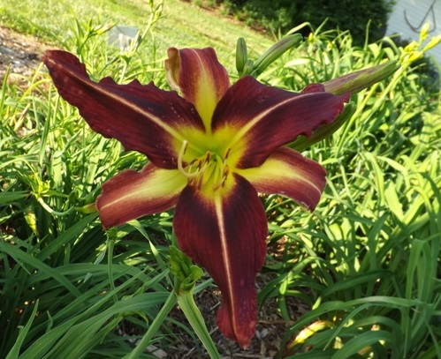
2013 Junior Citation
‘Gimme a Pigfoot’ (Bachman)
Image by Dan Bachman

Slide 20
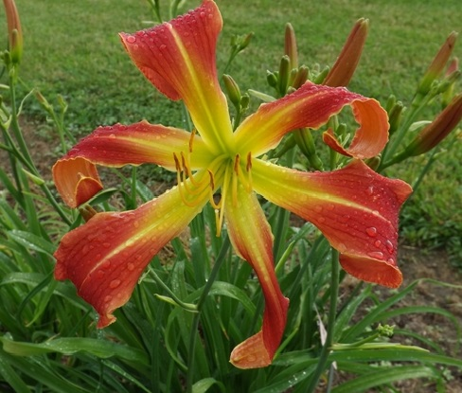
2013 Junior Citation
‘Mary Ann Farwick’ (Bachman)
Image by
Dan Bachman

Slide 21
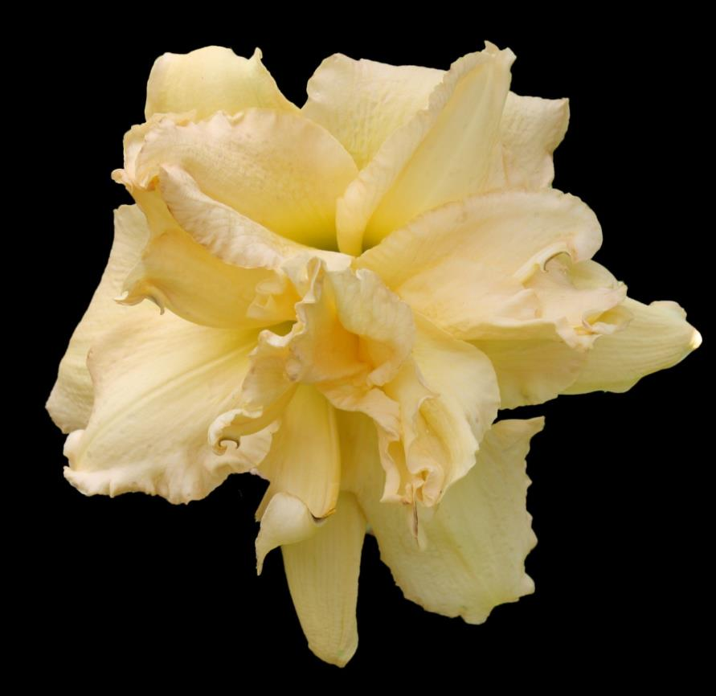
2013 Junior Citation
‘Our Girl Bob’ (Elliott)
Image by Scott Elliott

Slide 22
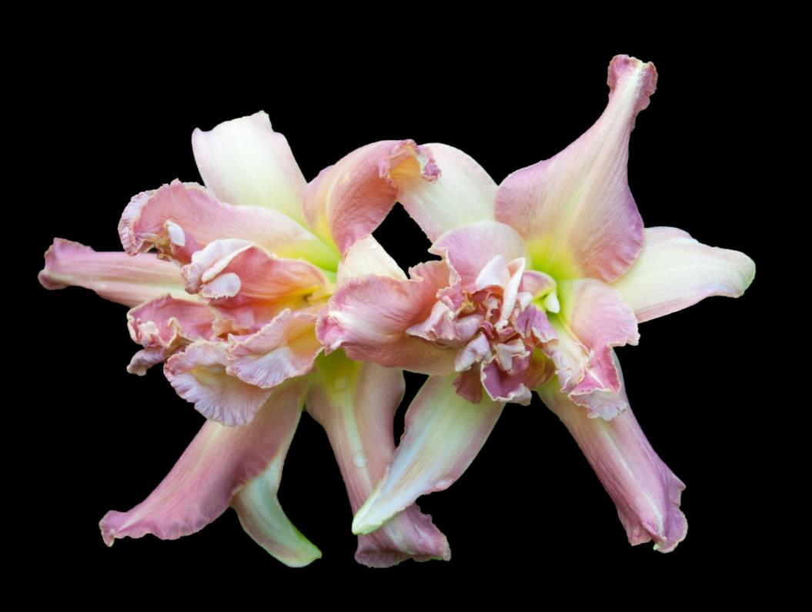
2013 Junior Citation
‘Wyvern’ (Elliott)
Image by Scott Elliott

Slide 23
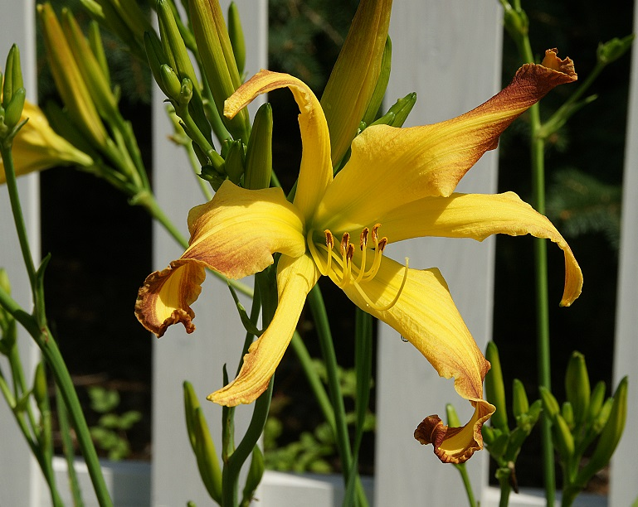
2013 Junior Citation
‘Cinnamon Crunch’ (Lamb)
Image by Kathy Lamb

Slide 24
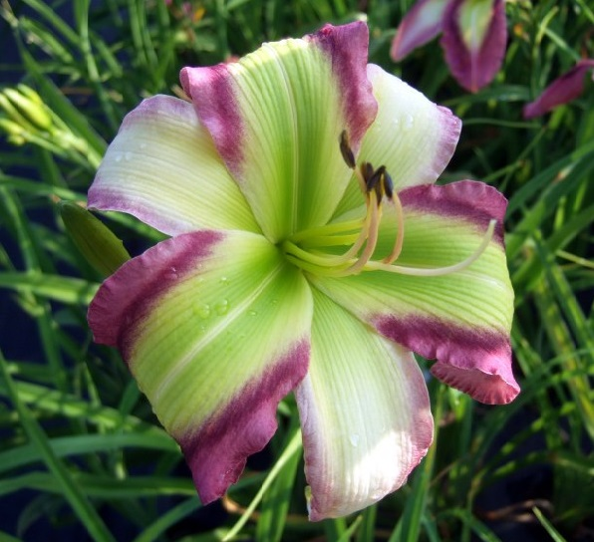
2013 Junior Citation
‘Star of Kryptonite’ (Polston)
Image by Tom Polston

Slide 25
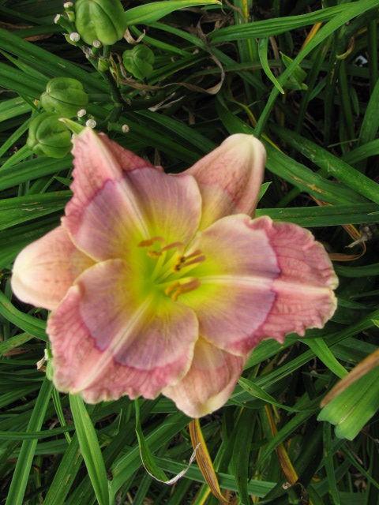
2013 Junior Citation
‘Suburban Mary Lois Burkett’ (Watts)
Photo by Earl Watts

Slide 26
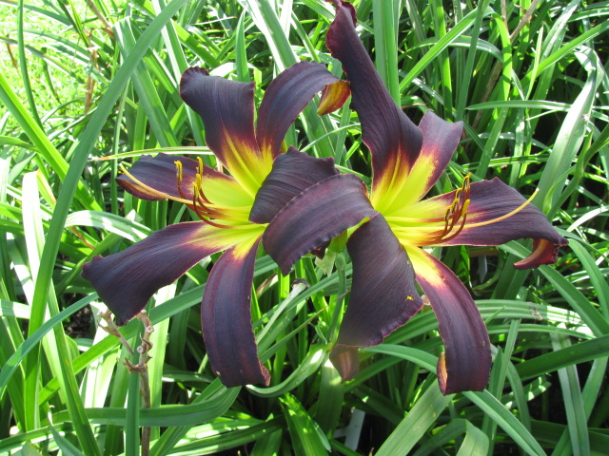
2013 Junior Citation
‘Suburban Cecil McClellan’ (Watts)
Image by Earl Watts

Slide 27
American Hemerocallis Society “Pyramid of Awards”
Stout
Silver
Medal
Top cultivar award
Eligible for 3 years
Judges vote for one cultivar as
Observed in their region or in a National tour garden
Award of
Merit
HM winners automatically move up to AM list 3 years later
Garden judges vote for up to 12 as observed in their regions
Eligible for 3 years
Honorable Mention
First official “Stamp of Approval”
Judges vote for up to 12 as observed in their regions
20 votes from 4 regions

Slide 28
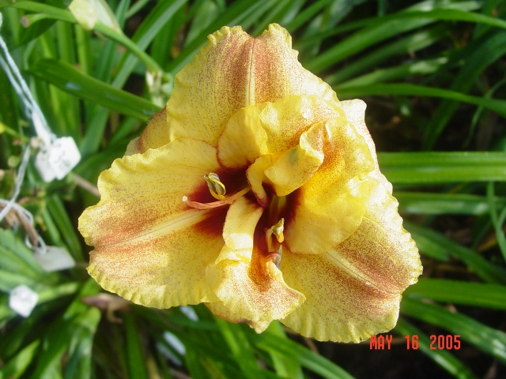
2013 Honorable Mention
‘Mark’s Bouquet’ (Agosta)
Image by Joe Agosta

Slide 29
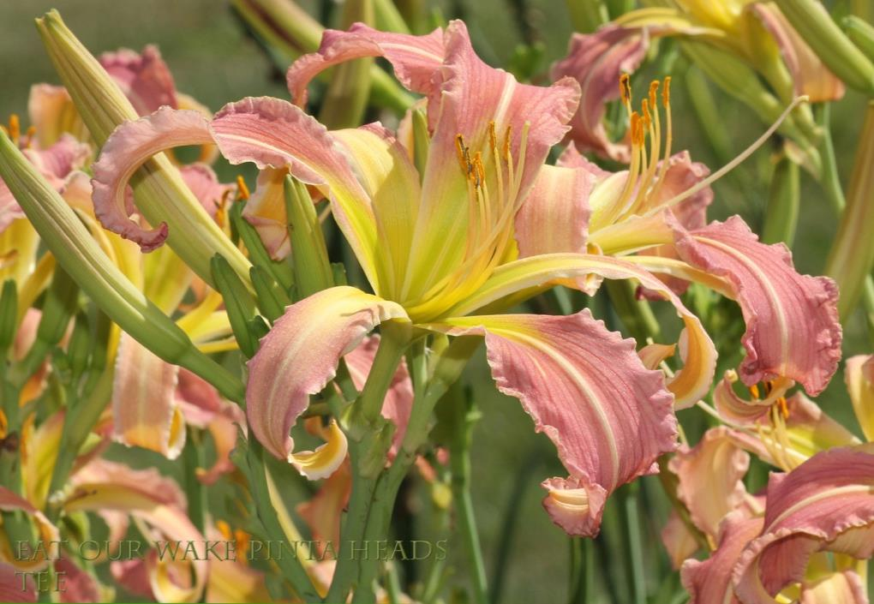
2013 Honorable Mention
‘Eat Our Wake Pinta Heads’ (Bachman)
Image by Tee Money

Slide 30
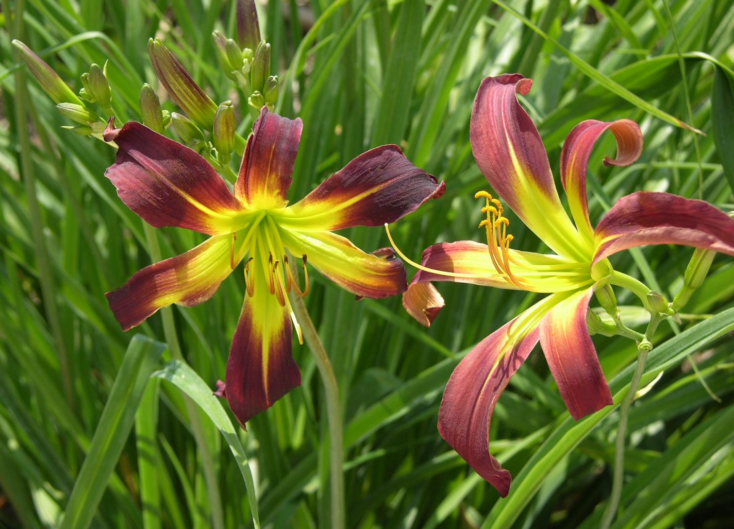
2013 Honorable Mention
‘Jazz at the Wool Club’ (Bachman)
Image by Chris Petersen

Slide 31
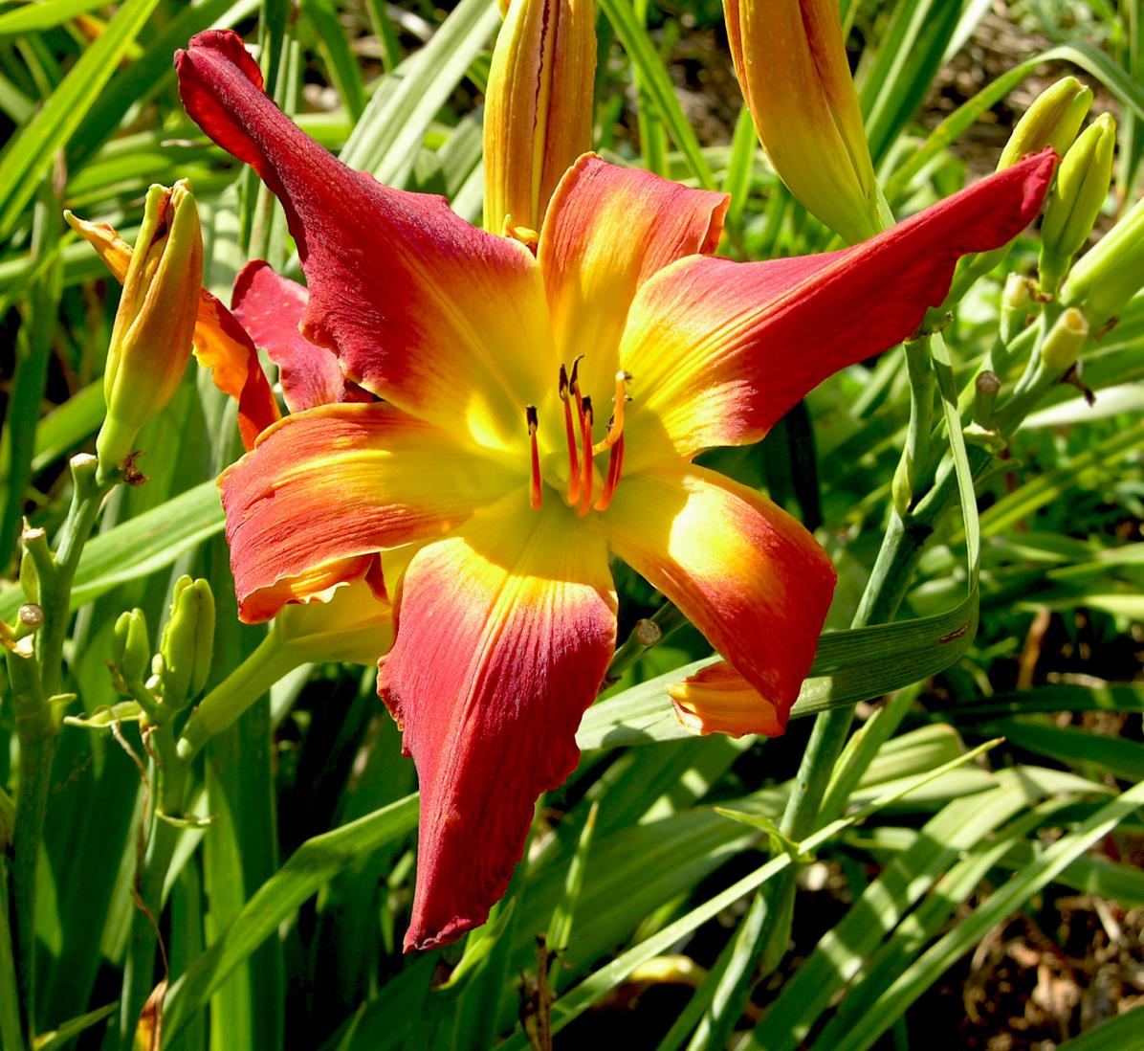
2013 Honorable Mention
‘Woman’s Scorn’ (Bachman)
Image by Chris Petersen

Slide 32
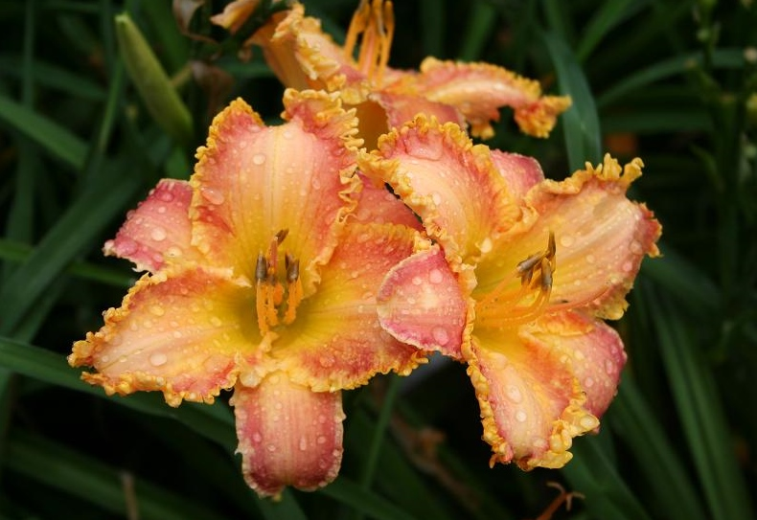
2013 Honorable Mention
‘Aliquippa’ (Baxter)
Image by Tim Herrington

Slide 33
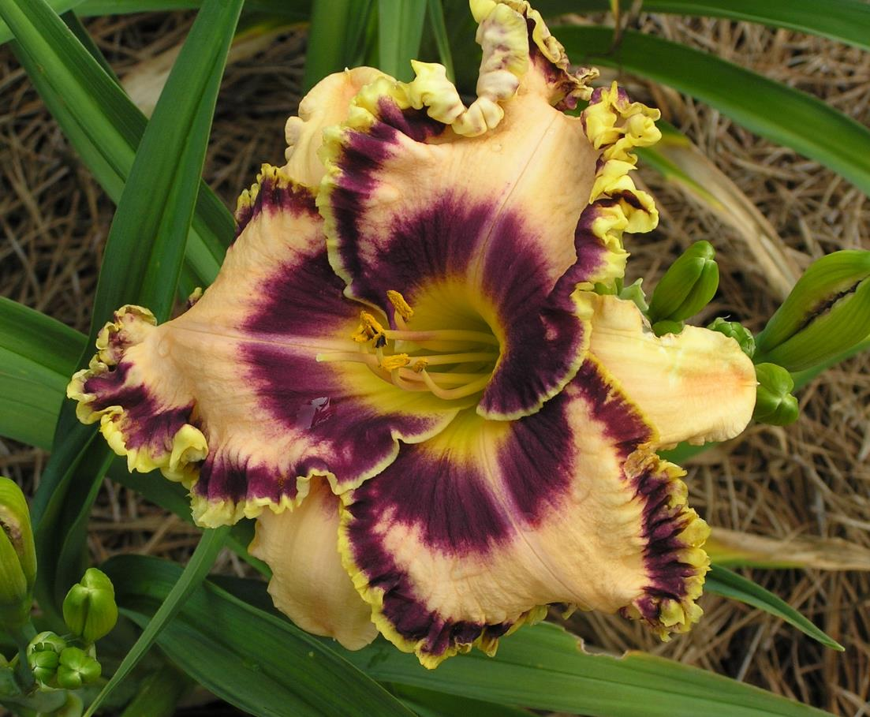
2013 Honorable Mention
‘A Few Good Men’ (Bell)
Image by Eddie Raye Andrews

Slide 34
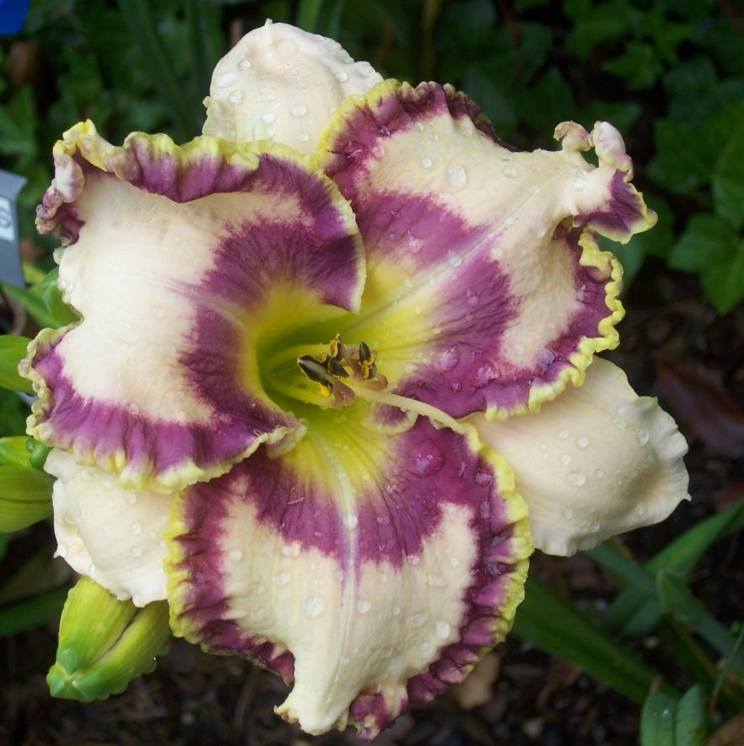
2013 Honorable Mention
‘Can’t Believe My Eyes’ (Bell)
Image by Mary & Jim Netherton

Slide 35
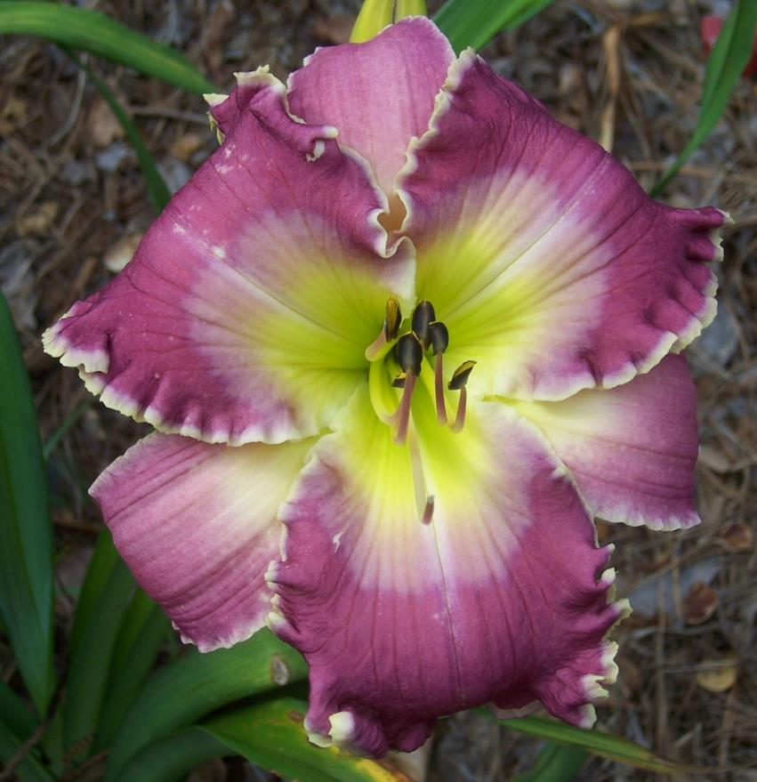
2013 Honorable Mention
‘Sycamore Southern Girl’ (Bell)
Image by Mary & Jim Netherton

Slide 36
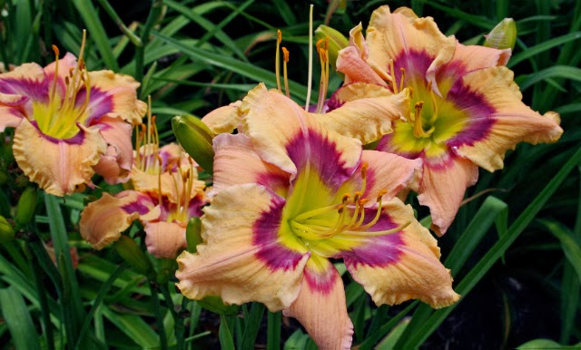
2013 Honorable Mention
‘Valdosta Again’ (Bell)
Image by Julie Covington

Slide 37
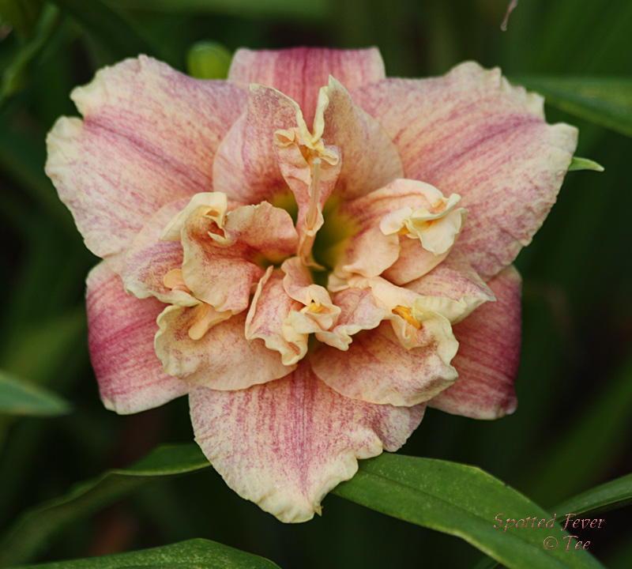
2013 Honorable Mention
‘Spotted Fever’ (Brown-Oakes)
Image by Tee Money

Slide 38
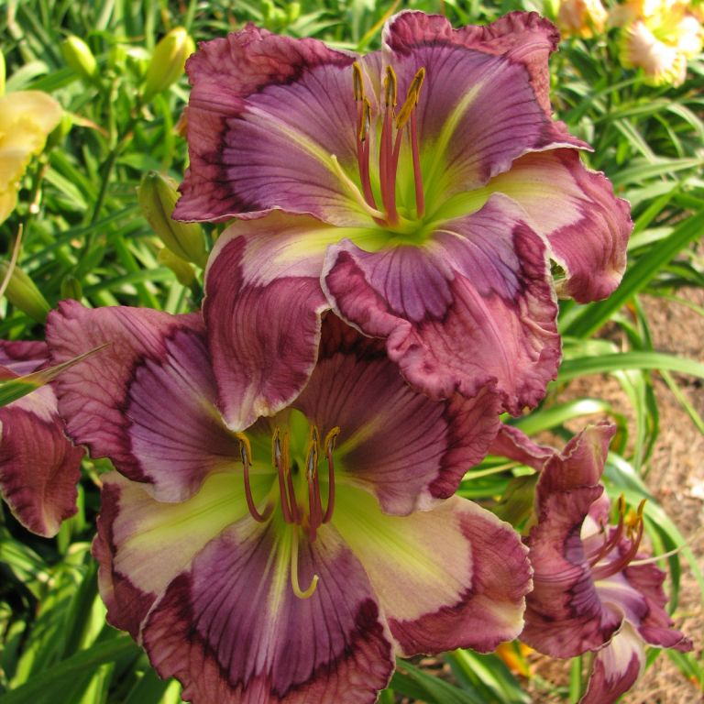
2013 Honorable Mention
‘Kaleidoscopic Intrigue’ (Carpenter)
Image by Heidi Douglas

Slide 39
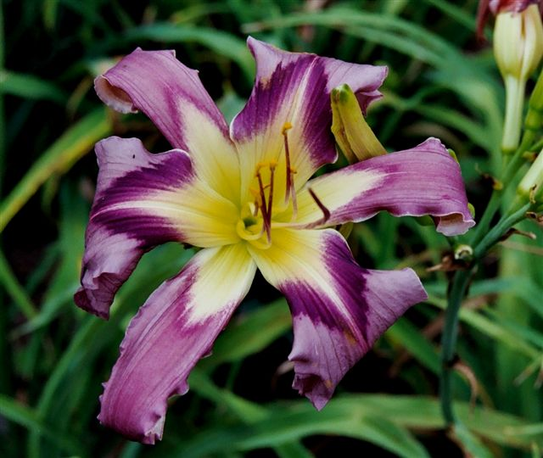
2013 Honorable Mention
‘Idoo Voodoo’ (Cochenour)
Image by Pat Cochenour

Slide 40
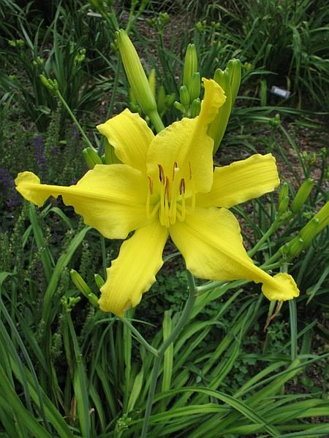
2013
Honorable Mention
‘Little Lemon Twist’ (Cochenour)
Image by Mary Ann Pruden

Slide 41
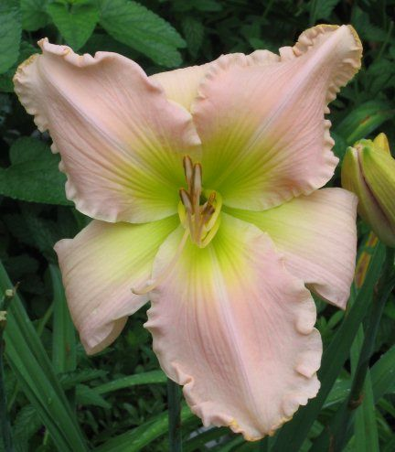
2013
Honorable Mention
‘Barbara White’ (Culver)
Image by Melodye Campbell

Slide 42
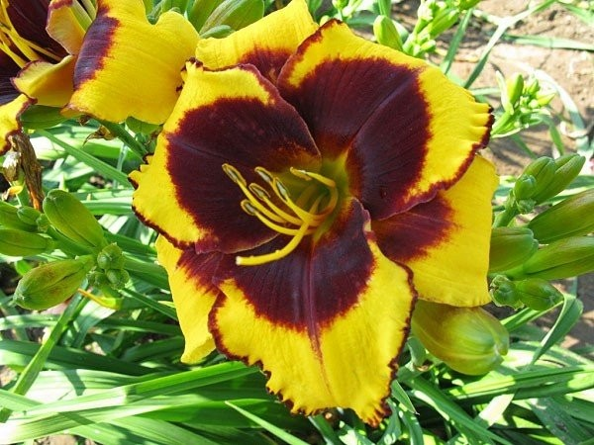
2013 Honorable Mention
‘Sun Panda’ (Culver)
Image by Bryan Culver

Slide 43
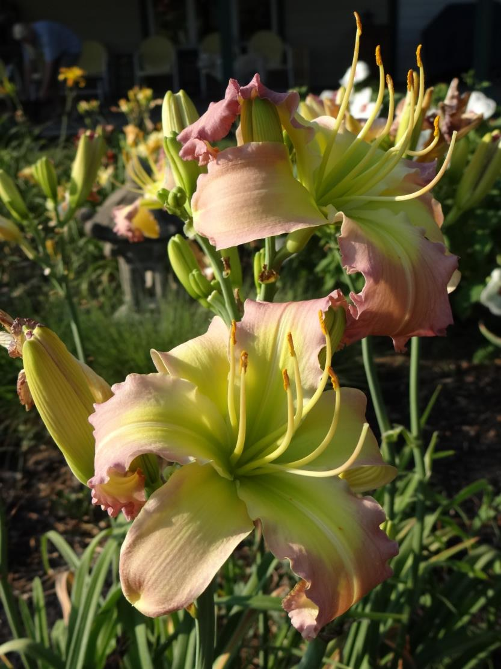
2013
Honorable Mention
‘Regency Heights’
(H. Dougherty)
Image by Nikki Schmith

Slide 44
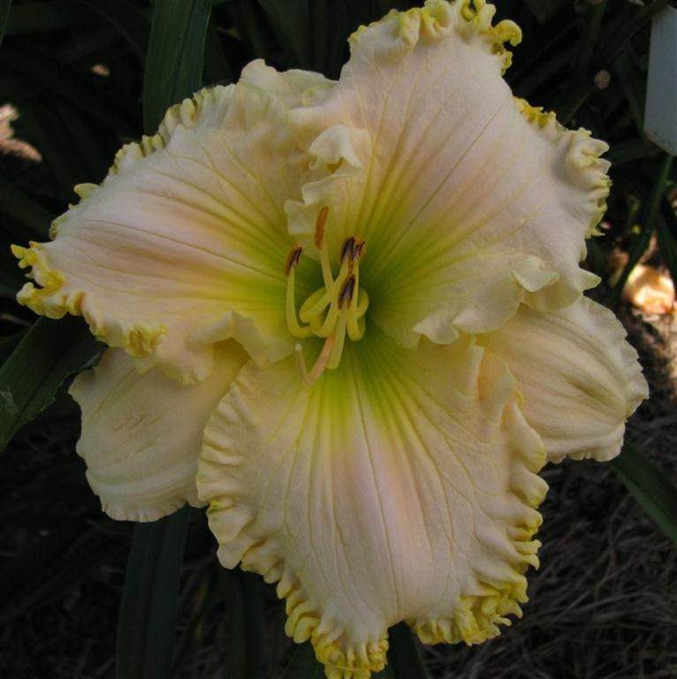
2013 Honorable Mention
‘Browns Ferry Sheer Magic’ (Douglas)
Image by
Heidi Douglas

Slide 45
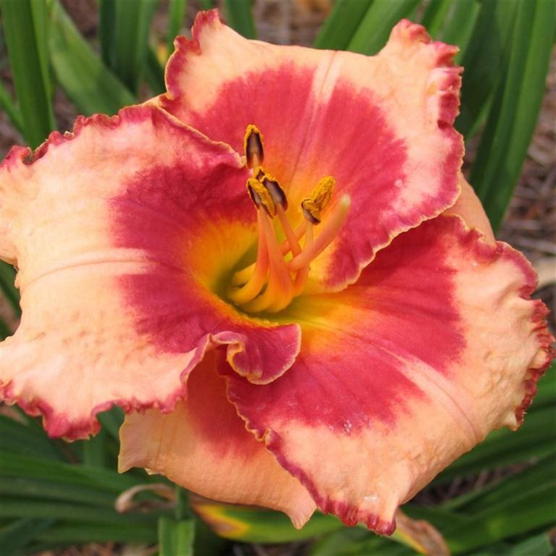
2013
Honorable Mention
‘Browns Ferry Sweetheart’
(Douglas)
Image by Heidi Douglas

Slide 46
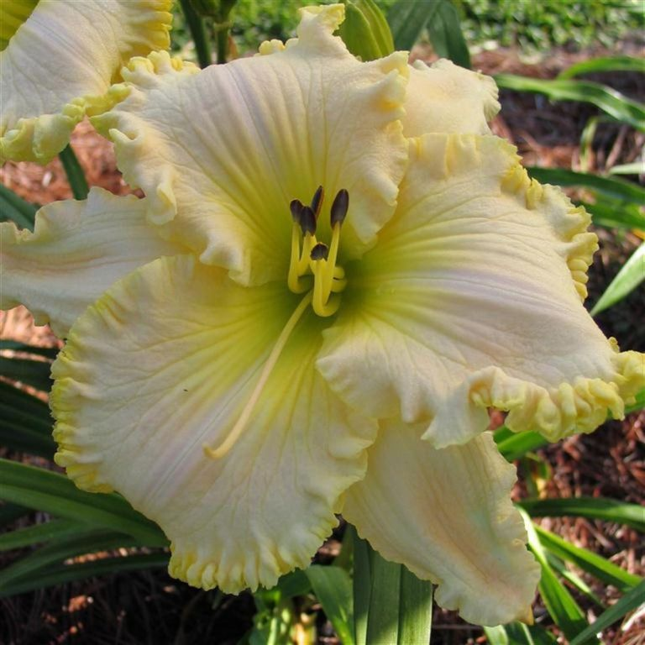
2013 Honorable Mention
‘Yankee Princess’ (Douglas)
Image by Heidi Douglas

Slide 47
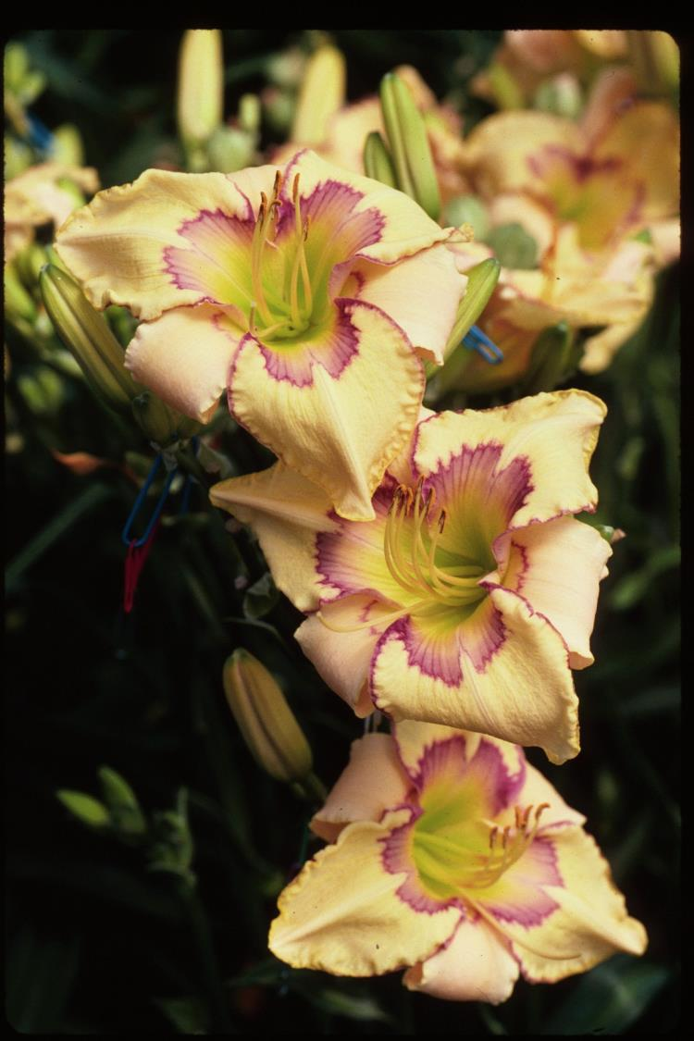
2013
Honorable Mention
‘Cast Your Net’ (Emmerich)
Image by Kyle Billadeau

Slide 48
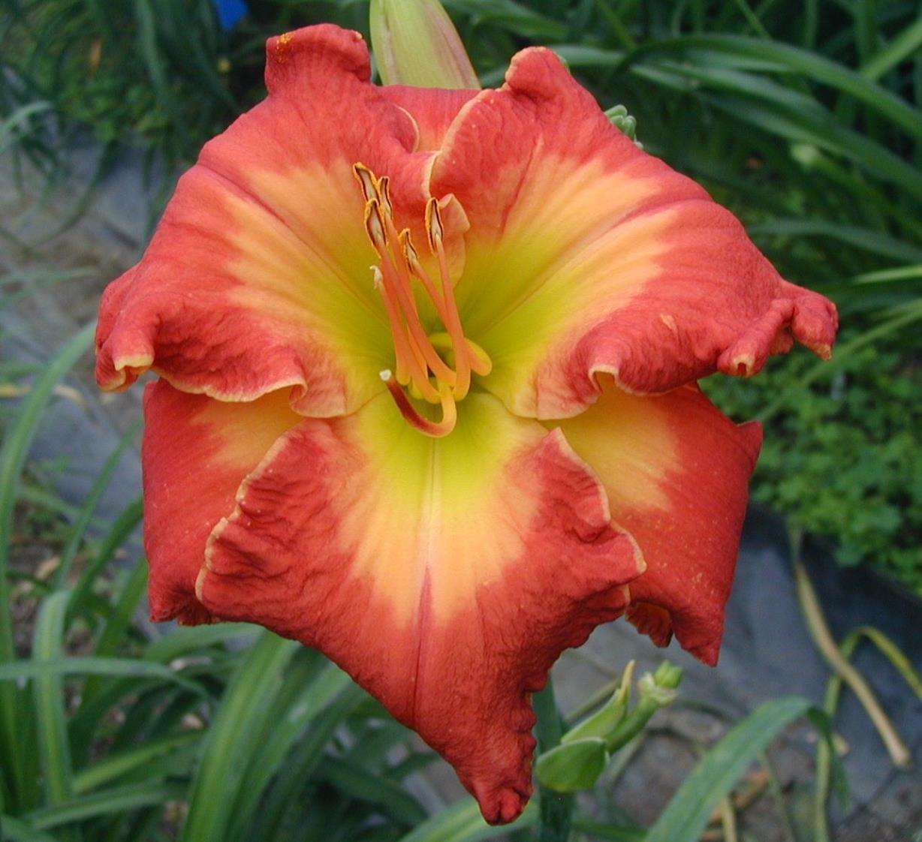
2013 Honorable Mention
‘Deliverer’ (Emmerich)
Image by Karol Emmerich

Slide 49
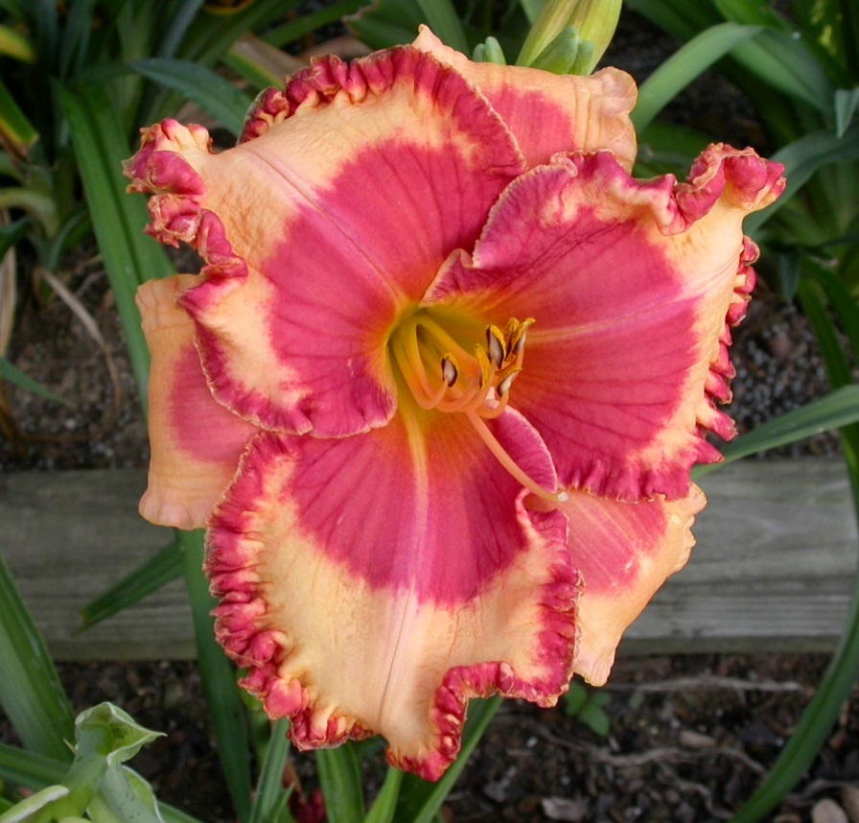
2013 Honorable Mention
‘Coach’s Hot Lips’ (J. George)
Image by Jesse George

Slide 50
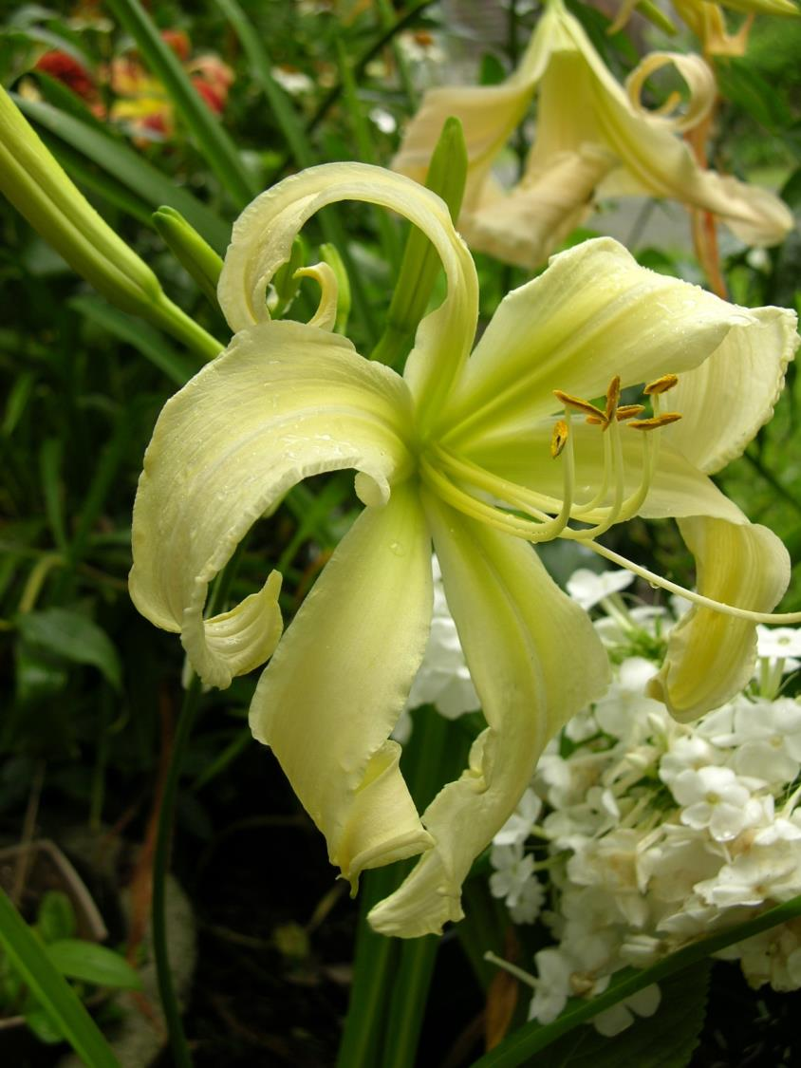
2013
Honorable Mention
‘Heavenly White Lightening’
(Gossard)
Image by Chris Petersen

Slide 51
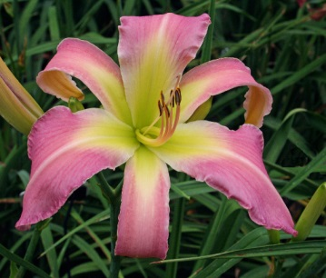
2013 Honorable Mention
‘Miss Piggy’ (Gossard)
Image by Julie Covington

Slide 52
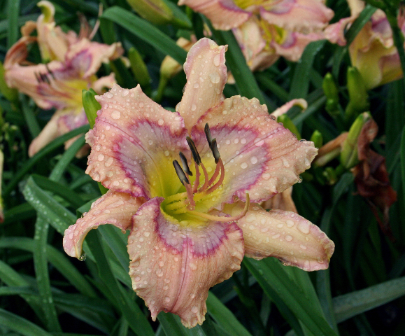
2013 Honorable Mention
‘Blue Eyed Bandit’ (D. Hansen)
Image by Julie Covington

Slide 53
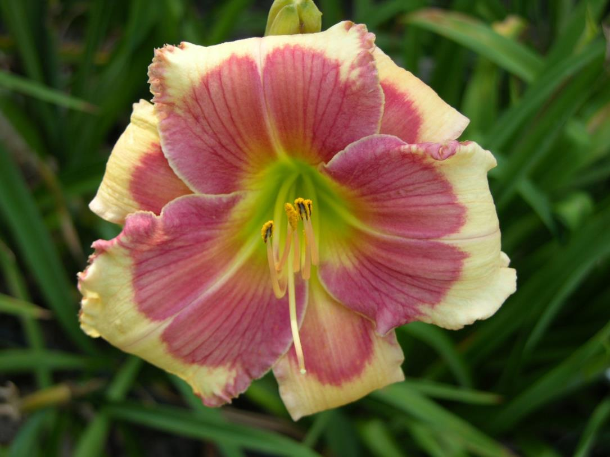
2013 Honorable Mention
‘Hello Screamer’ (D. Hansen)
Image by Chris Petersen

Slide 54
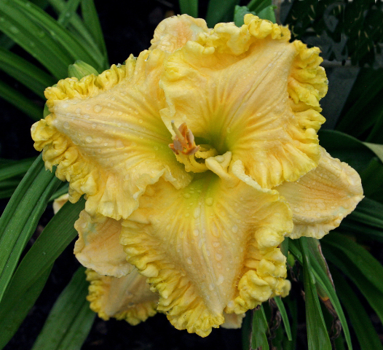
2013 Honorable Mention
‘Maryzell’ (D. Hansen)
Image by Julie Covington

Slide 55
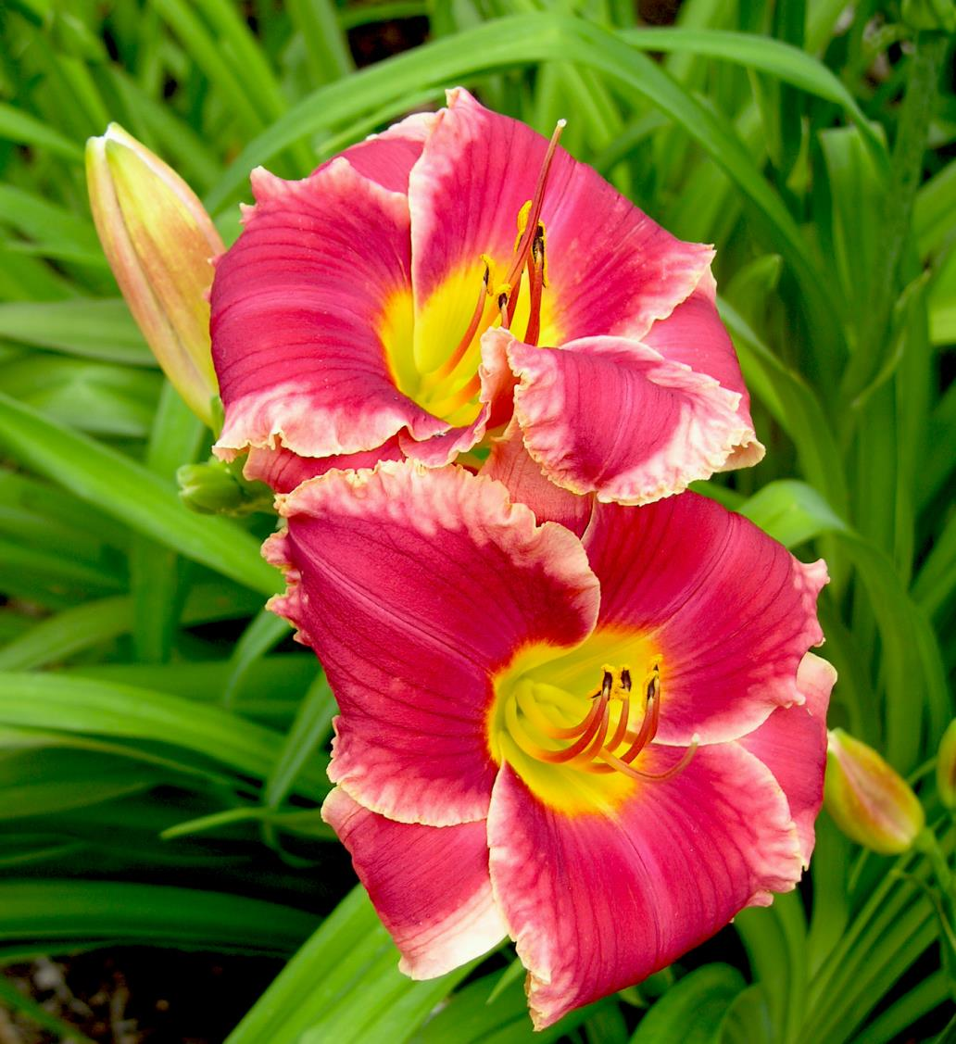
2013
Honorable Mention
‘Seduced’
(D. Hansen)
Image by Chris Petersen

Slide 56
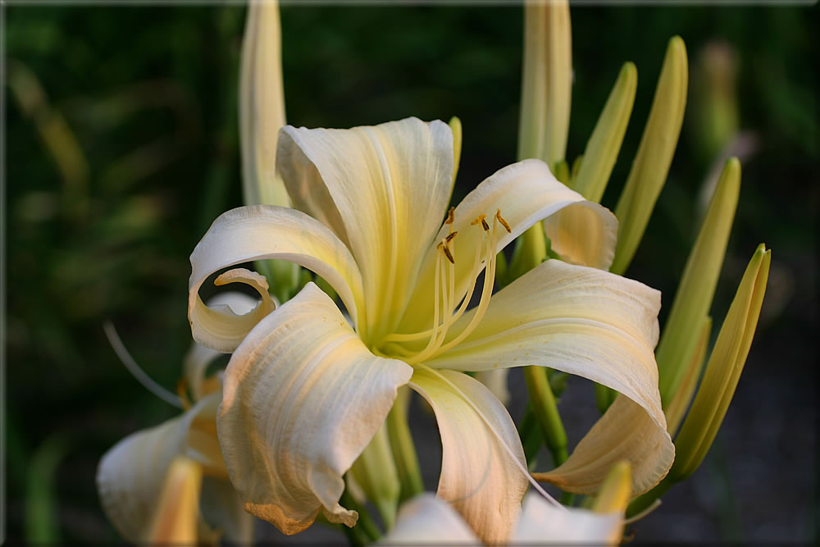
2013 Honorable Mention
‘Carolyn’s Curls’ (Herr)
Image by Don Herr

Slide 57
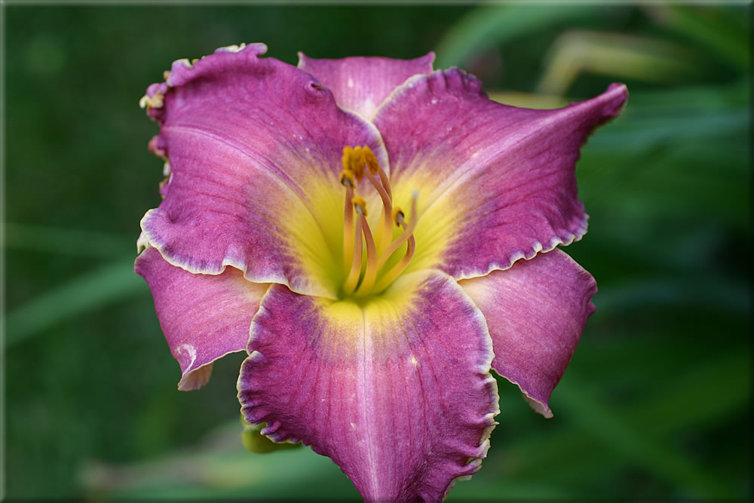
2013 Honorable Mention
‘Roger Herr’ (Herr)
Image by Don Herr

Slide 58
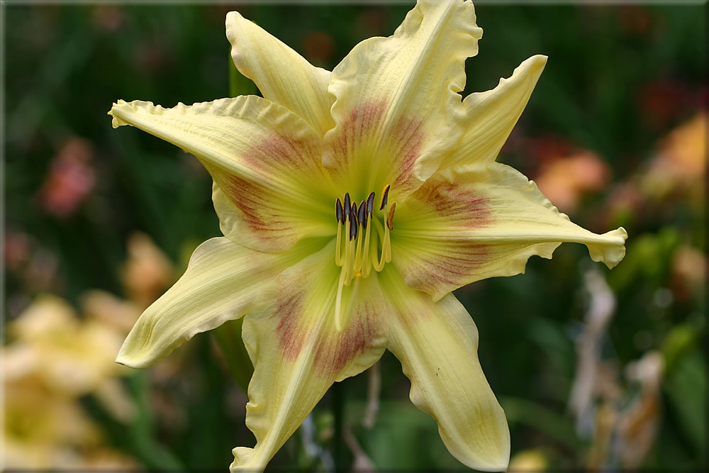
2013 Honorable Mention
‘Star Poly’ (Herr)
Image by Don Herr

Slide 59
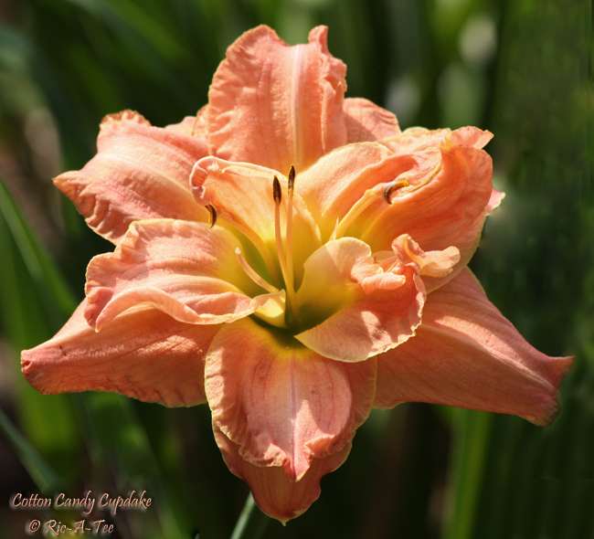
2013 Honorable Mention
‘Cotton Candy Cupcake’ (T. Herrington)
Image by Tee Money

Slide 60
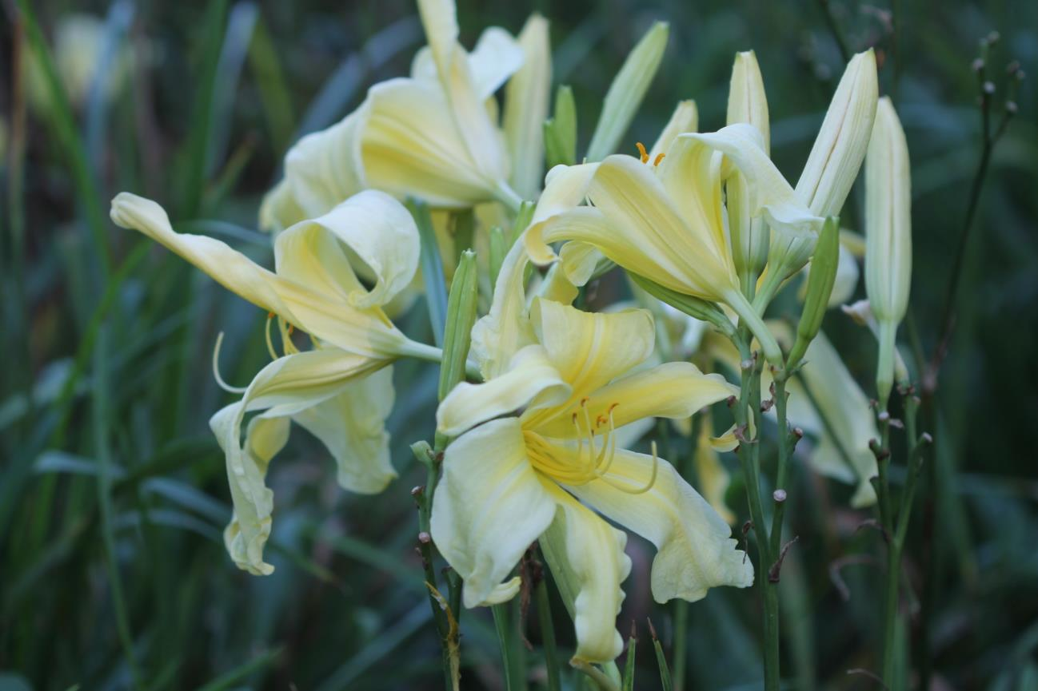
2013 Honorable Mention
‘Vanilla Gorilla’ (Huben)
Image by Marlene Harmon

Slide 61
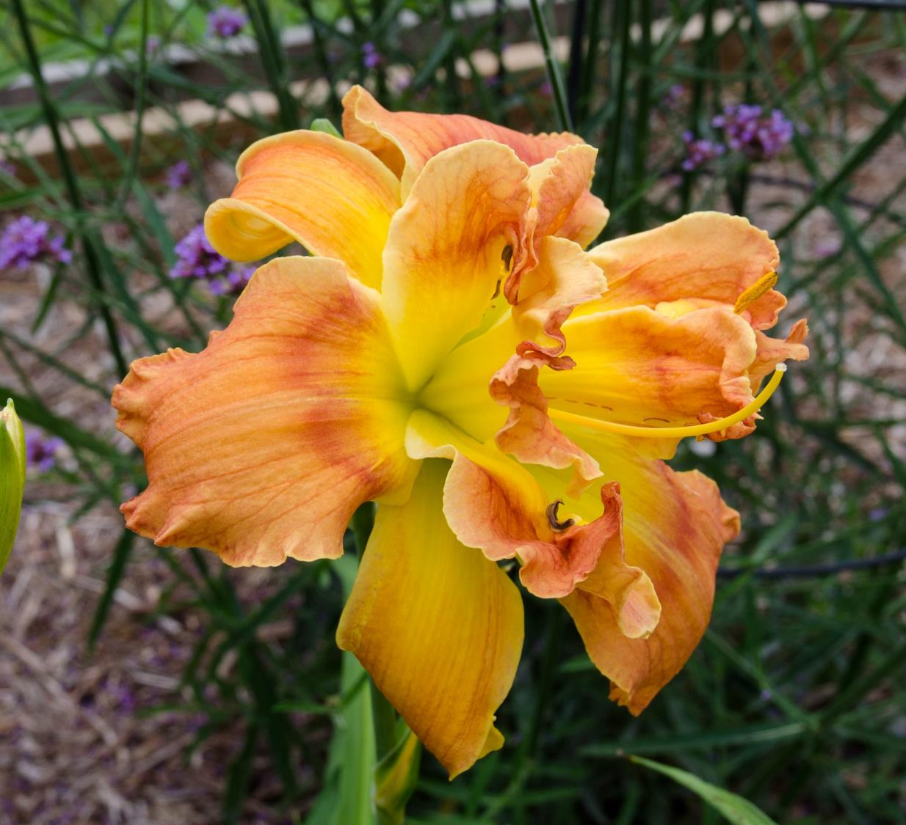
2013 Honorable Mention
‘Clearly a Thrill’
(J. Joiner)
Image by Claude Carpenter

Slide 62
2013 Honorable Mention
‘Georgia Gee Whiz’ (J. Joiner)
Image by Jan Joiner

Slide 63
2013 Honorable Mention
‘Circus Truffle’ (Kirchhoff)
Image by Chris Petersen

Slide 64
2013 Honorable Mention
‘Hotter than July’ (Kirchhoff)
Image by Julie Covington

Slide 65
2013 Honorable Mention
‘Seattle Dreaming’ (Kirchhoff)
Image by Richard Rosen

Slide 66
2013 Honorable Mention
‘August Wedding’ (P. Korth & L. Korth)
Image by Phil Korth

Slide 67
2013 Honorable Mention
‘Oktoberfest’ (Maryott)
Image by Sue Brown

Slide 68
2013 Honorable Mention
‘Double Old Ivory’ (J. Miles)
Image by Chris Petersen

Slide 69
2013 Honorable Mention
‘Eli Murphy’ (J. Murphy)
Image by Margo Reed

Slide 70
2013 Honorable Mention
‘Oy Vey’ (Owen)
Image by Paul Owen

Slide 71
2013
Honorable Mention
‘Vicky’s Radiance’ (Owen)
Image by Paul Owen

Slide 72
2013 Honorable Mention
‘Lady Alvatine’ (Petit)
Image by Patrick Guidry

Slide 73
2013 Honorable Mention
‘Ruffles have Ripples’ (Petit)
Image by Claude Carpenter

Slide 74
2013 Honorable Mention
‘Ruffles and Ribbons’ (Polston)
Image by Chris Petersen

Slide 75
2013 Honorable Mention
‘White Chocolate’ (Reed)
Image by Julie Covington

Slide 76
2013 Honorable Mention
‘Scarlet Pimpernel’ (Ripley)
Image by Nan Ripley

Slide 77
2013
Honorable Mention
‘Kathy Macartney’
(N. Roberts)
Image by Joe Hawkins

Slide 78
2013 Honorable Mention
‘Legs Limmer’ (N. Roberts)
Image by Chris Petersen

Slide 79
2013 Honorable Mention
‘Passion’s Promise’ (Sayers)
Image by Chris Petersen

Slide 80
2013 Honorable Mention
‘Flying Down to Rio’ (B. Schwarz)
Image by Melodye Campbell

Slide 81
2013 Honorable Mention
‘Hurricane Bob’ (B. Schwarz)
Image by Julie Covington

Slide 82
2013 Honorable Mention
‘Topguns Molten Lava’ (B. Scott)
Image by Chris Petersen

Slide 83
2013 Honorable Mention
‘Crossfire’ (Stadler)
Image by J.D. Stadler

Slide 84
2013 Honorable Mention
‘Fiji’ (Stamile)
Image by Julie Covington

Slide 85
2013
Honorable Mention
‘New Paradigm’
(P. Stamile)
Image by Julie Covington

Slide 86
2013 Honorable Mention
‘Violet Becomes You’ (Stamile)
Image by Tee Money

Slide 87
2013
Honorable Mention
‘Walter Kennedy’ (Stamile)
Image by Tee Money

Slide 88
2013 Honorable Mention
‘Boogie Woogie Blues’ (G. Stamile)
Image by Julie Covington

Slide 89
2013 Honorable Mention
‘Broadway Raves’ (G. Stamile)
Image by Julie Covington

Slide 90
2013 Honorable Mention
‘Statuesque’ (Stout)
Image by Gil Stelter

Slide 91
2013
Honorable Mention
‘Eskimo Kisses’ (Trimmer)
Image by Julie Covington

Slide 92
2013 Honorable Mention
‘Lemon Go Lightly’ (J. Trimmer)
Image by Jane Trimmer

Slide 93
American Hemerocallis Society “Pyramid of Awards”
Stout
Silver
Medal
Top cultivar award
Eligible for 3 years
Judges vote for one cultivar as
Observed in their region or in a National tour garden
Award of
Merit
HM winners automatically move up to AM list 3 years later
Garden judges vote for up to 12 as observed in their regions
Eligible for 3 years
Honorable Mention
First official “Stamp of Approval”
Judges vote for up to 12 as observed in their regions
20 votes from 4 regions

Slide 94
2013 Award of Merit
‘Texas Kaleidoscope’ (Carpenter)
Image by Julie Covington

Slide 95
2013 Award of Merit
‘Rose F. Kennedy’ (Doorakian)
Photo by Julie Covington

Slide 96
2013 Award of Merit
‘Jelly Filled Donut’ (N. Eller)
Image by Julie Covington

Slide 97
2013 Award of Merit
‘Heavenly Dragon Fire’
(Gossard)
Image by Kathy Rinke

Slide 98
2013 Award of Merit
‘White Eyes Pink Dragon’ (Gossard)
Image by Julie Covington

Slide 99
2013 Award of Merit
‘Neon Flamingo’ (Gossard)
Image by Bill Monroe

Slide 100
2013 Award of Merit
‘Everybody Loves Earnest’ (T. Herrington)
Image by Debbie Monbeck

Slide 101
2013 Award of Merit
‘God Save the Queen’ (Morss)
Image by Julie Covington

Slide 102
2013 Award of Merit
‘President Ronald Reagan’ (F.R. Smith)
Image by Claude Carpenter

Slide 103
2013 Award of Merit
‘Free Wheelin’ (P. Stamile)
Image by Julie Covington

Slide 104
2013 Award of Merit
‘Boundless Beauty’ (P. Stamile)
Image by Julie Covington

Slide 105
2013 Award of Merit
‘Santa’s Little Helper’ (Trimmer)
Image by Julie Covington

Slide 106
AHS Specialty Awards
Recognize those daylilies which have excelled within certain categories:
Floral Dimensions
Color Patterns
Bloom time
Blossom form ( configuration)
(The AHS awarded the first specialty awards in 1961. There are currently ten special awards.)

Slide 107
2013 Donn C. Fischer Award
‘Plum Cupcake’ (T. Herrington)
Photo by Richard Rosen

Slide 108
2013 Lambert Webster Award
‘Christmas in Oz’ (K. Herrington)
Photo by Lea Ann Williams

Slide 109
2013 Annie T. Giles Award
‘Riot on the Kindergarten Bus’ (Davisson)
Photo by Judy Davisson

Slide 110
2013 Eugene S. Foster Award
‘Last Snowflake’ (P. Stamile)
Photo by Julie Covington

Slide 111
2013
Harris Olson
Spider Award
‘Wild Wookie’
(P. Stamile)
Image by Claude Carpenter

Slide 112
2013 Early Season Bloom Award
‘Free Wheelin’ (P. Stamile)
Photo by Julie Covington

Slide 113
2013 Extra Large Diameter Award
‘Neon Flamingo’ (Gossard)
Photo by Bill Monroe

Slide 114
2013 R.W. Munson Award
‘Rose F. Kennedy’ (Doorakian)
Image by Julie Covington

Slide 115
2013
Don C. Stevens Award
‘Gavin Petit’ (Petit)
Photo by Nikki Schmith

Slide 116
2013 Ida Munson Award
‘Amanda’s Little Red Shoes (N. Eller)
Photo by Julie Covington

Slide 117
2013 Lenington
All American Award
‘Thin Man’
by Dan Trimmer
Image by Julie Covington

Slide 118
2013 Stout Silver Medal
‘Heavenly Angel Ice’
By James Gossard
Image by Richard Rosen

Slide 119
2014 Convention Awards
Region 15 Seedling Award
The Florida Sunshine Cup ~ Region 12
The Georgia Doubles Appreciation Award ~ Region 5
The Ned Roberts Spider/Unusual Form Award ~ Region 3
The President’s Cup

Slide 120
AHS Service & Personal Awards
2014 Moldovan Mentoring Award
2014 Bertrand Farr Silver Medal
2014 Helen Field Fischer Gold Medal

Slide 121
Many thanks to all the talented AHS photographers
who contributed their photographs to this presentation!

