Slide 1
Daylilies
Let’s take
a look at
The essential perennial
A presentation provided by
The American Hemerocallis Society
Prepared by Charles Harper, March, 2015

Slide 2
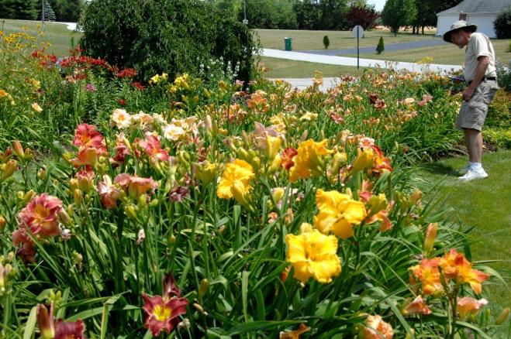
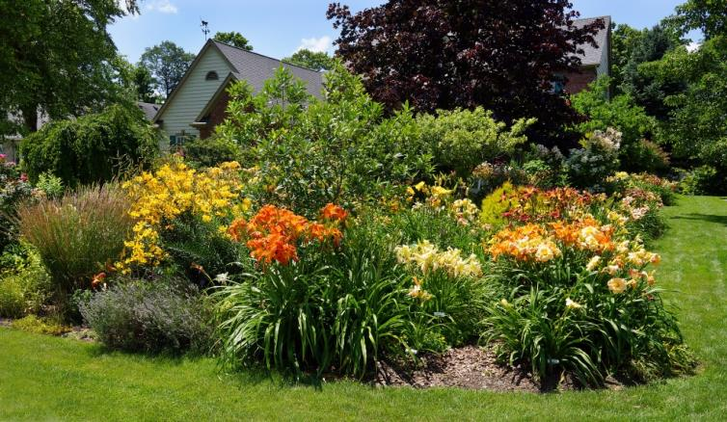
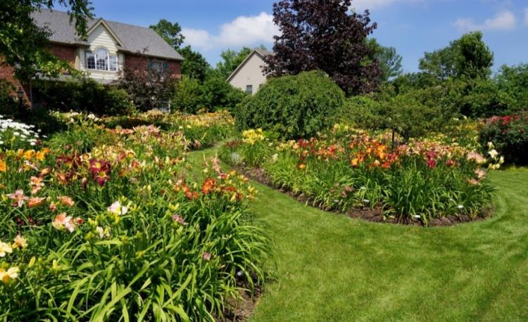
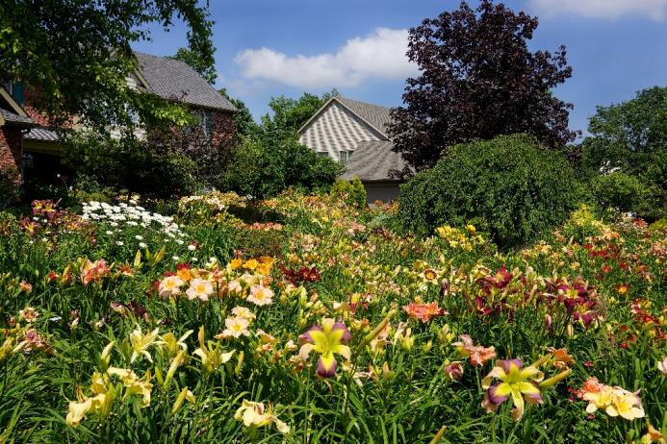
A Garden of Flowers

Slide 3
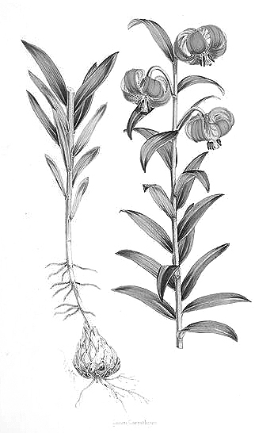
How can you tell the difference between a daylily and a true lily?
Petals + Sepals = Tepals
Naked stalk
Fan of leaves
Crown
Bulb
Bottlebrush of leaves on stalk

Slide 4
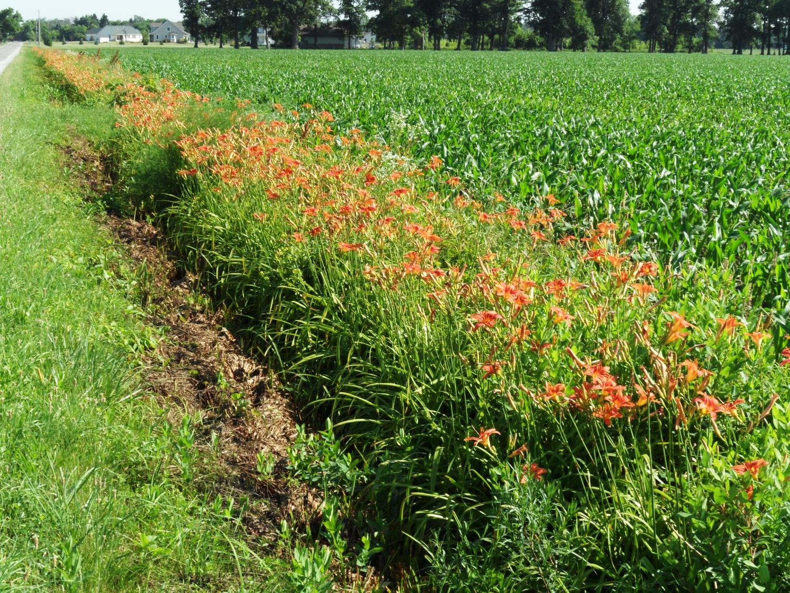
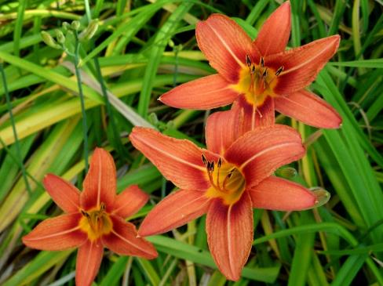
The most “common” daylily in the U. S. (Hemerocallis fulva)
This native of Asia has become invasive in some
U. S. locations.

Slide 5
The most frequently used daylily
for landscape plantings.
‘Stella de Oro’
Rest stops on the Ohio Turnpike are all landscaped with
‘Stella de Oro’!

Slide 6
Trumpet Lily
Petal stalk is at a sharp angle.

Slide 7
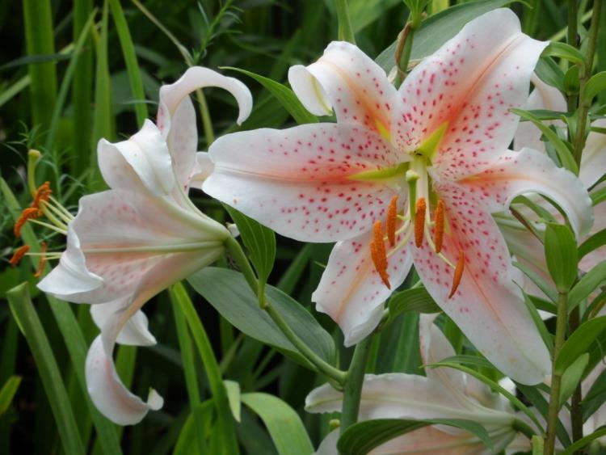
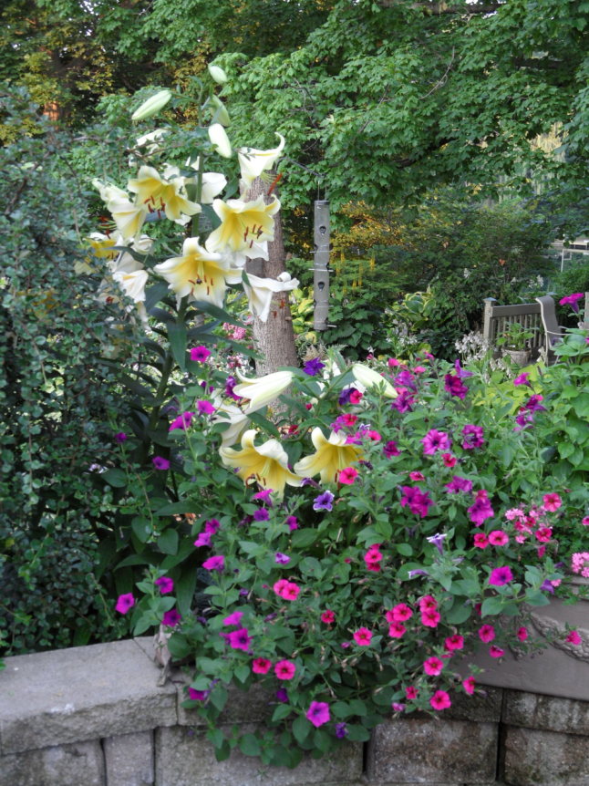
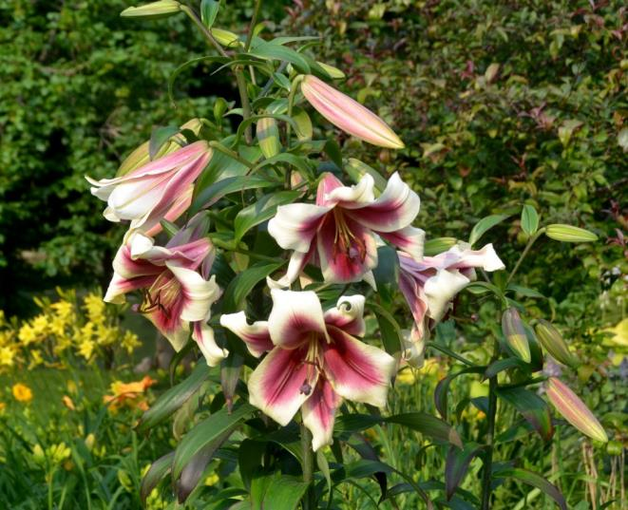

Slide 8
Daylily characteristics
Very easy to grow.
Very few pests.
Have a bloom season of over two months.
Can tolerate mixed shade.
They are tough and rebound from hot, dry weather well.
Most cultivars thrive between Zone 10 to Zone 4.

Slide 9
Daylilies come in an
incredible panoply of
sizes, shapes and
colors

Slide 10
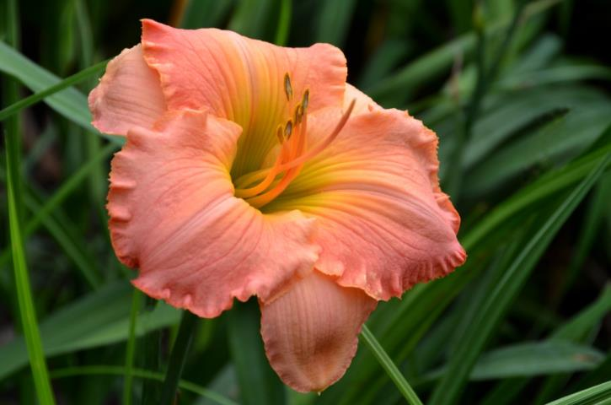
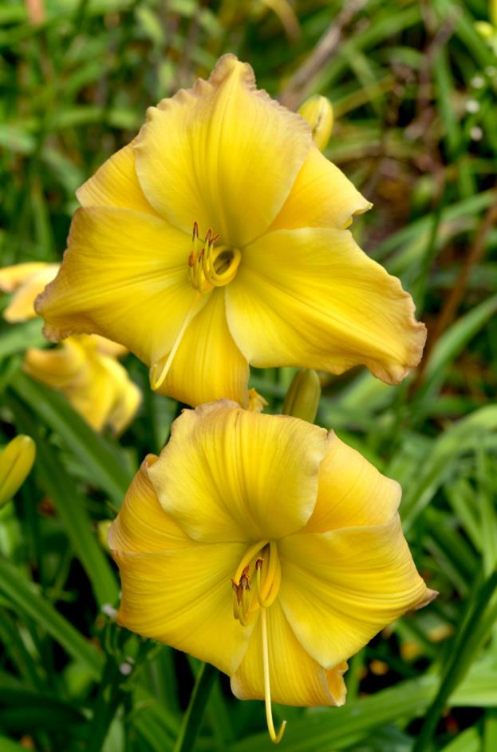
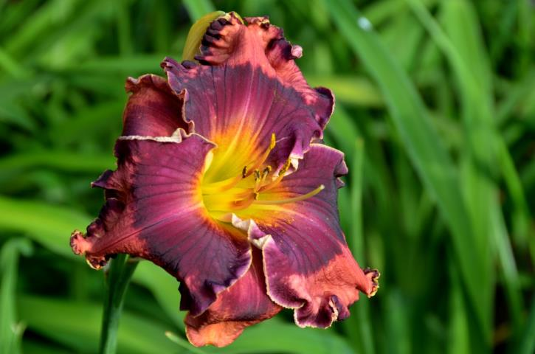
Single form
‘Lizard’s Lair’
‘The Band Played On’
‘Substantial Evidence’

Slide 11
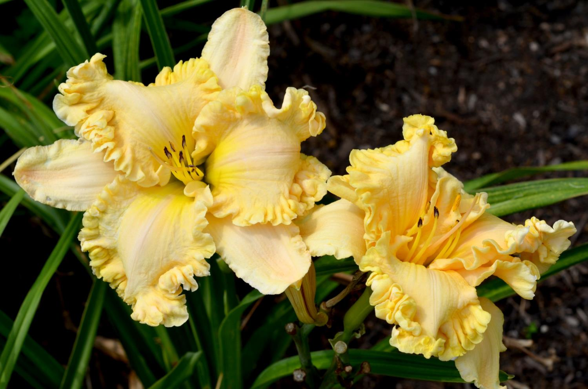
Edges can be smooth, wavy, ruffled, or heavily ruffled.
‘Carved Complexity’

Slide 12
The dark purple zone on this flower is called an “Eye.”
‘Lavender Blue Baby’

Slide 13
‘Eyes Right Jones’
Notice how the
color sequence on this pattern reverses midway, as you go from the edge to
the throat.

Slide 14
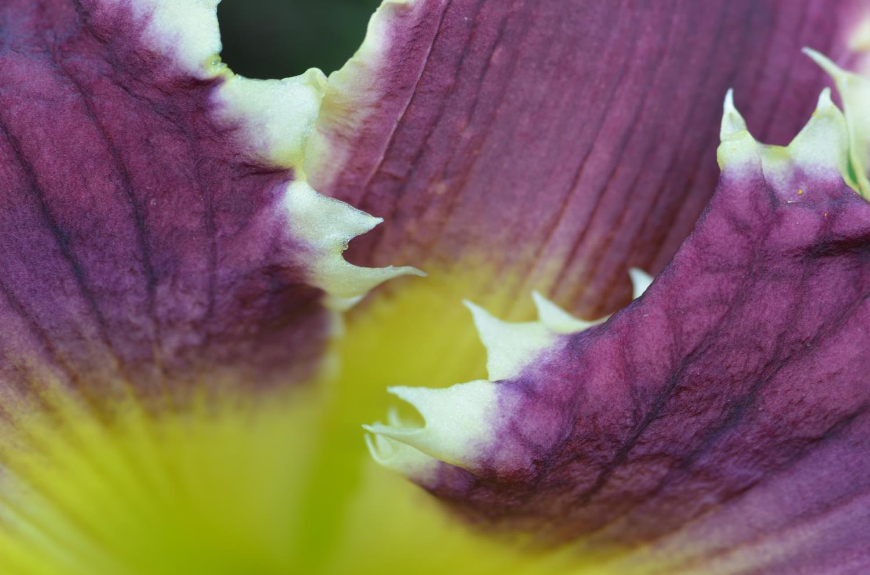
Edges can also have teeth, tentacles, or other pointy projections.
‘Eagles Gift’

Slide 15
‘Forestlake Ragamuffin’
Wow, this flower seems to have just about every imaginable edge decoration.

Slide 16
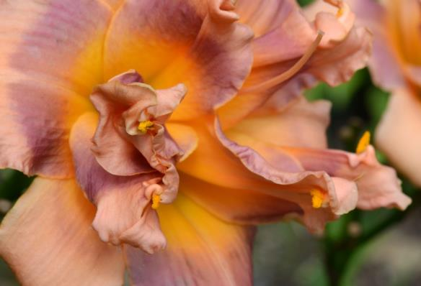
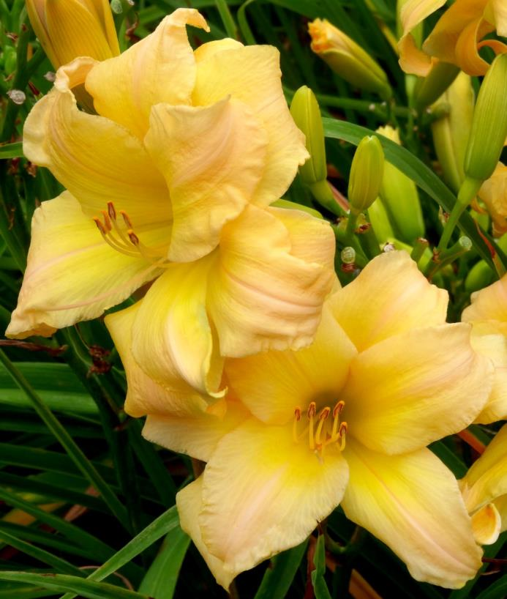
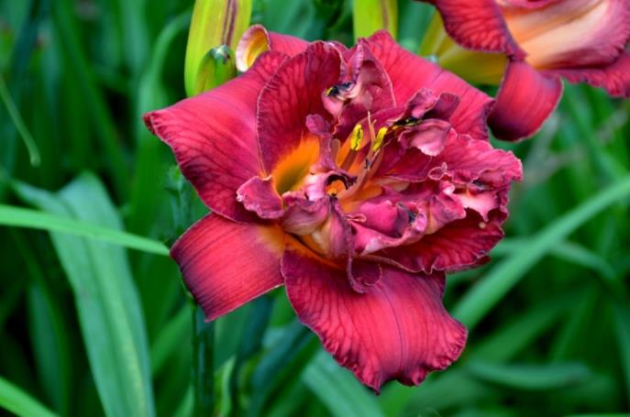
Double forms
‘Honey Crunch Cupcake’
‘Double Blue Blood’
‘Double Peacemaker’
Peony Form
Hose-in-Hose Form

Slide 17
Double Hose-in-Hose
Multiple, nested sets of tepals. Stamens normal.
‘Condilla’
Photo by Charmaine Rich

Slide 18
In a peony or petaloid-stamen double form, the stamens are replaced by petaloid (petal-like) stamens. The pollen sacs are still visible and functional.
‘Truffle Heritage’

Slide 19
Here’s a double flower that combines Hose-in-Hose and Peony forms.
‘Savannah Skipper Doodle’

Slide 20
Accidental double flowers can appear on just about any normal plant.
‘Orange Velvet’

Slide 21
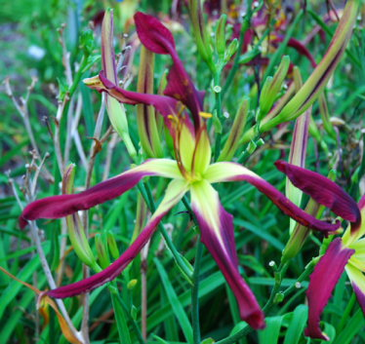
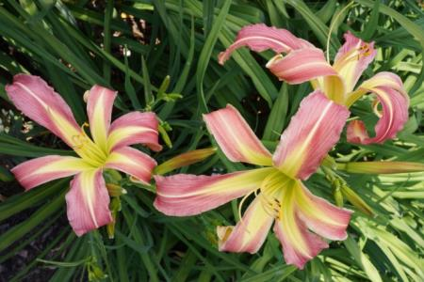
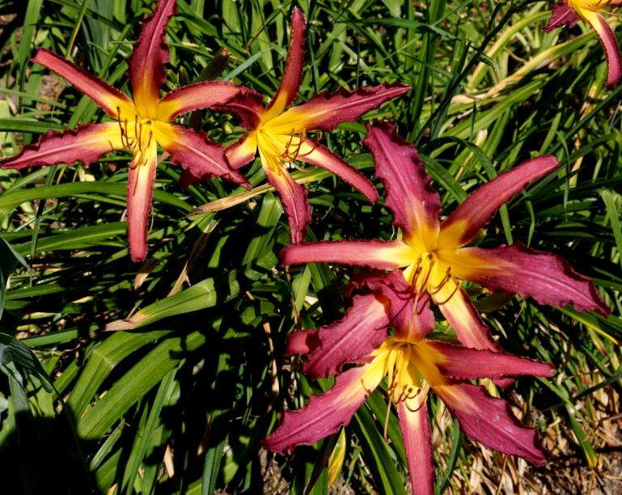
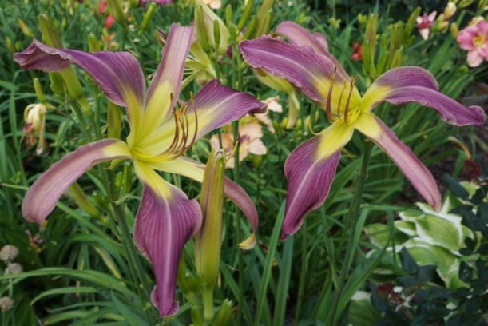
Spider form
‘Flamingo Flambeau’
‘Narrow Path’
‘Laughing Skies’
Petals are at least four time as long as wide.
‘Jack Sprat’

Slide 22
Spider-UF: Crispate
‘Narrow Path’

Slide 23
Spider
‘Skinwalker’

Slide 24
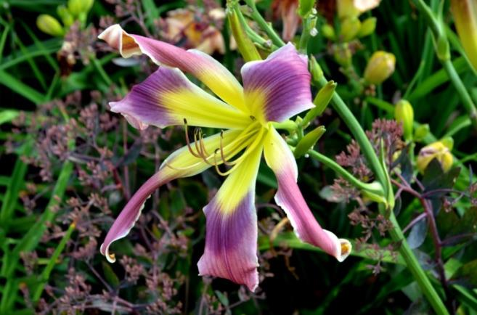
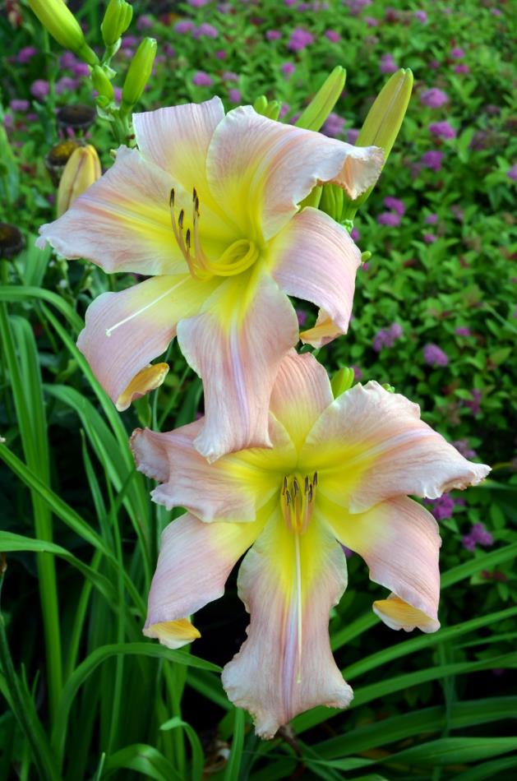
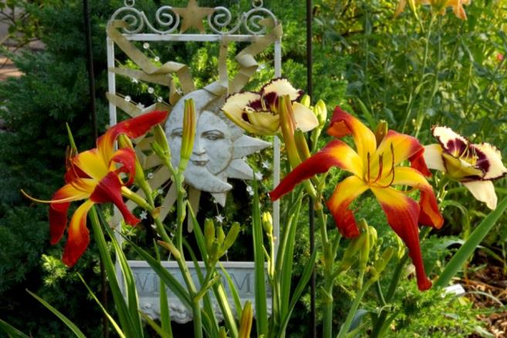
Unusual form
‘Heavenly Final Destiny’
‘Hotter Than The Fourth of July’
Determined by the shape of the petals and sepals (together called tepals)
‘Sugar Magnolia’

Slide 25
UF: Pinched Crispate
‘Cor-de-Rosa Crispate’

Slide 26
UF: Quilled Crispate
‘Trifecta’

Slide 27
UF: Spatulate
‘Frog’s Eye’

Slide 28
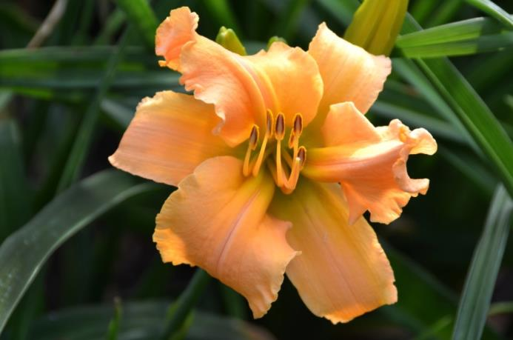
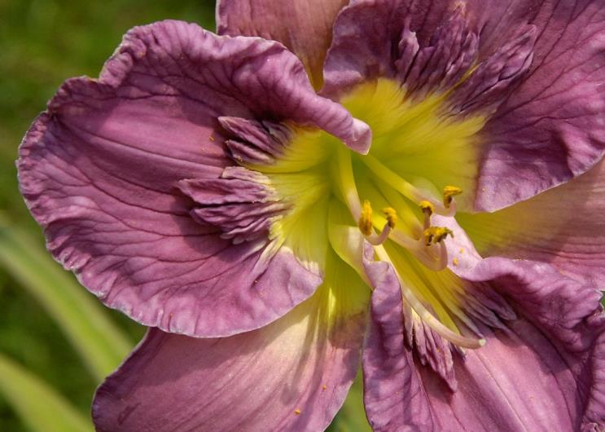
Sculpted Forms
‘Fad Gadget’
‘Texas Feathered Fancy’
The flowers have 3-dimensional structural features, involving or emanating from the throat, midrib, or elsewhere on the petal surfaces. Bizarre and beautiful flowers in this group.
‘Permanent Impression’

Slide 29
Sculpted-Pleated
‘Fad Gadget’

Slide 30
Sculpted-Cristate
‘Texas Feathered Fancy’

Slide 31
Sculpted- Relief
‘Permanent Impression’

Slide 32
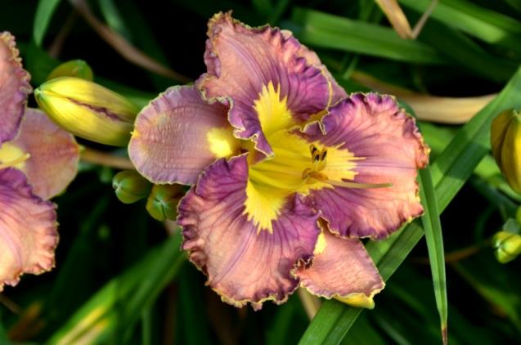
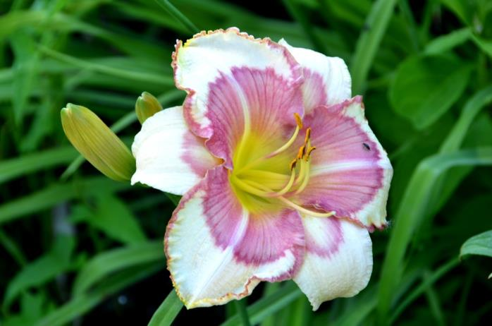
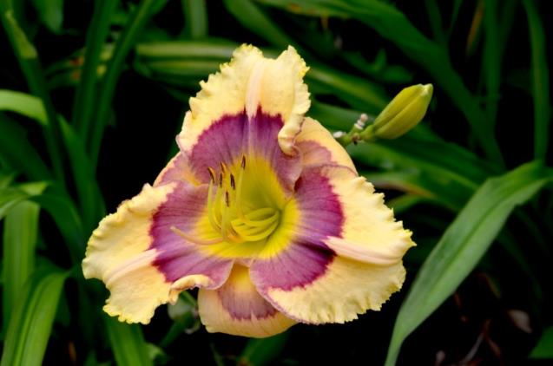
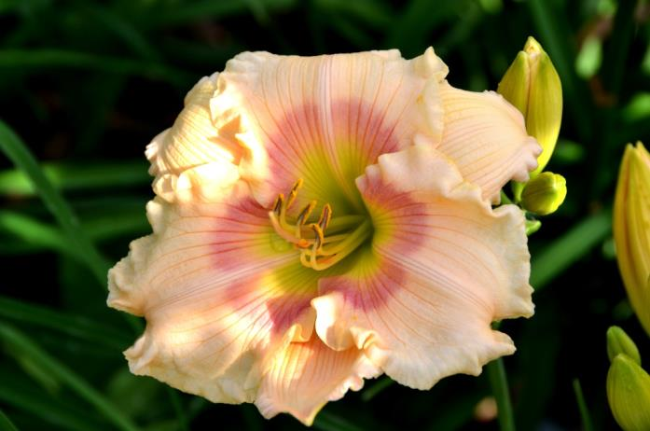
Patterns
‘Spacecoast Pattern Plus’
‘Dr. Jules Michael Vinkman’
‘Blockbuster’
A complex design appears in the eye zone, that exhibits variations in color, hue, value, or saturation.
‘Sophie Ann Burkey’

Slide 33
Patterns can extend out onto the sepals.
‘Exotic Pattern’

Slide 34
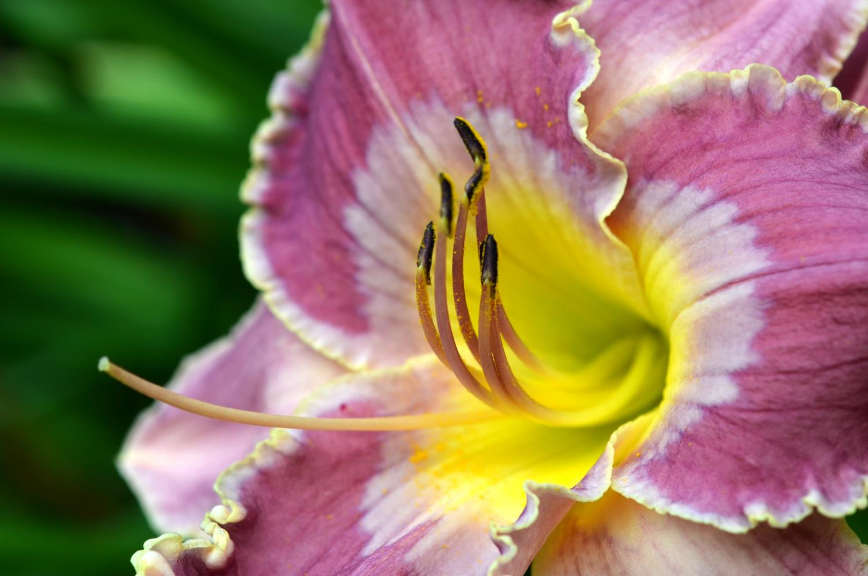
‘Ancient Wisdom’
Watermark: A zone outside the throat that is a lighter color than the petal color.

Slide 35
This distinctive pattern is called “Applique”, appearing as though it was stamped onto the eyezone.
‘Spacecoast Pattern Plus’

Slide 36
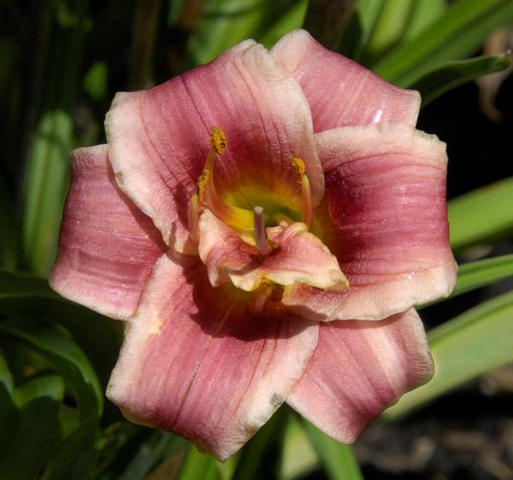
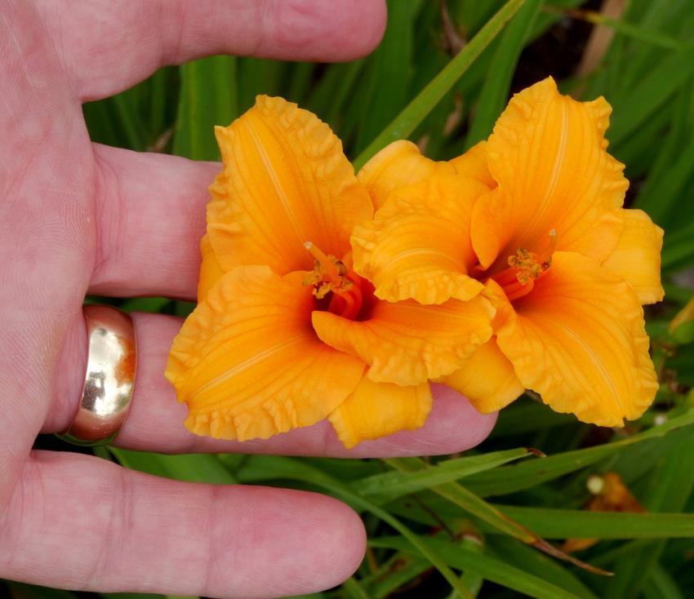
Miniatures
Sugar Shoppe
‘Sugar Shoppe’
‘Bertie Ferris’
Flowers are less than three inches across.
‘Southern Blues’

Slide 37
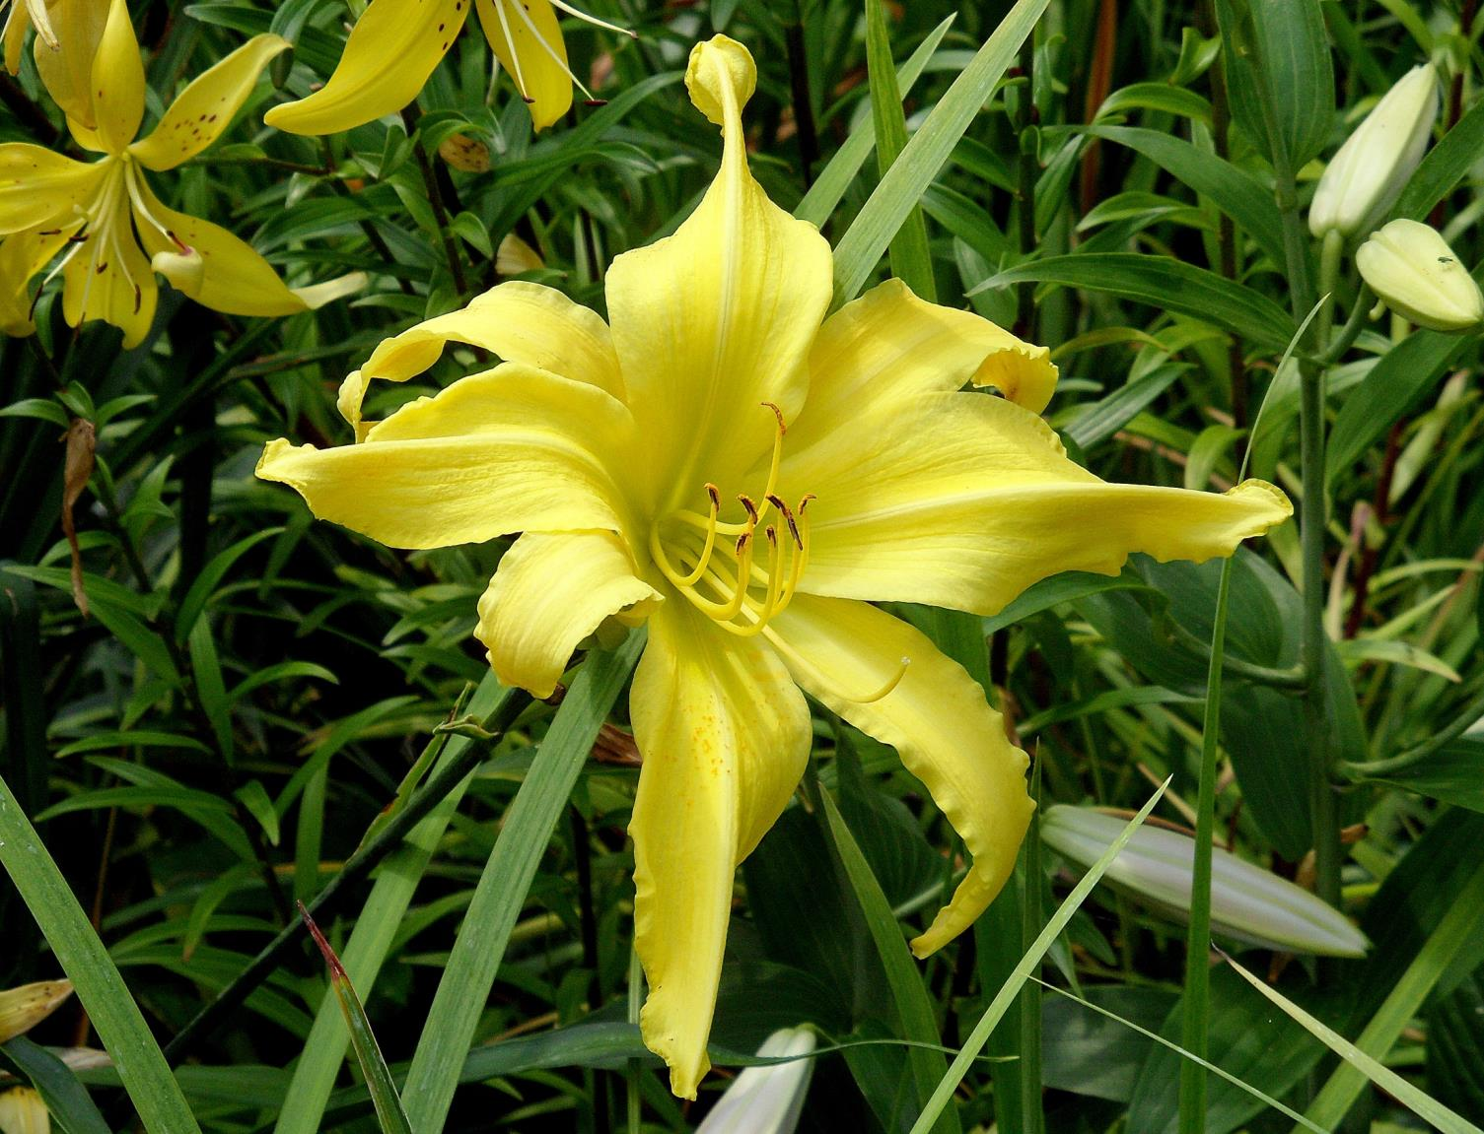
A daylily that consistently produces flowers with more than the normal number of floral organs in each whorl is called a “Polymerous” form.
Notice the additional sepals, and petals. The number of stamens also increases, one for each tepal.
‘Osterized’

Slide 38
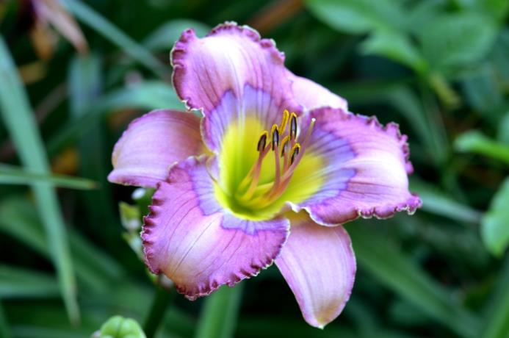
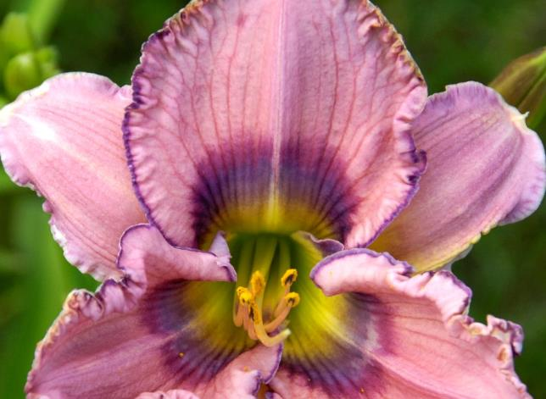
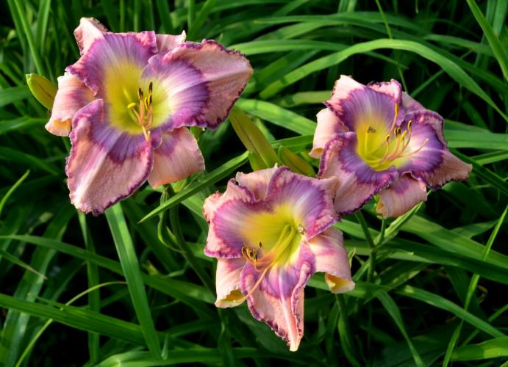
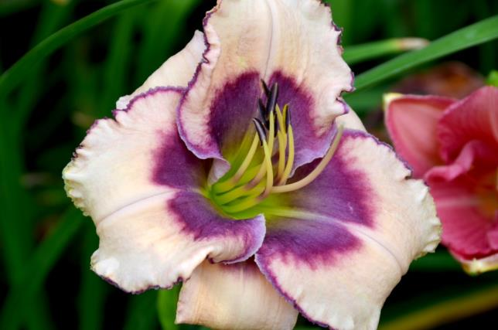
Alas, there are no blue daylilies
‘Blue Inspiration’
‘Cedar Key’
‘Suddenly Blue’
‘Smoky Eyes’

Slide 39
Now, let’s take a
leisurely walk through
the garden
and see what daylilies
are in bloom.

Slide 40
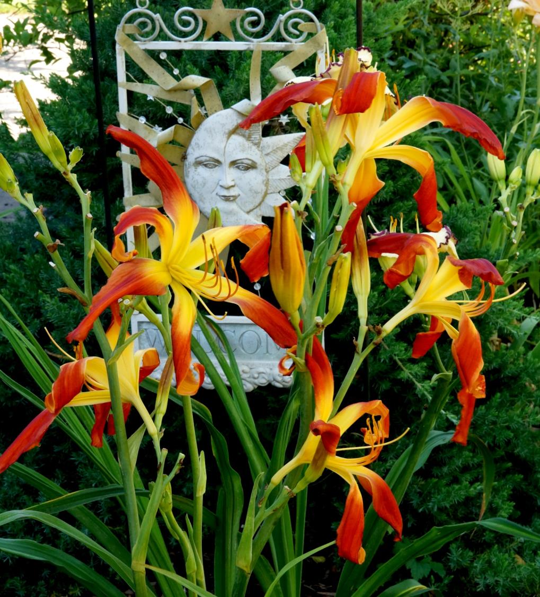
‘Hotter Than the Fourth of July’

Slide 41
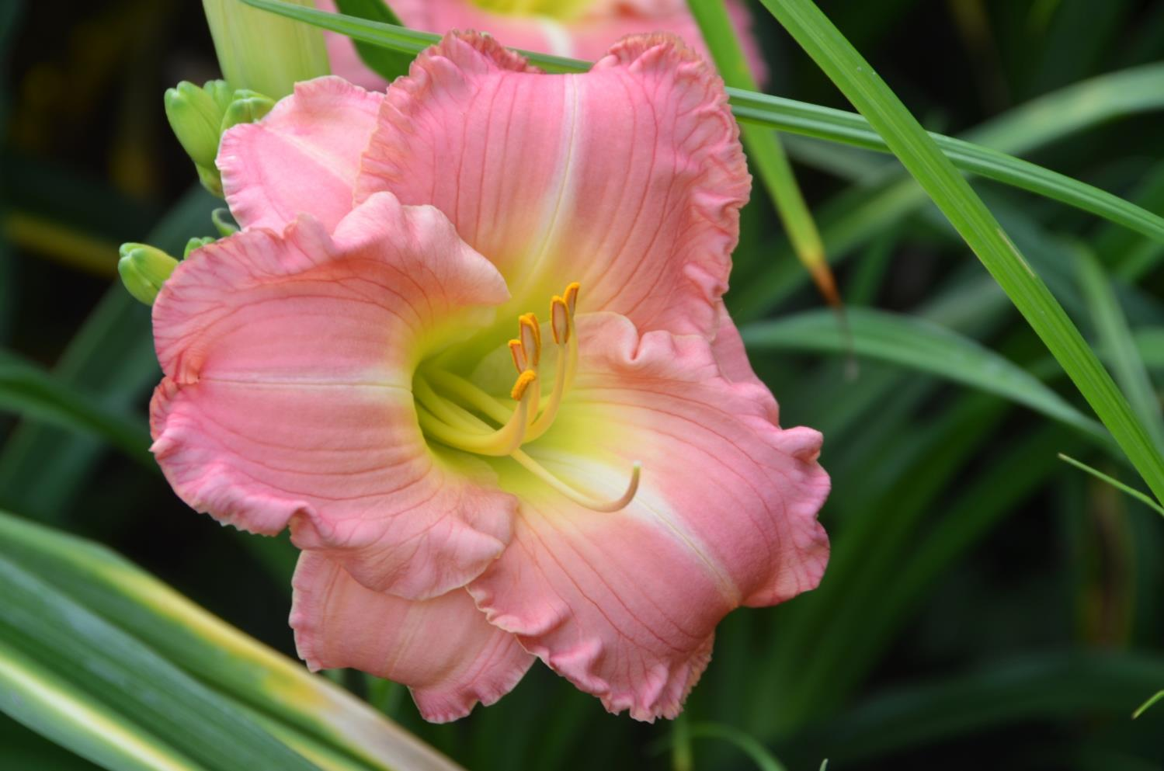
‘Paige Elizabeth’

Slide 42
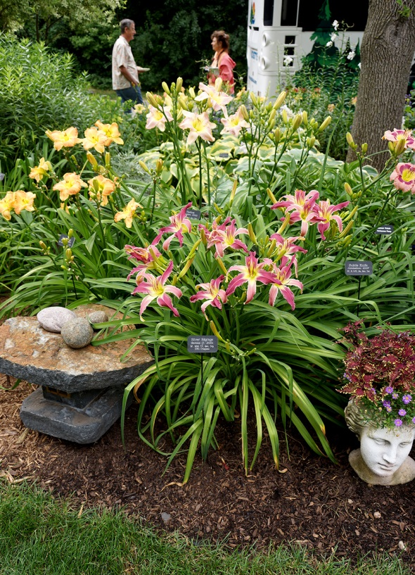
‘Silver Edgings’

Slide 43
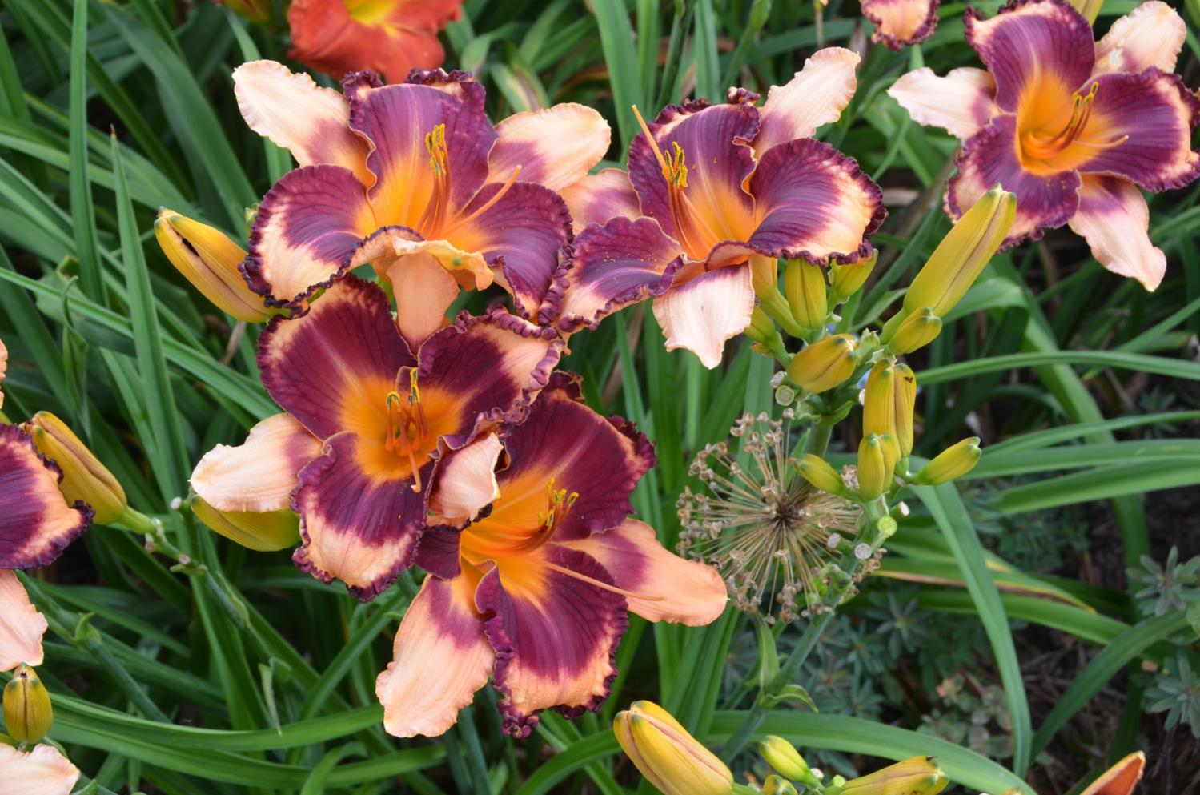
‘Betty Sue Milford’

Slide 44
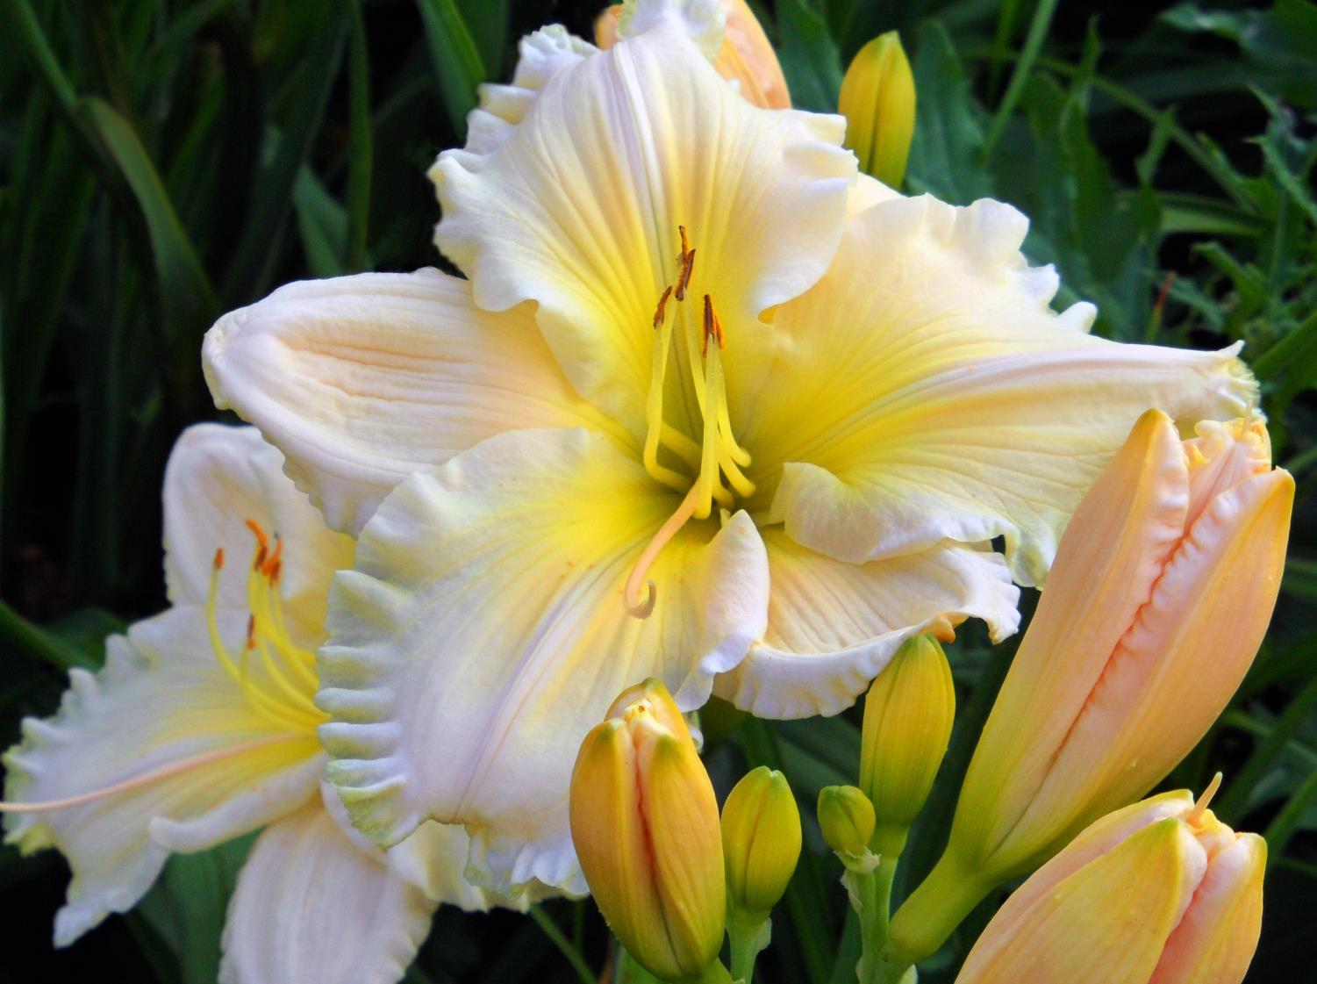
‘Ann and Russell Burgess’

Slide 45
‘Stupid In Love’

Slide 46
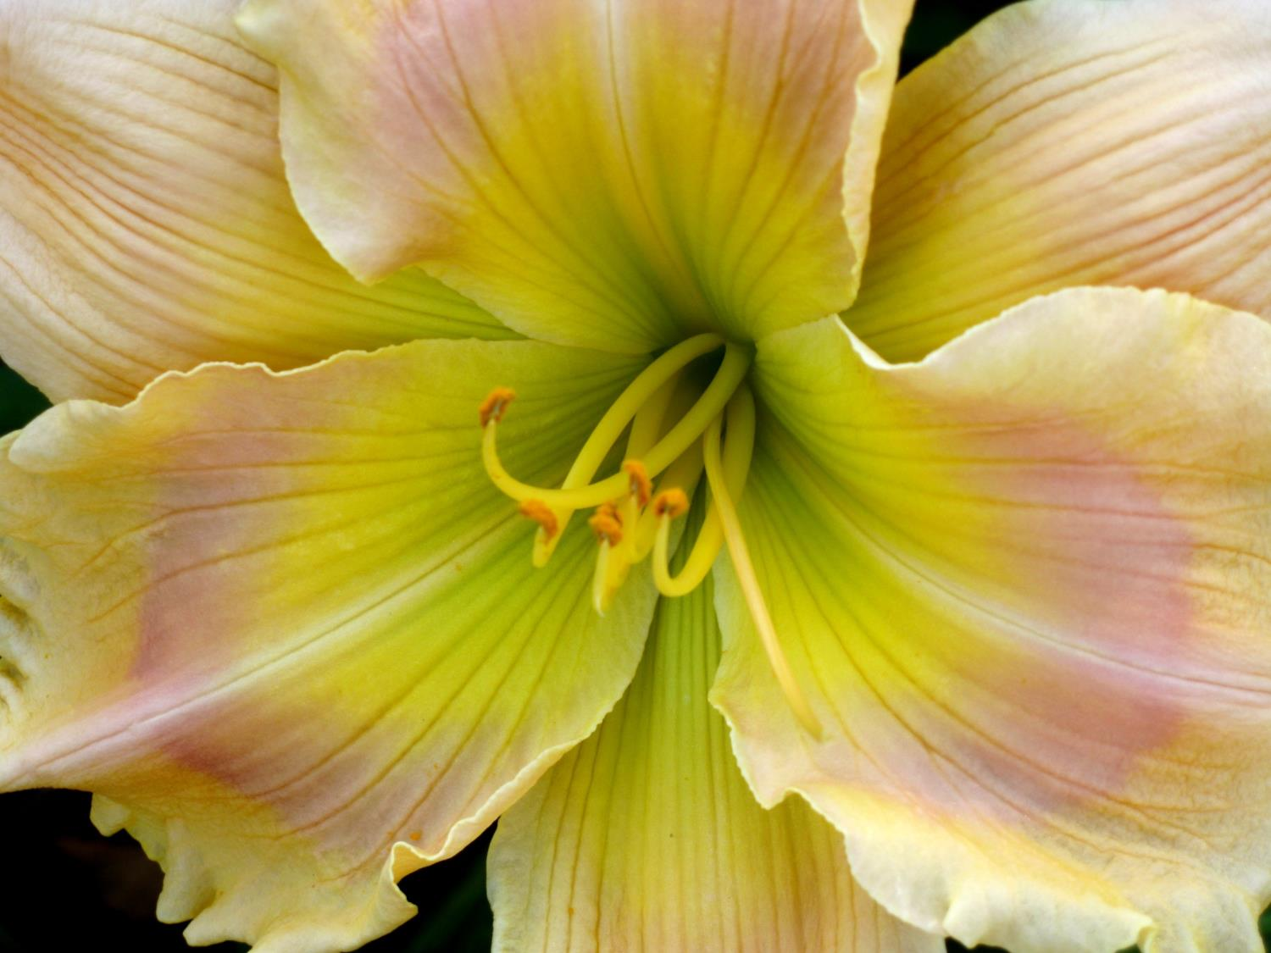
‘Rainbow Radiance’

Slide 47
‘Amanda’s Little Red Shoes’

Slide 48
‘Oy Vey’

Slide 49
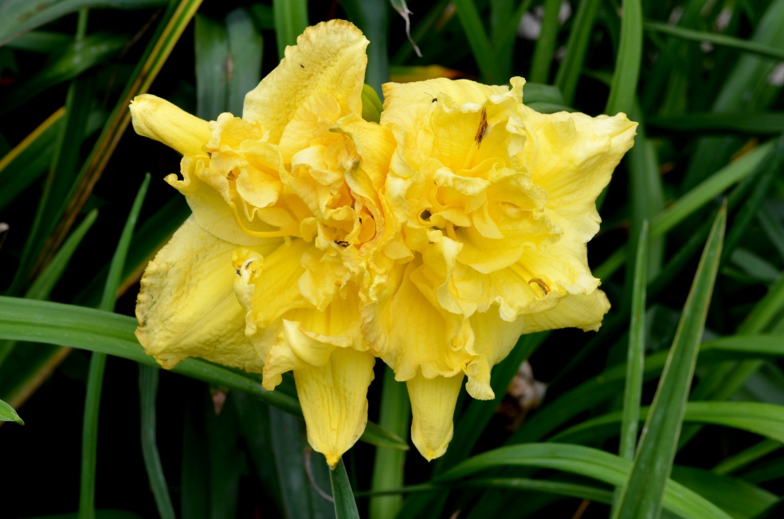
‘Grapefruit Truffle’

Slide 50
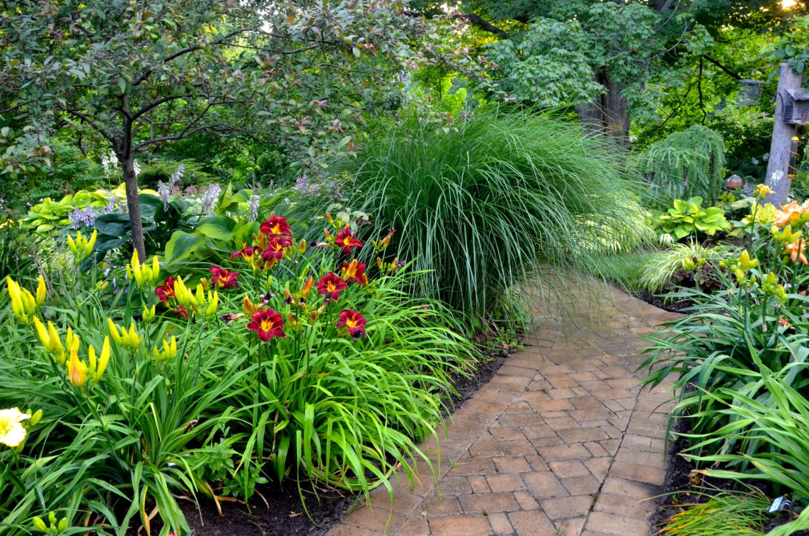
‘Dominic’
‘Mount Echo Sunrise’

Slide 51
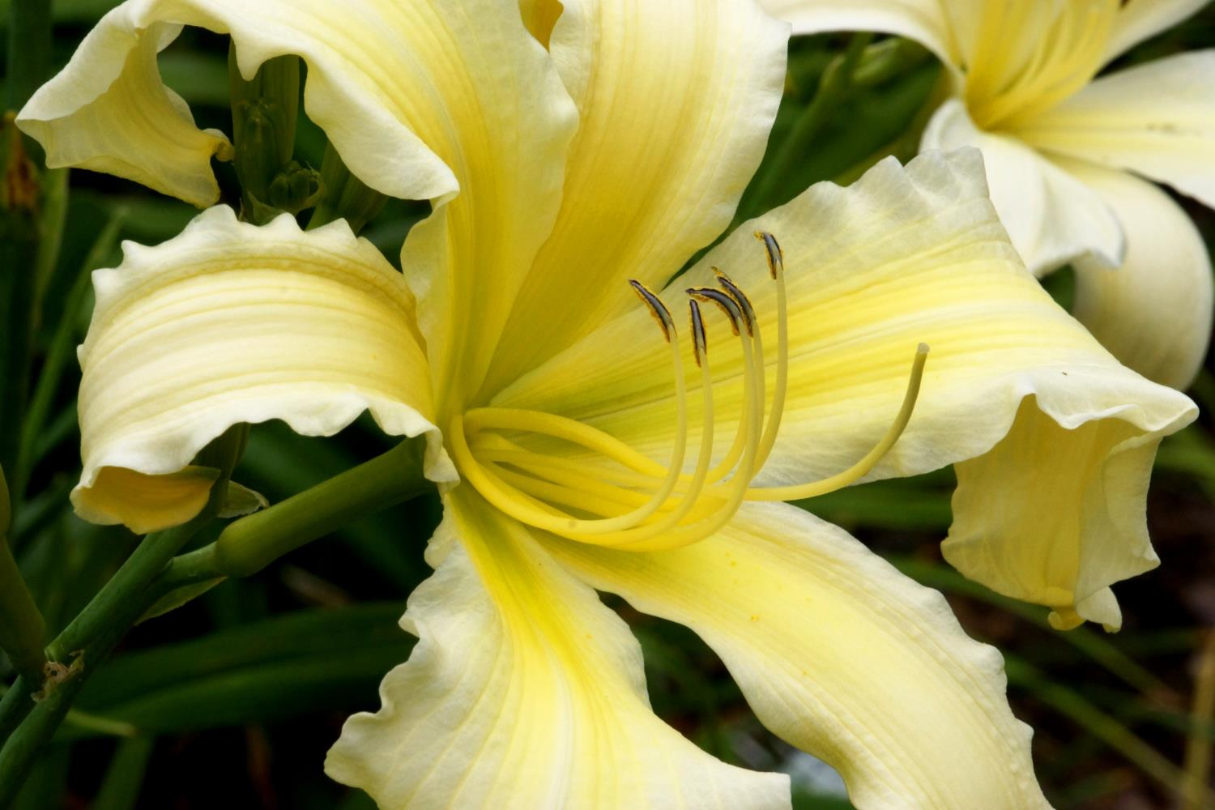
UF: Cascade
‘Mount Echo
Sunrise’

Slide 52
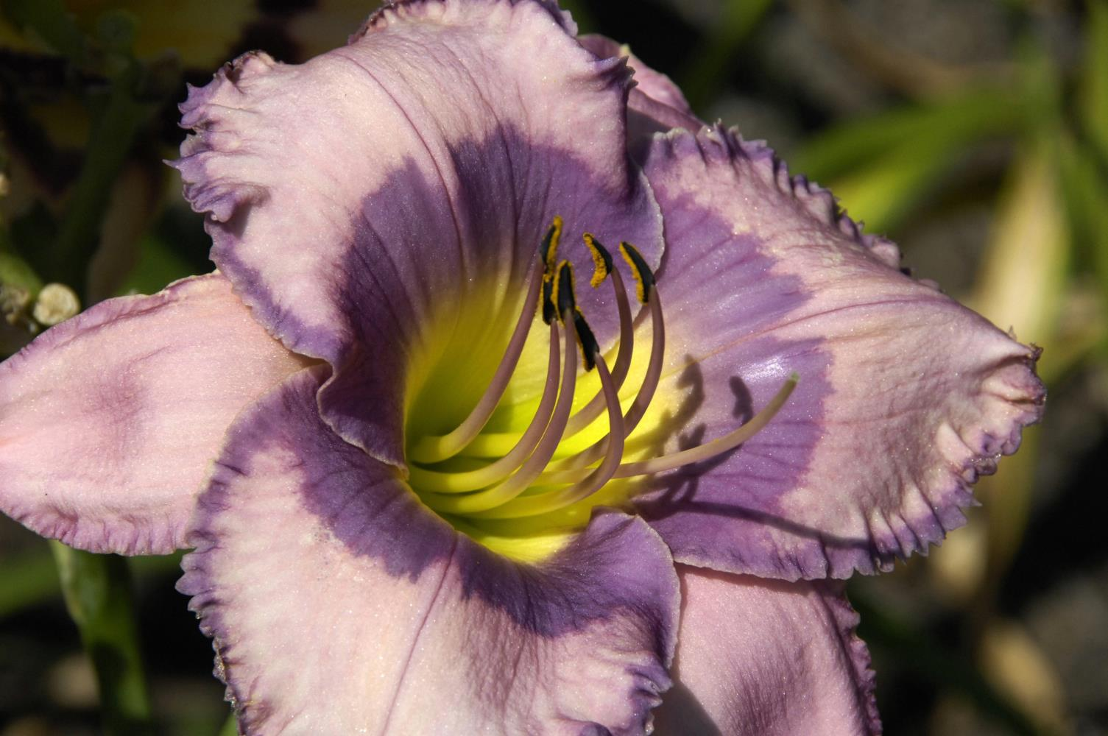
‘Linda Sierra’

Slide 53
Sculpted- Midrib Cristate
‘Little Miss Lucy’
Photo by Paul Owen

Slide 54
‘Point of Divergence’
Photo by Chris Petersen

Slide 55
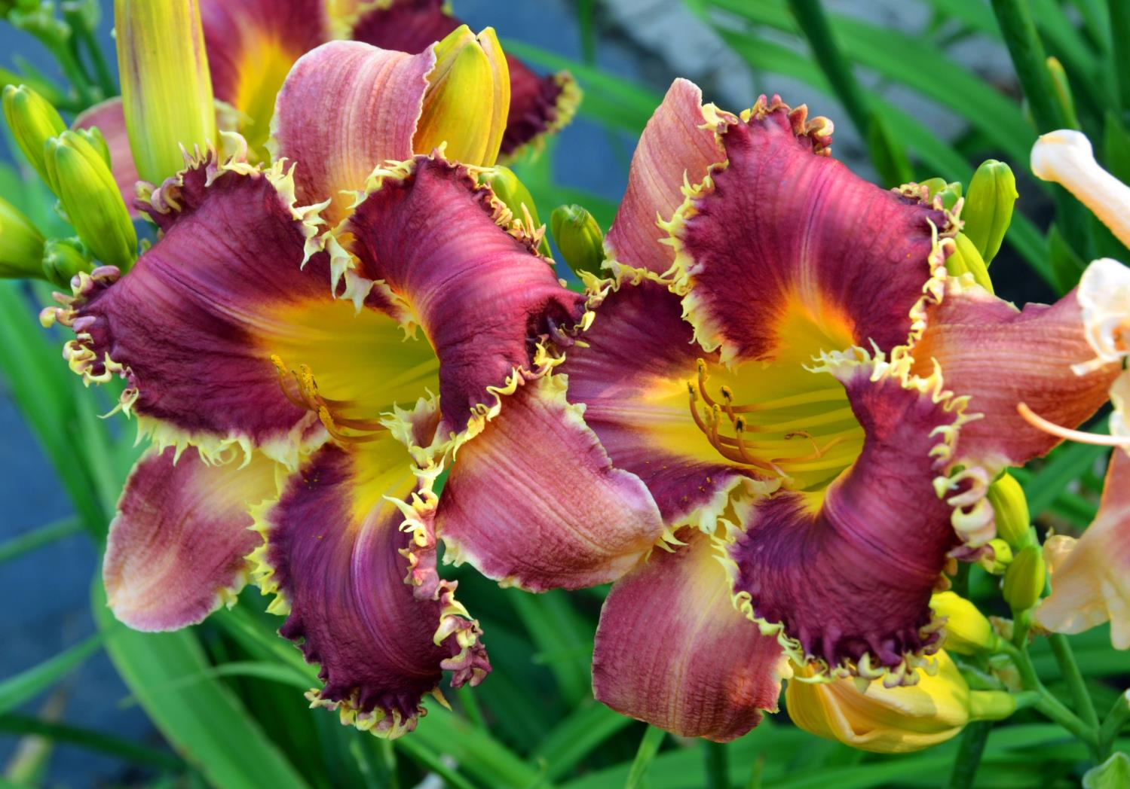
‘Venus Flytrap’

Slide 56
‘Dreams of Destiny’

Slide 57
‘Grape Kiss’
Photo by Jane Guillard

Slide 58
‘Kingdom Without End’

Slide 59
Spider-UF: Cascade
‘Heavenly Pink Twister’

Slide 60
‘Pat Bonner’

Slide 61
‘Party Pinafore’

Slide 62
‘Free Wheelin’

Slide 63
‘Bob Faulkner’

Slide 64
‘Arms Reaching Out’

Slide 65
‘Overflowing Heart’

Slide 66
‘Breaking With Tradition’

Slide 67
‘Aurora Blues’

Slide 68
Orienpet Lily var. ‘Conca d’ Or’’
Did you notice that this is a lily, not a daylily?

Slide 69
UF: Crispate
‘Dark Monkey’

Slide 70
UF: Cascade
‘Navajo Pony’

Slide 71
‘Message of Love’
Photo by Charlotte Chamitoff

Slide 72
UF: Cascade
‘Primal Scream’

Slide 73
‘Sunrise Sunset Beautiful’

Slide 74
‘Sybil’s Blues’

Slide 75
‘Glazed Porcelain Truffle’

Slide 76
UF: Crispate
‘Heavenly Ooh La La’

Slide 77
‘Riot on the Kindergarten Bus’

Slide 78
‘Webster’s Pink Wonder’

Slide 79
Hostas and daylilies growing side by side
‘Siloam Shocker’

Slide 80
‘Casabella Red’

Slide 81
‘Last Snowflake’

Slide 82
‘Piano Man’

Slide 83
UF:Crispate-Sculpted:Cristate
‘Greetings Earthling’

Slide 84
Each evening, today’s flowers begin to close, while tomorrow’s get ready to open. Each morning provides
a fresh, exciting view of the beauty of daylilies.
‘Wispy Rays’

Slide 85
Try not to be Overtaken by the Obsession!

Slide 86
Enjoy
Daylilies
The essential perennial

Slide 87
For further information on daylily hybridization and gardening, go to:
www.daylilies.org

