Slide 1
Award Winning 2016 Photographs
Presenting the results of the
AHS National Photo Contest and those of
Regions 2, 4, 11, 13 and 15
Part I: AHS Contest Winners

Slide 2
Welcome
We hope you enjoy this compendium of the “best of the best” photos from the 2016 AHS and Regions 2, 4, 11, 13 and 15 contests. Each has won recognition in a judged contest held by the AHS or those five regions. While each contest had its individual requirements, all share a
common goal of identifying the most outstanding among the entries.

Slide 3
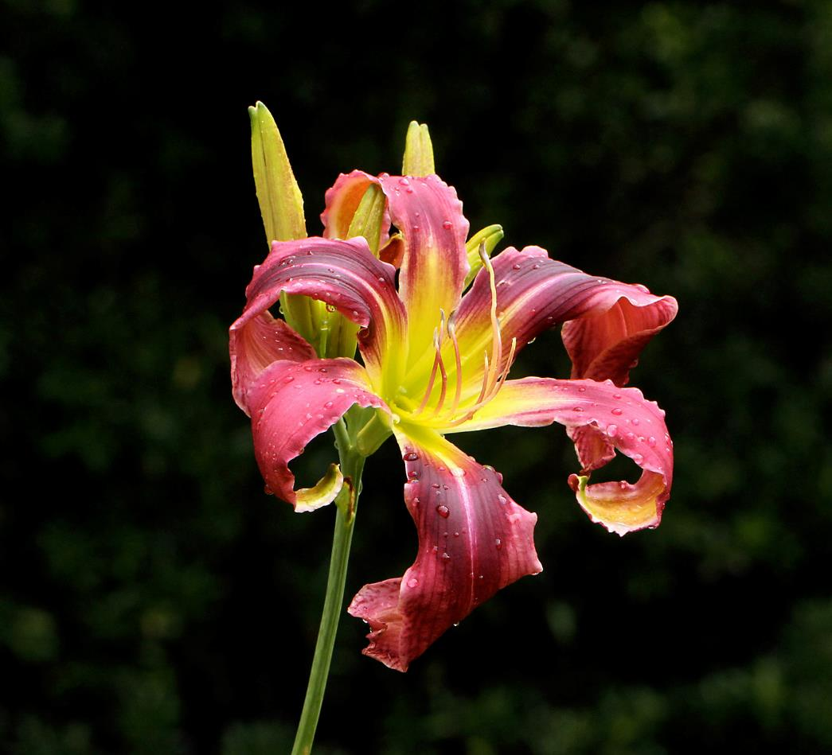
AHS 2016 Mildred Schlumpf Award: Single Bloom
FIRST PLACE
John Stahl
‘Purple Tarantula’ (Gossard, 2011)

Slide 4
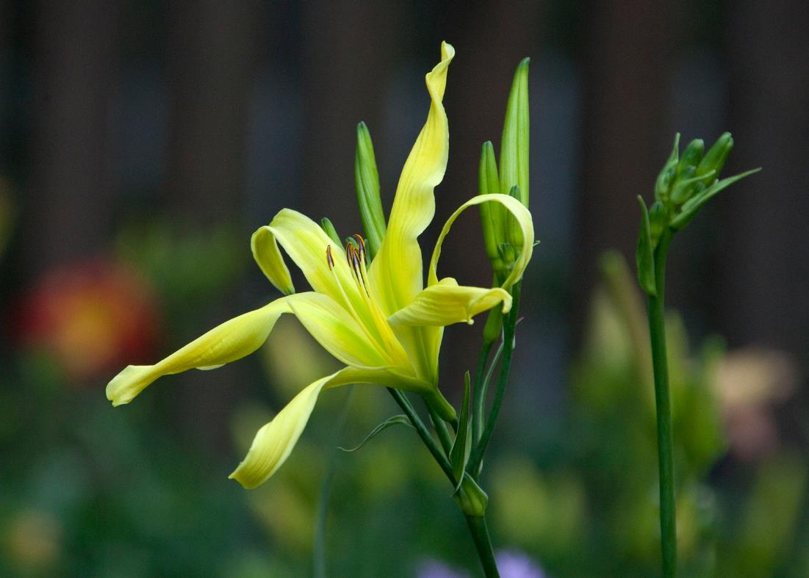
AHS 2016 Mildred Schlumpf Award: Single Bloom
SECOND
PLACE
Scott Elliot
‘Godwin’s Glory’
(Elliot-S., 2014)

Slide 5
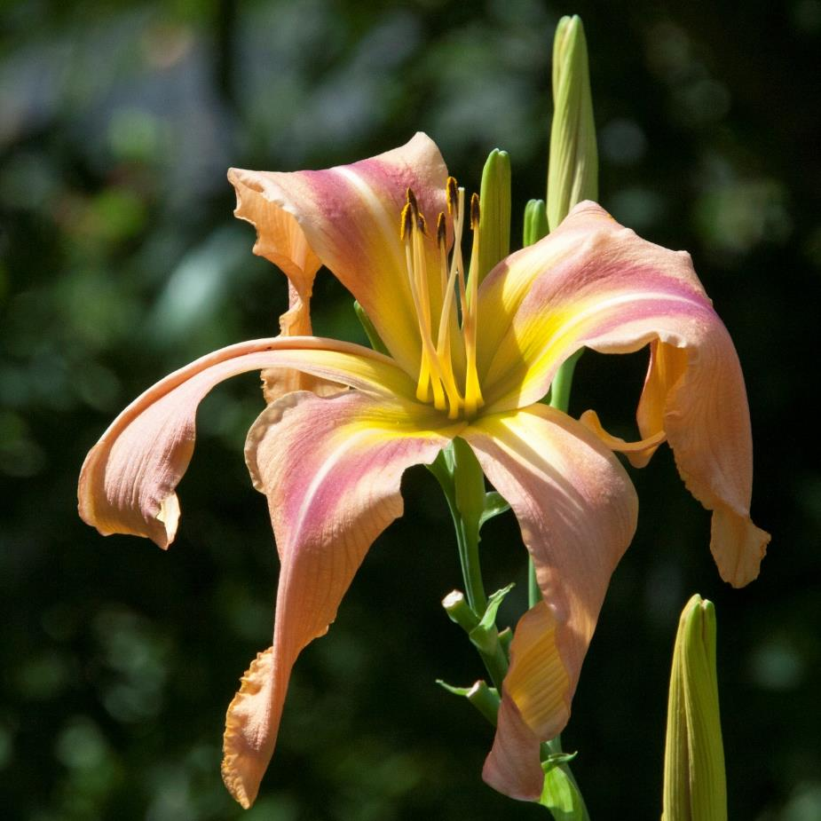
AHS 2016 Mildred Schlumpf Award: Single Bloom
THIRD PLACE
Scott Elliot
‘Peripatetic Albatross’
(Elliot-S., 2014)

Slide 6
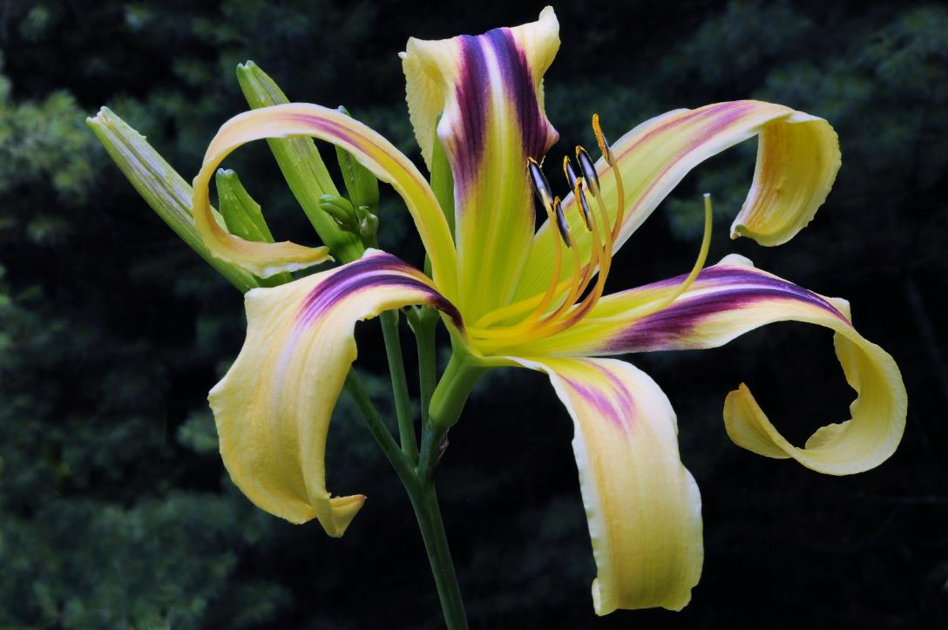
AHS 2016 Mildred Schlumpf Award: Single Bloom
FINALIST
Jerry Gantar
‘Free Wheelin’ (Stamile-P.,
2004)

Slide 7
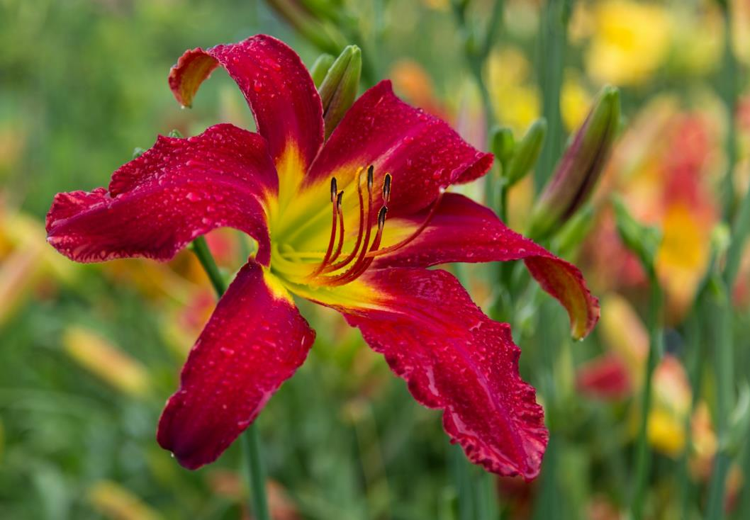
AHS 2016 Mildred Schlumpf Award: Single Bloom
FINALIST
Randy Dinkins
‘Heavenly United
We Stand’
(Gossard, 2009)

Slide 8
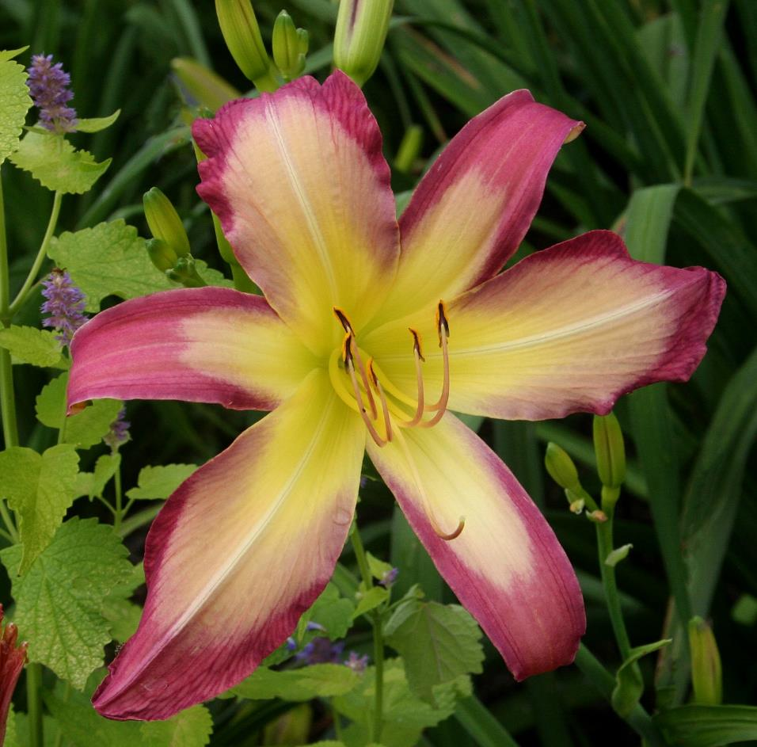
AHS 2016 Mildred Schlumpf Award: Single Bloom
FINALIST
Julie Covington
‘In Walked Bud’ (Clement-B., 2013)

Slide 9
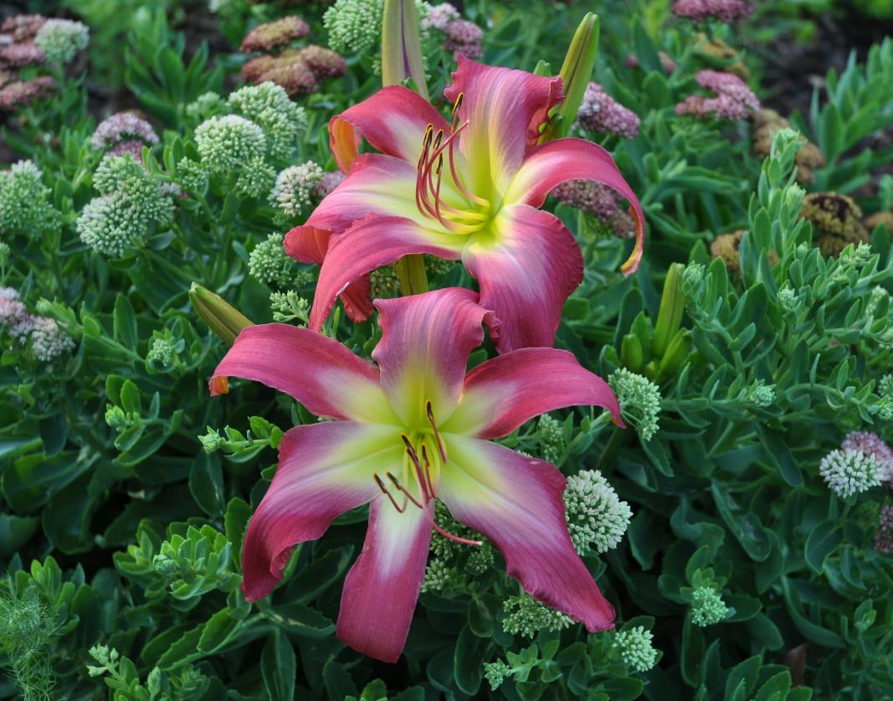
AHS 2016 Multi-Bloom Awards
FIRST PLACE
Susan
Okrasinski
‘Neon Flamingo’ (Gossard-J., 2006)

Slide 10
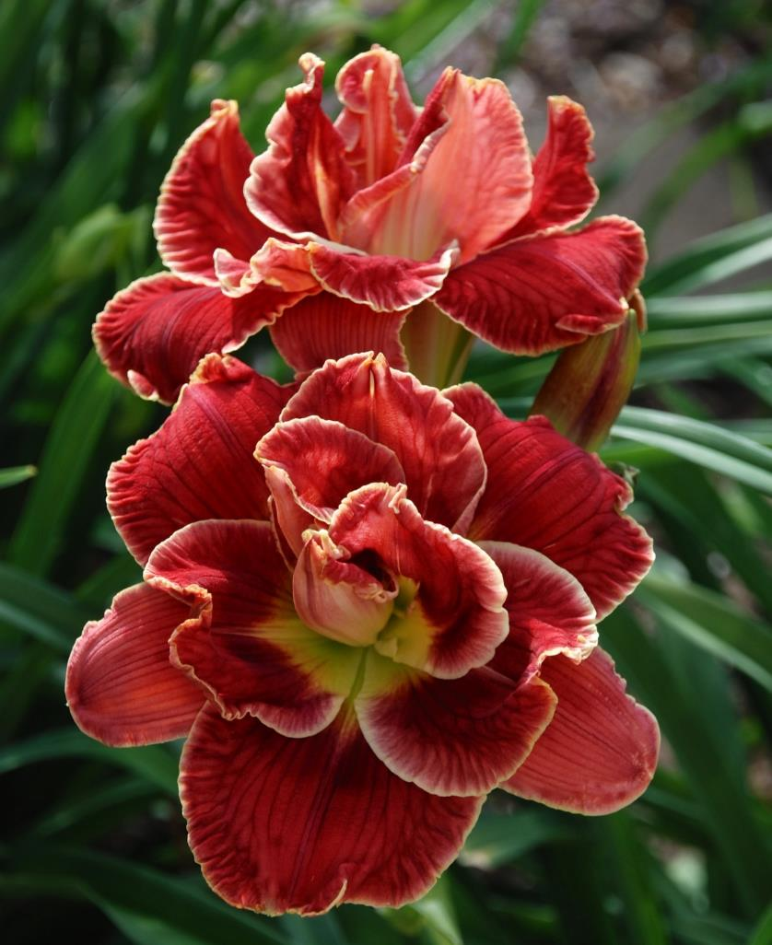
AHS 2016 Multi-Bloom Awards
SECOND PLACE
Jane Guillard
‘Amanda’s Little Red Shoes’
(Eller-N., 2004)

Slide 11
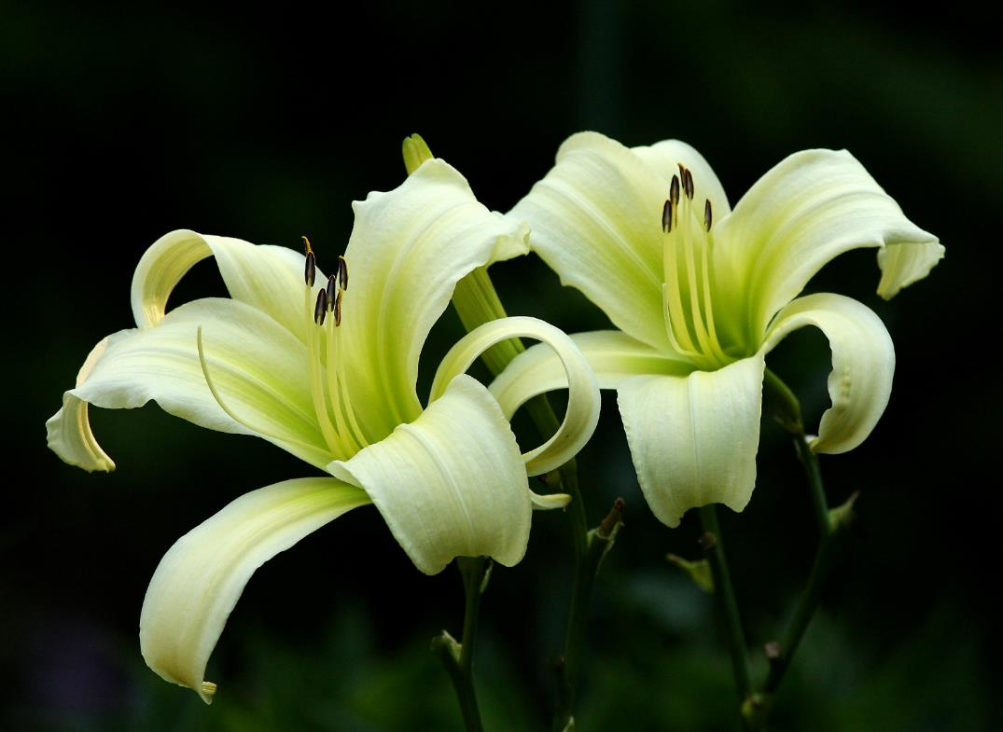
AHS 2016 Multi-Bloom Awards
THIRD PLACE
John Stahl
‘Noorland’
(Mahieu-Burris, 2007)

Slide 12
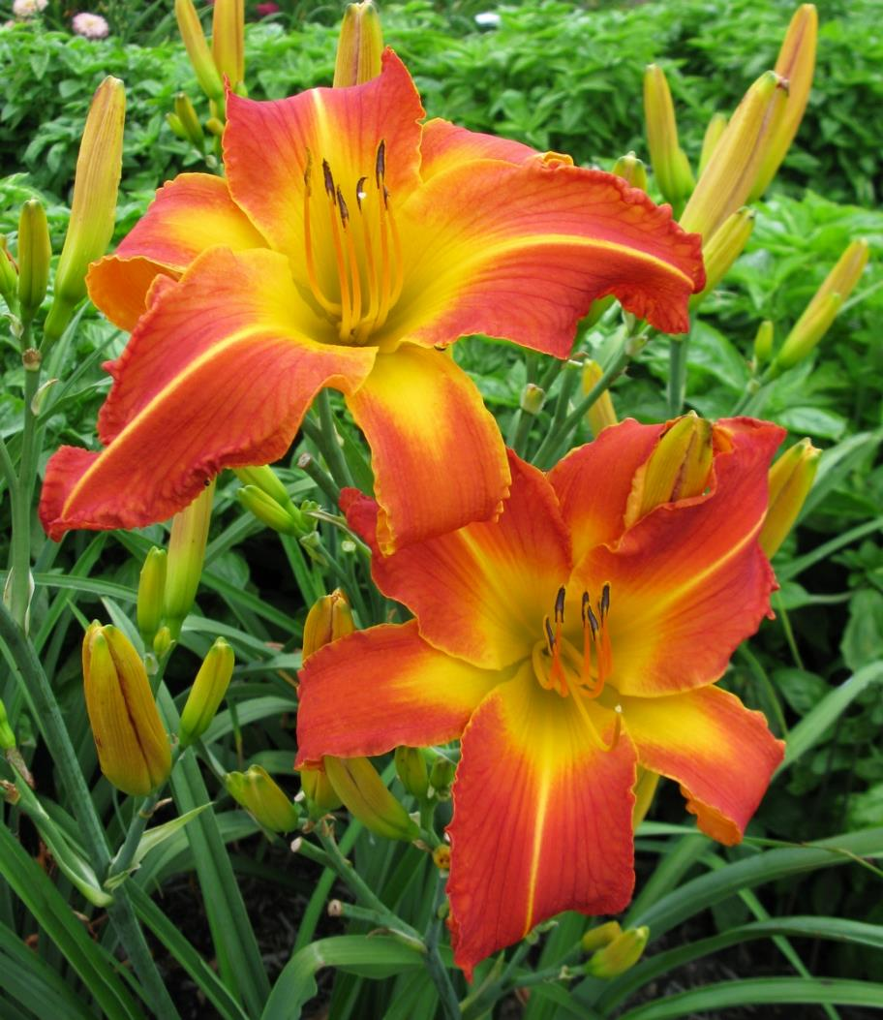
AHS 2016 Multi-Bloom Awards
FINALIST
Paul Owen
‘Ballistic’ (Owen-P., 2016)

Slide 13
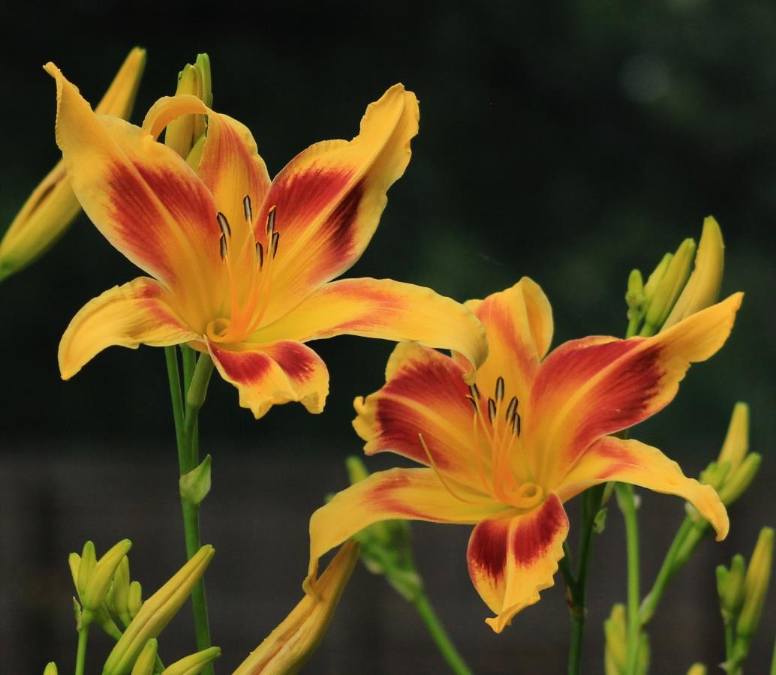
AHS 2016 Multi-Bloom Awards
FINALIST
Vicky Goedde
‘Lady Neva’
(Alexander-Moody, 1970)

Slide 14
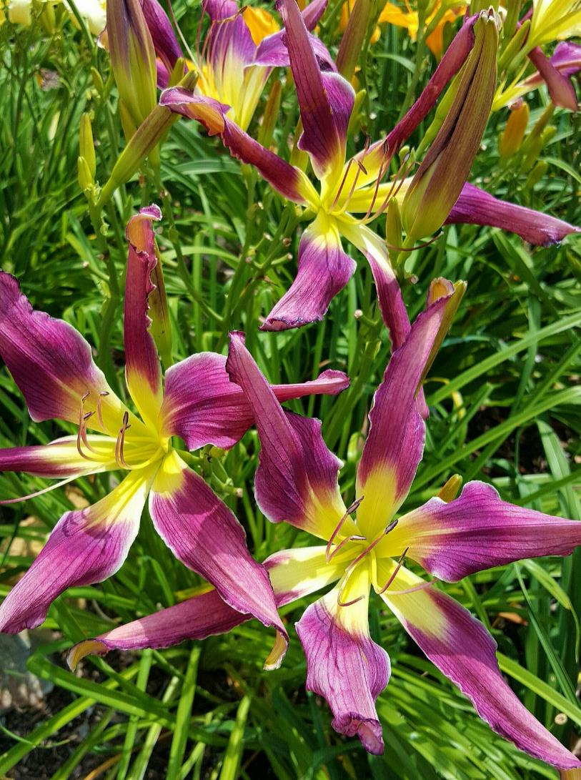
AHS 2016 Multi-Bloom Awards
FINALIST
Carl Hamilton
‘Purple Satellite’
(Mahieu, 2003)

Slide 15
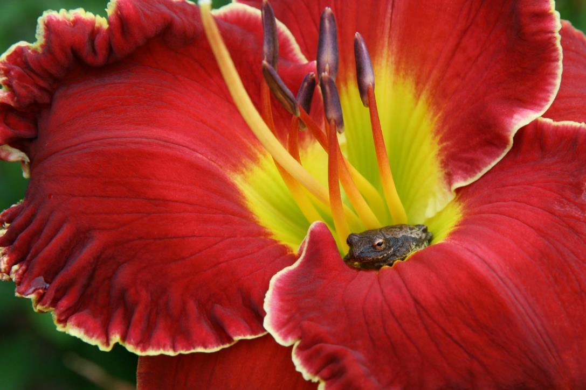
AHS 2016 Artistic Award
FIRST PLACE
Ginny Pearce
‘Big Red Wagon’
(Stamile, 2008)
with tree frog’

Slide 16
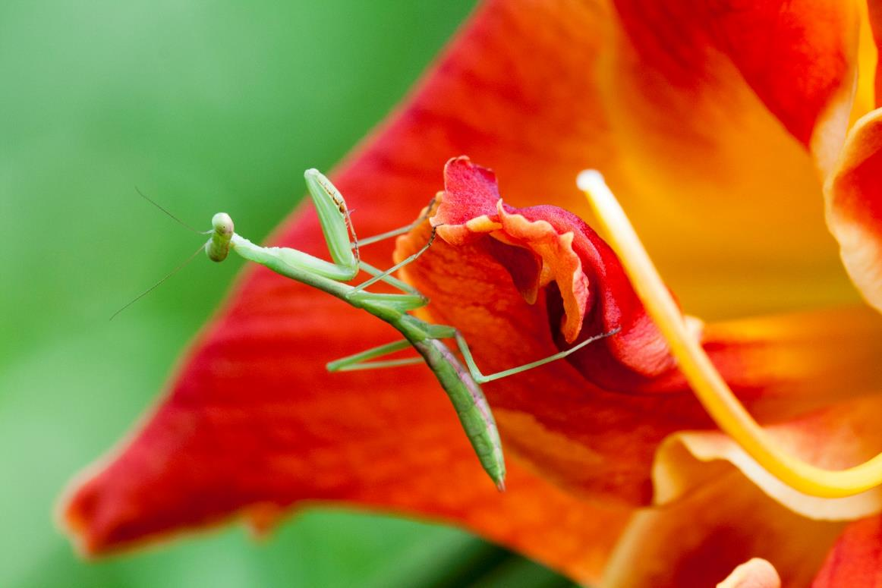
AHS 2016 Artistic Award
SECOND PLACE
Dominique Elliot
‘Killer Bees’ (Elliott, 2014) with Praying Mantis’

Slide 17
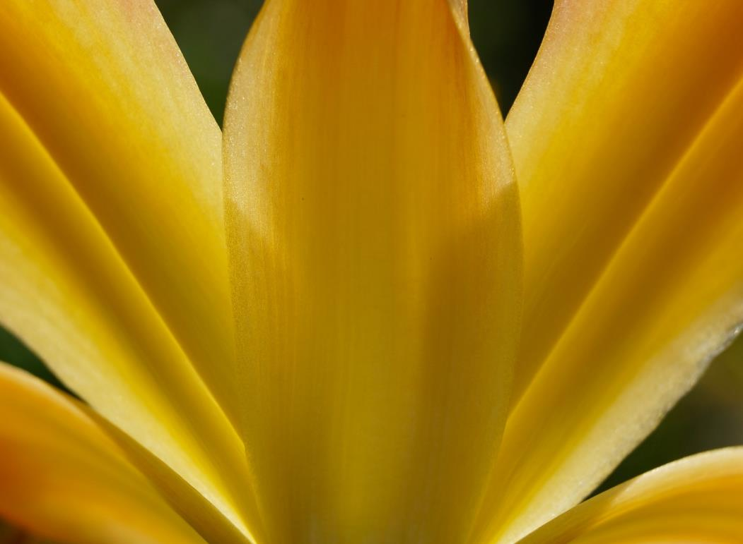
AHS 2016 Artistic Award
THIRD PLACE
Anna Carlson
‘Hotter than the Fourth of July’ (Wilkerson, 2010)

Slide 18
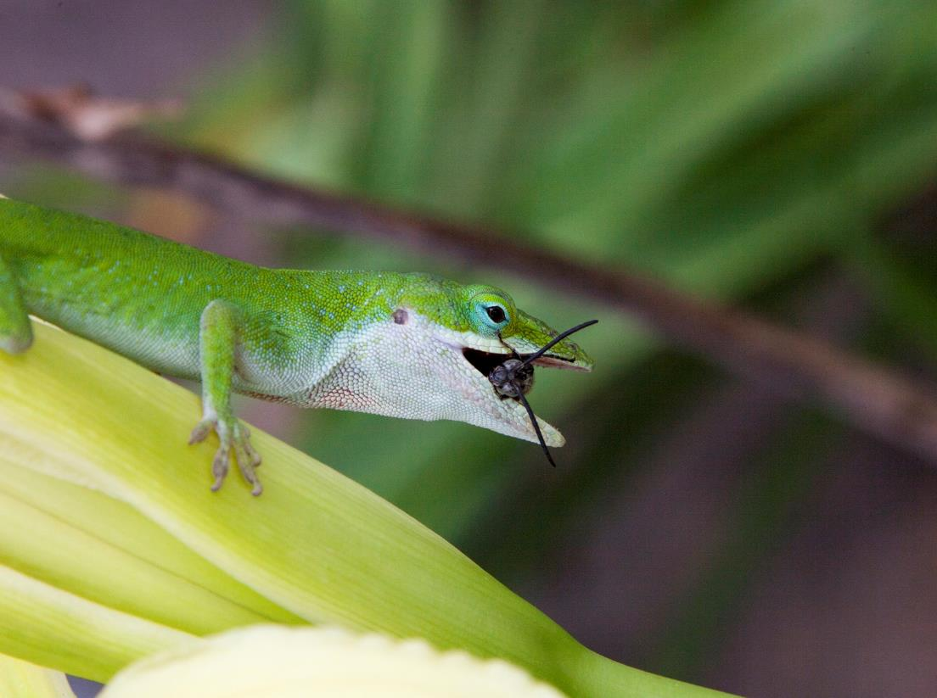
AHS 2016 Artistic Award
FINALIST
Dominique Elliott
‘‘Frog’s Eye’ (Stamile-P., 2004) with feeding Anolis lizard’

Slide 19
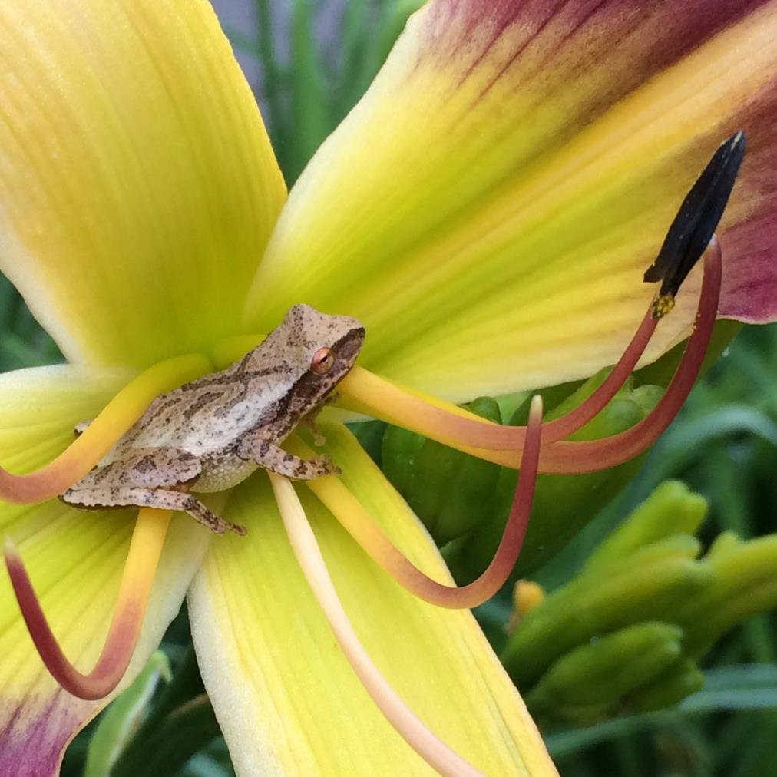
AHS 2016 Artistic Award
FINALIST
Claudia Conway
‘‘Pursuit of Happiness’
(Trimmer, 2010) with tree frog’

Slide 20
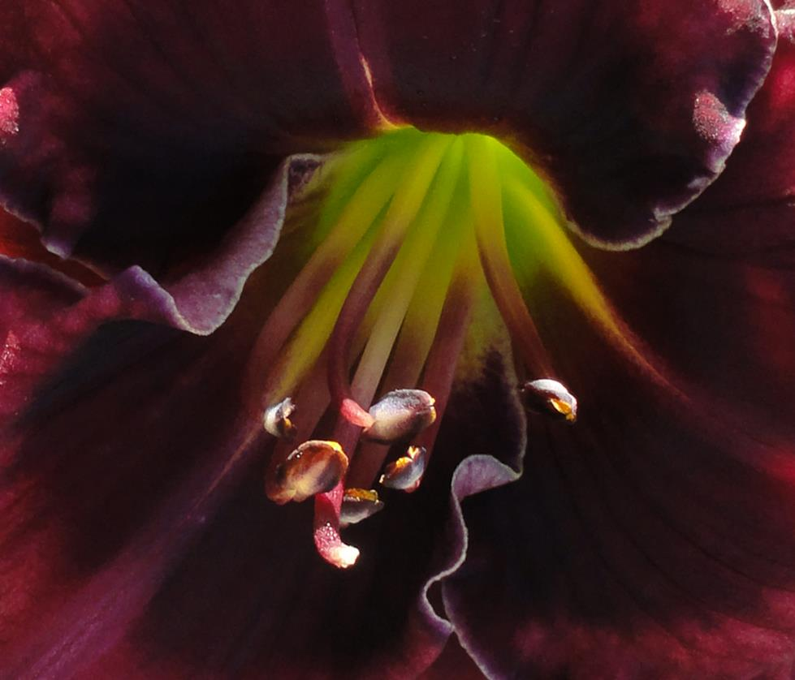
AHS 2016 Artistic Award
FINALIST
Nan Ripley
‘Shadow Music’
(Ripley, 2014)

Slide 21
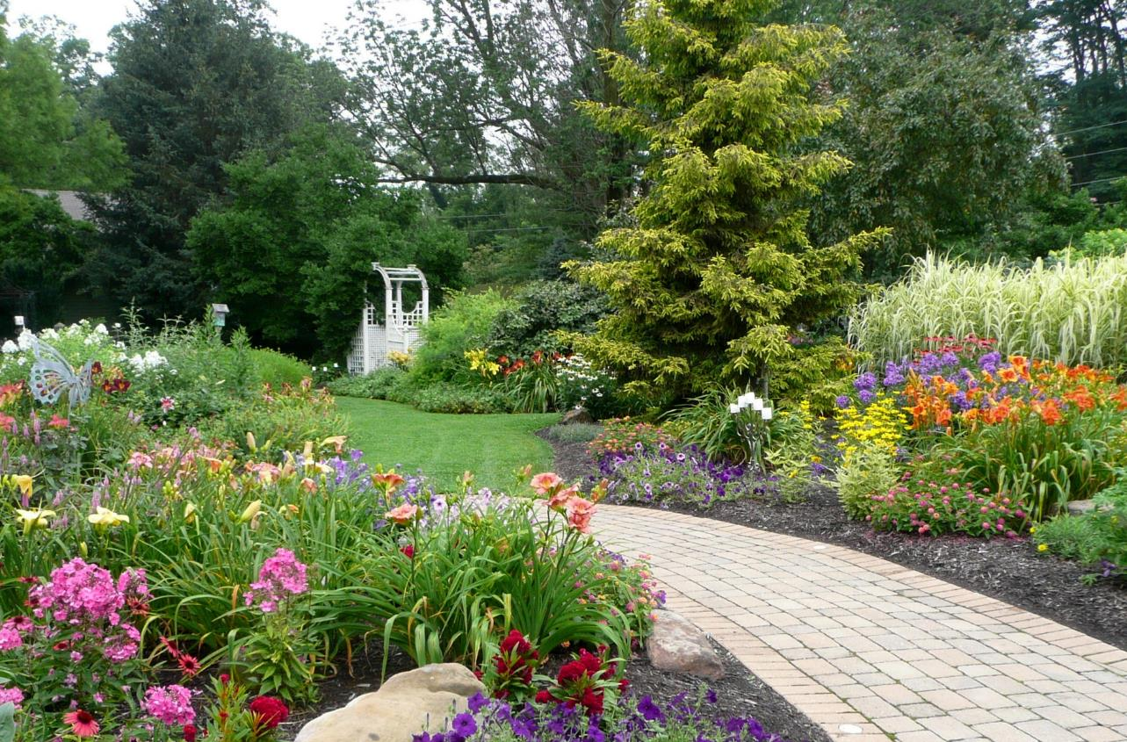
AHS 2016 Mildred Schlumpf Award: Landscape
FIRST PLACE
Debbie Monbeck, ‘Avon Garden’ (IN)

Slide 22
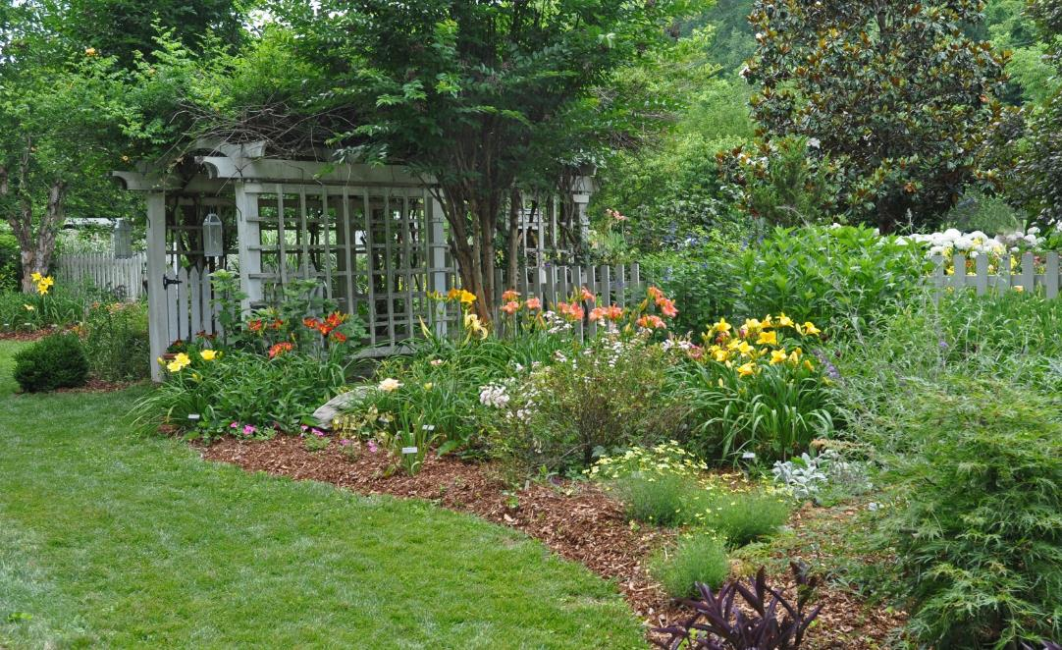
AHS 2016 Mildred Schlumpf Award: Landscape
SECOND PLACE
Susan
Okrasinski
‘The Coltharp
and Alexander
Garden’
(TN)

Slide 23
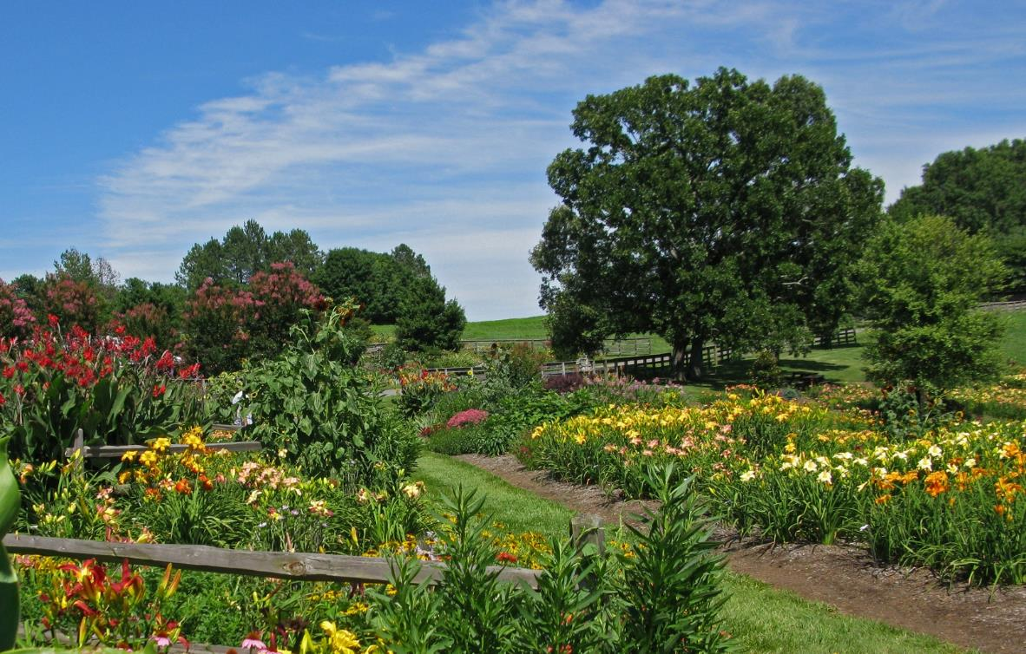
AHS 2016 Mildred Schlumpf Award: Landscape
THIRD
PLACE
Paul Owen
‘Slightly Different Daylily Garden’
(SC)

Slide 24
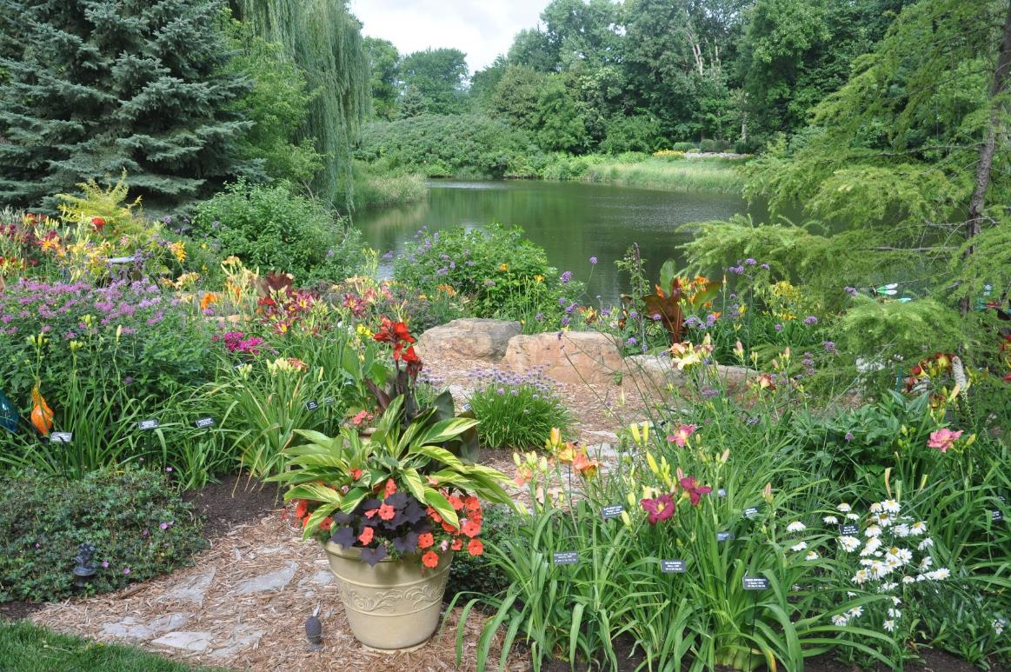
AHS 2016 Mildred Schlumpf Award: Landscape
FINALIST
Bill Monroe
‘The
Billadeau Garden’
(MN)

Slide 25
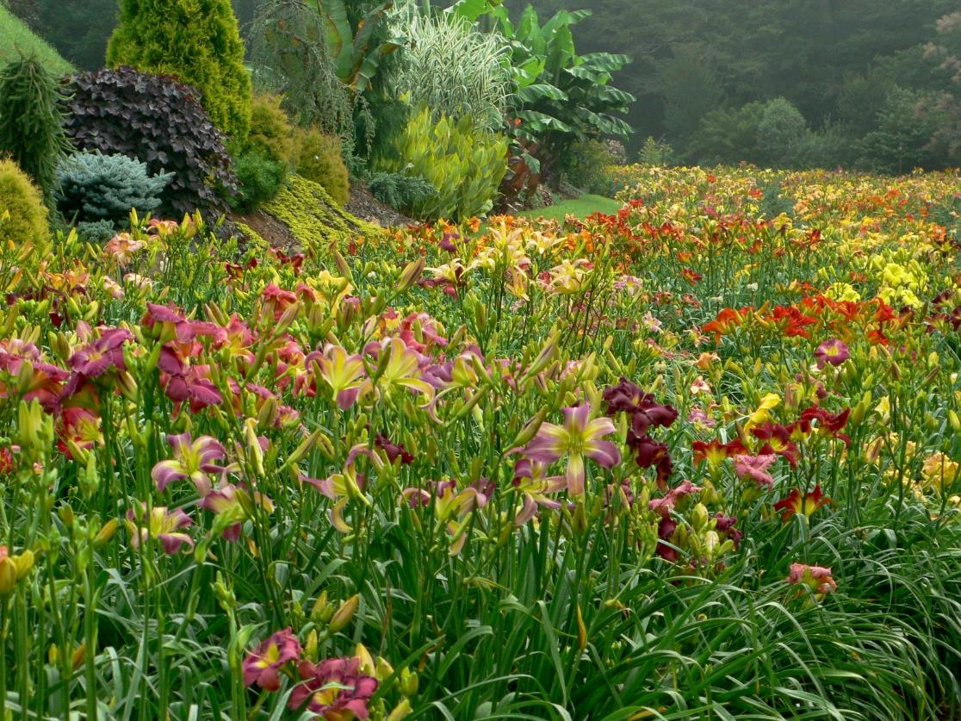
AHS 2016 Mildred Schlumpf Award: Landscape
FINALIST
Bob Selman
‘Blueridge Daylilies Garden’ (NC)

Slide 26
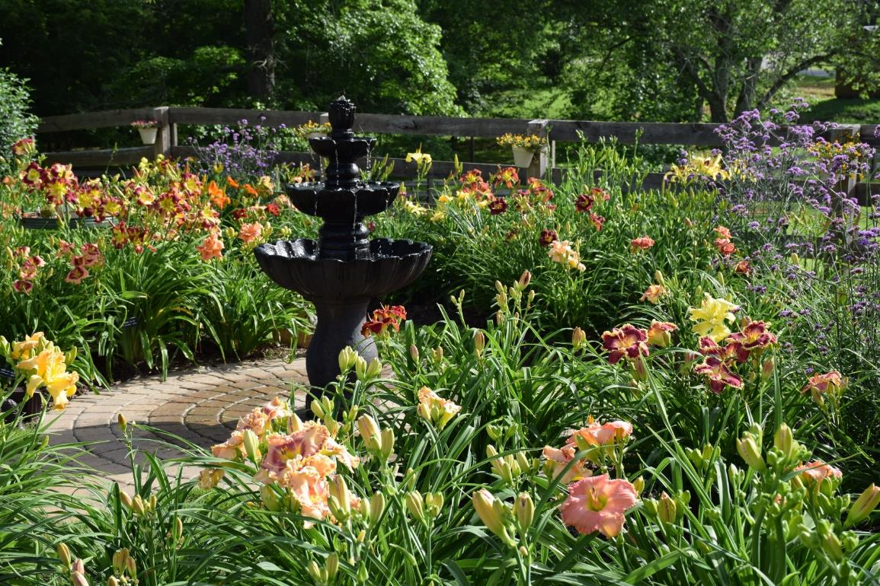
AHS 2016 Mildred Schlumpf Award: Landscape
FINALIST
Kyle Billadeau
‘The Claude Carpenter Garden’
(GA)

Slide 27
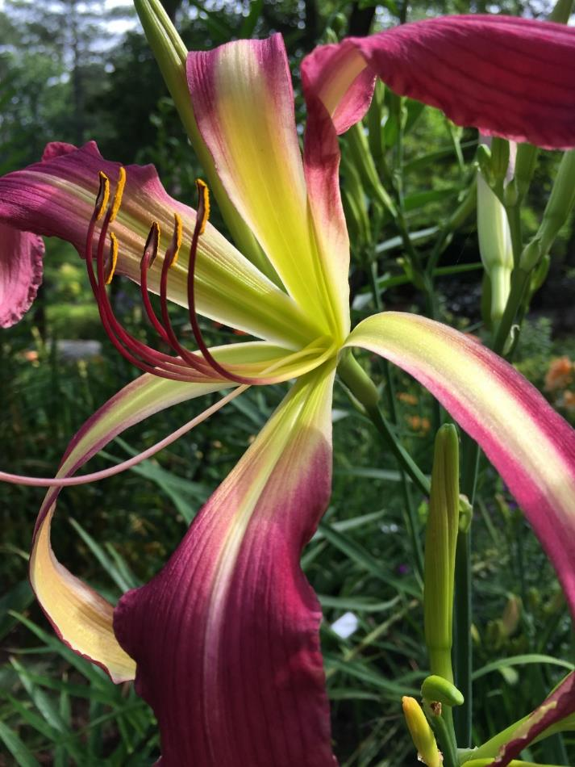
AHS 2016 Youth Photography Awards: Beginners Division
First Place
Hans Herrington
‘Dave Guleke’
(Herrington-K., 2008)

Slide 28
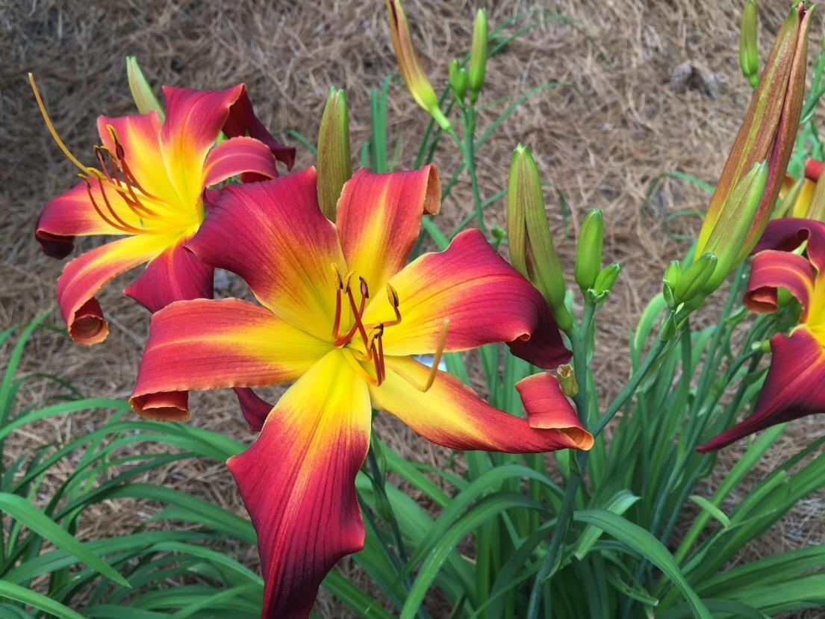
AHS 2016 Youth Photography Awards: Beginners Division
Finalist
Hans Herrington
‘Raspberry Propeller’
(Roberts-N., 2003)

Slide 29
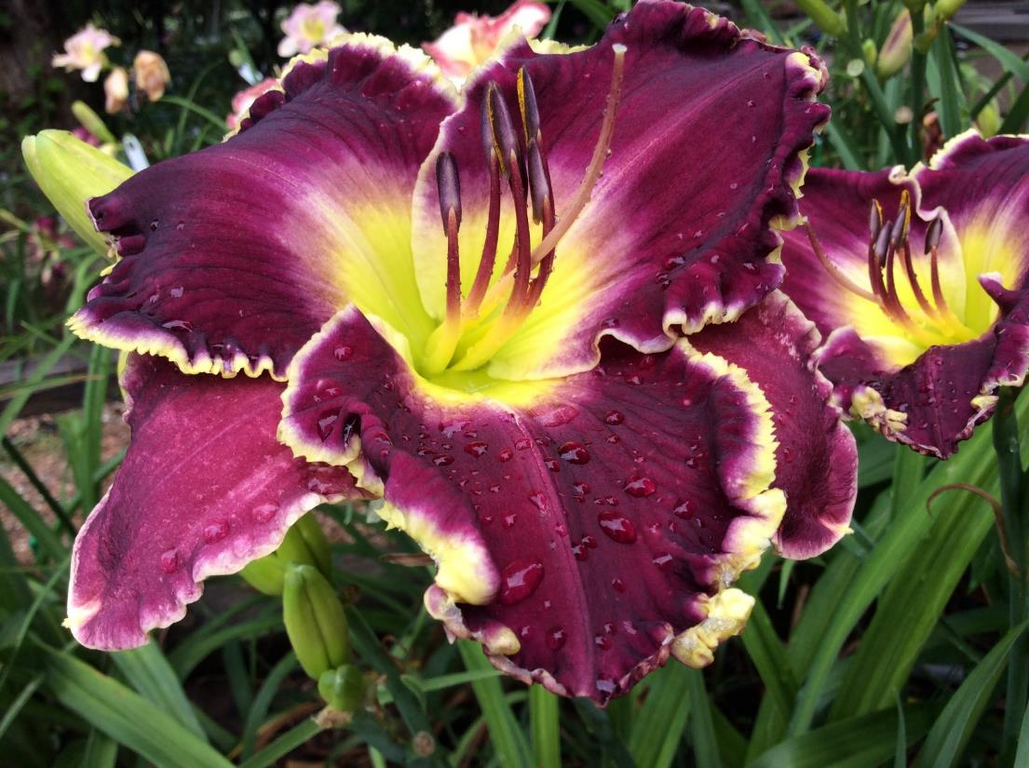
AHS 2016 Youth Photography Awards: Intermediate Division
FIRST PLACE
Ashton Lopp
‘Violet Becomes You’
(Stamile-P., 2007)

Slide 30
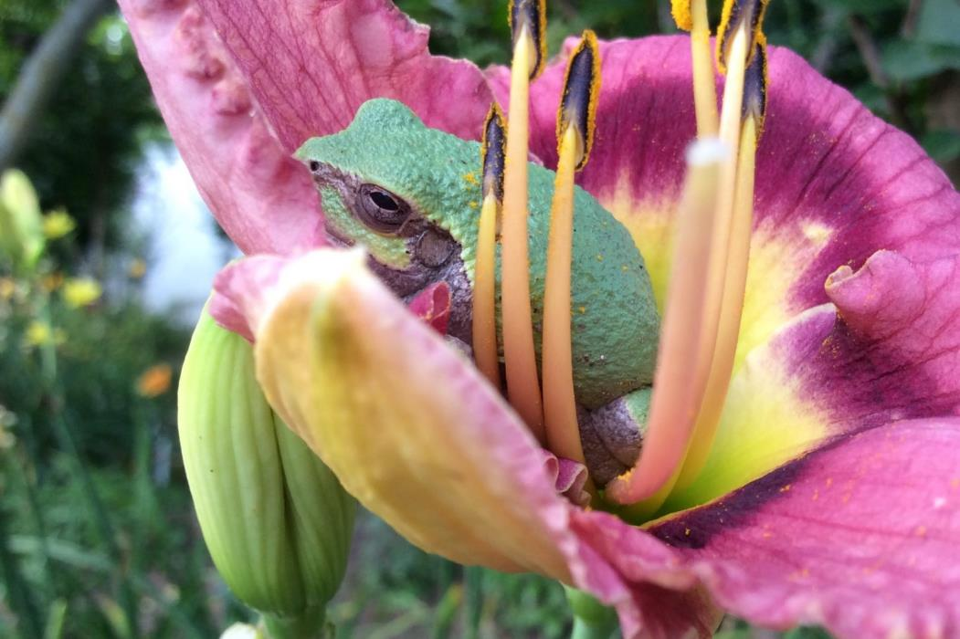
AHS 2016 Youth Photography Awards: Intermediate Division
FINALIST
Ashton Lopp
‘‘Lowcountry Gem’
(Roycroft, 1998)
with tree frog’

Slide 31
End of Part I
Please go to Part II, for the Region 2 and 4 winners.
Please go to Part III, for the
Region 13, 14 and 15 winners.

Slide 33
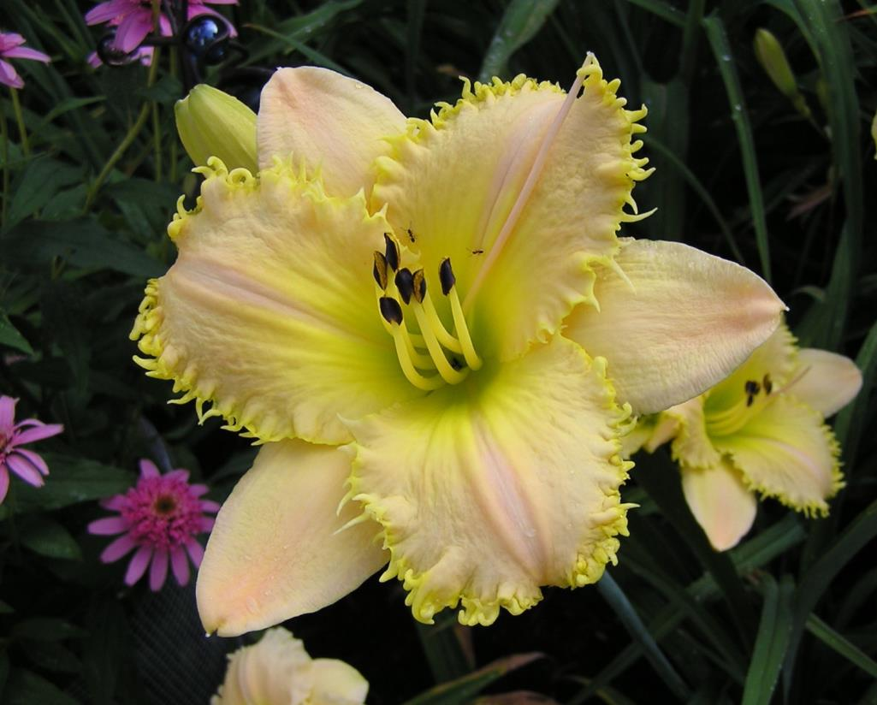
AHS 2016 Mildred Schlumpf Award: Single Bloom
FINALIST
Janice Kennedy
‘Lemon Fringed Pastel’
(Klehm, 2003)

Slide 34
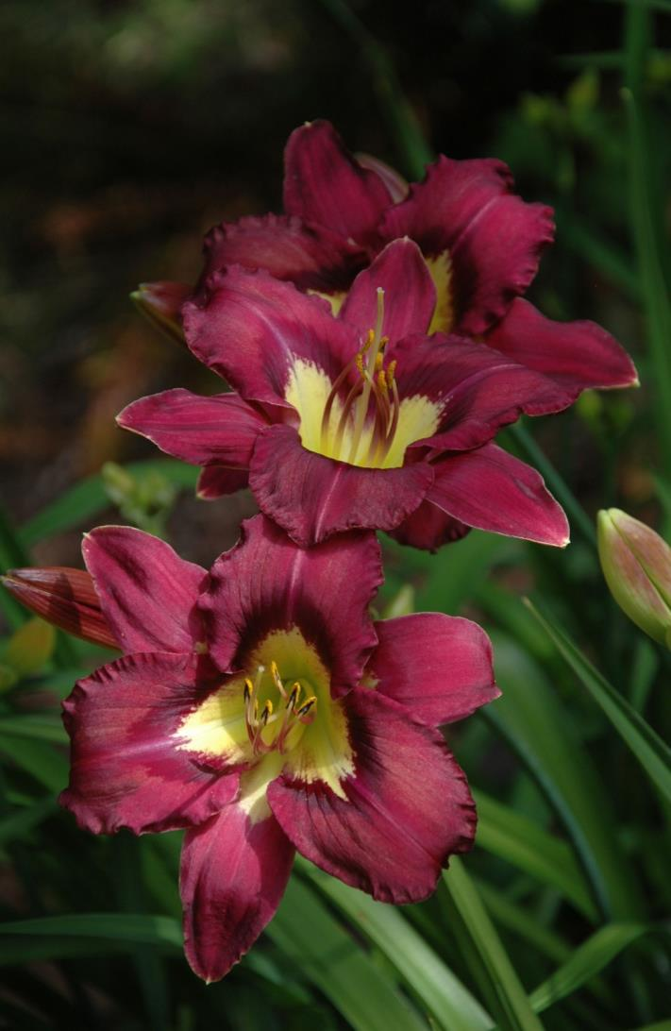
AHS 2016 Multi-Bloom Awards
FINALIST
Patricia Loveland
‘Olympic Lightning Flash’ (Loveland-P., 2012)

Slide 35
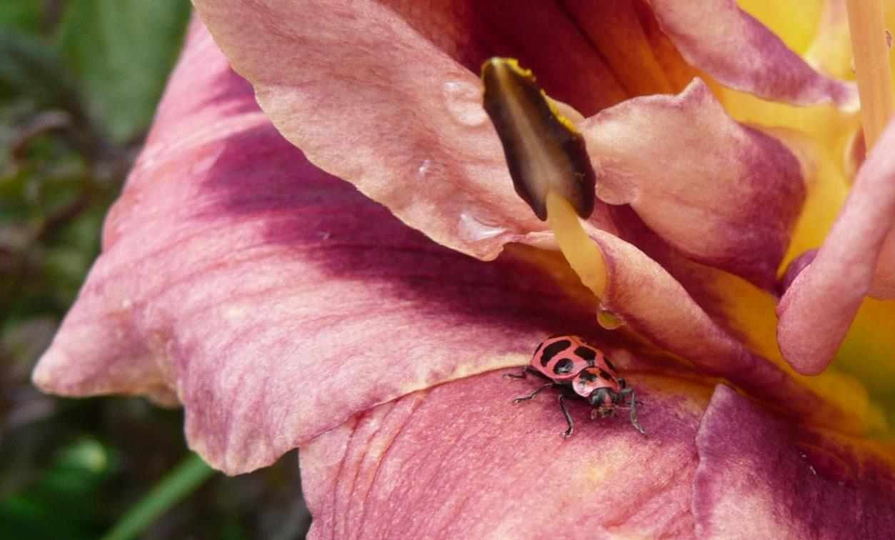
AHS 2016 Artistic Award
FINALIST
Debbie Monbeck
‘Grape Cupcake’ (Herrington, 2002) with Pink Beetle

Slide 36
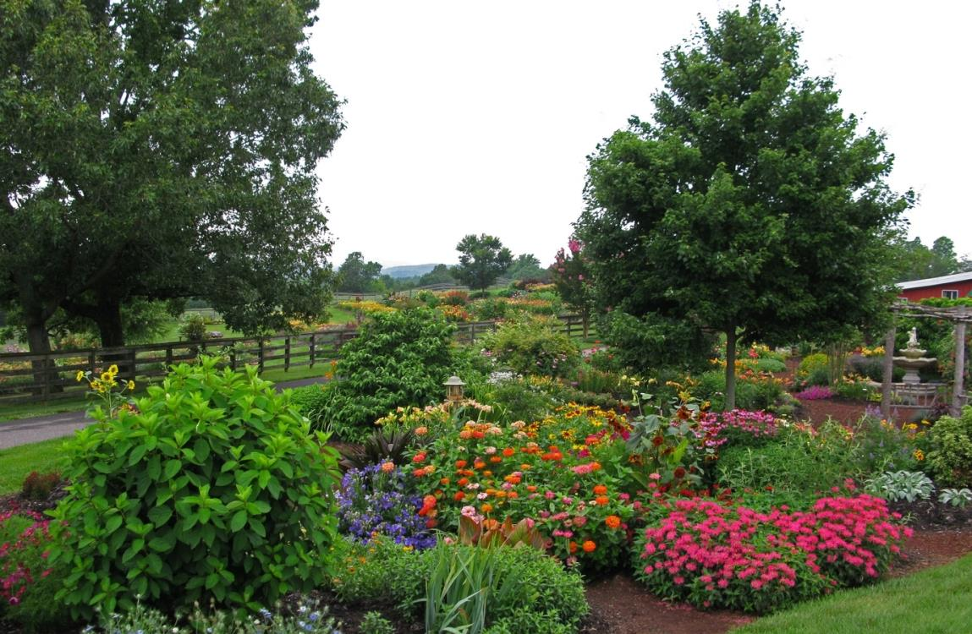
AHS 2016 Mildred Schlumpf Award: Landscape
FINALIST
Paul Owen
Slightly
Different
Nursery
(NC)

Slide 37
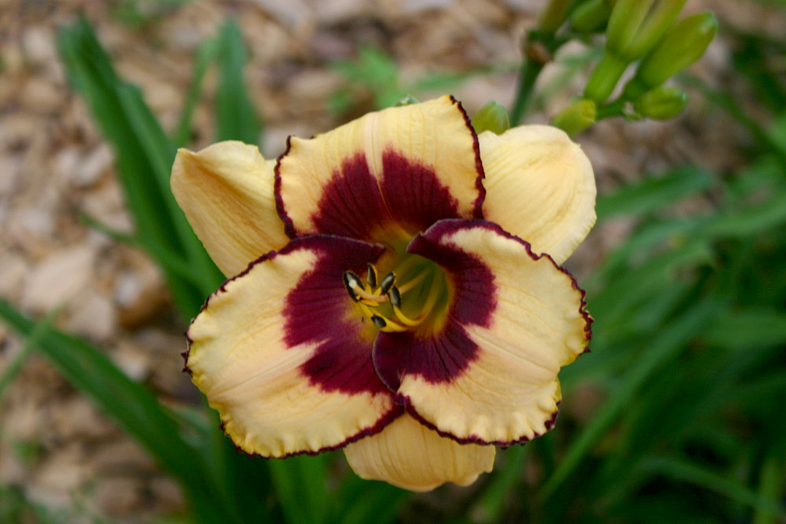
AHS 2016 Youth Photography Awards: Intermediate Division
FINALIST
Jon Whitinger
‘Circle of
Friends’
(Shooter-F.,
1997)

