Slide 1
A Review of What’s New for 2017

Slide 2
Daylily Exhibitions
Major changes effective January 1, 2017.
Changes affect everyone involved with a show; judges, exhibitors, hybridizers and show hosts.

Slide 3
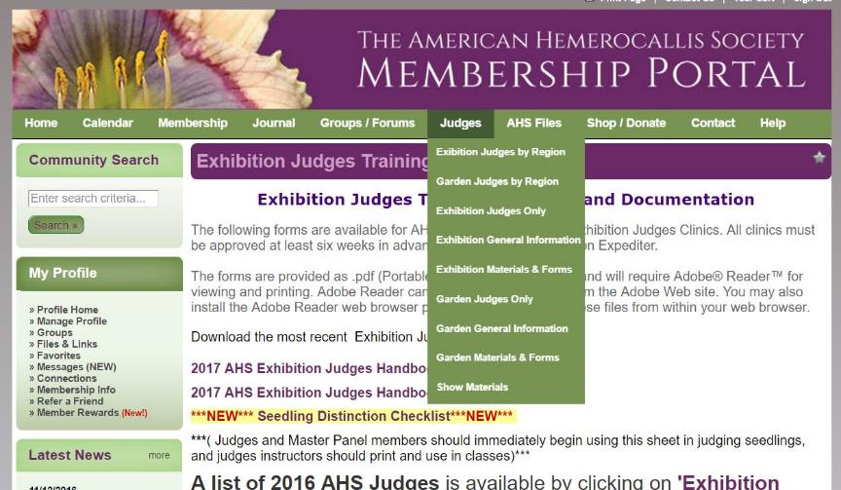
www.DaylilyNetwork.com
* free download *

Slide 4
Topics of Interest
Judging Considerations for Doubles
Clarification on pollen and transitory insects
Judging Spiders
Using Seedling Distinction Worksheet
Ethics
Misplacement, misnamed entries
Disqualification
Signatures now required on Best In Show ballots

Slide 5
Judging Considerations for Doubles
For a double to be considered to be fully double, it must have at least three extra petals. Entries exhibiting less than three extra petals may NOT be disqualified, but should be assessed points under “Form”. Pages 18-19
Missing or deformed pistil or stamens are not penalized with doubles. Rationale: the extra petals in doubles are formed by the transformation of the pistil and/or stamens into petals. They cannot be penalized for doing what they are supposed to do. Pages 18-19

Slide 6
A new registration rule and its application in a Daylily Exhibition
1. For a cultivar to be recognized as double or polymerous, it must be registered as exhibiting the respective trait 50% or more of the time. Pages 18-19
2. Only those cultivars listed on the official Double and Polymerous List, may be entered in Section 5, regardless of their condition on the day of the show. Pages 18-19
3. Double and polymerous cultivars with no percentage listed in the AHS database will be continue to be listed on the official Double and Polymerous List and will continue to be shown in Section 5. Pages 18-19

Slide 7
A new registration rule and its application in a Daylily Exhibition
4. Any cultivar listed on the official Double and Polymerous List not exhibiting the trait on the day of the show, will be assessed points under “Form”. It may NOT be disqualified. Page 38
5. Any cultivar that is not listed on the official Double and Polymerous List will be placed in its corresponding size/form section, regardless of any doubling or polymerous traits that may be apparent.
6. A cultivar that is not on the official Double and Polymerous List exhibiting doubling or polymerous traits on the day of the show, will be assessed points under “Form”. It may NOT be disqualified. Page 38

Slide 8
Pollen and transitory insects will no longer be penalized.
Pollen that has fallen on the petals is not considered a fault. Page 41
Pollen that is smeared across the petals, is a fault. Page 41
Insects that are capable of moving from one entry to another are not considered faults-ants, flying insects, etc. Page 41
Insects that are living on the entry, and/or evidence of such residence, for example spider webs, is considered a fault. Page 41

Slide 9
Points may no longer be deducted for spiders that appear to not meet the 4:1 ratio requirement.
A cultivar registered as a spider must be assumed to meet the 4:1 ratio requirement. Page 38
It is impossible for a judge to accurately determine if a daylily meets the 4:1 ratio required for spiders. The measurement requires physically handling the flower to measure the petal length. Judges are expressly forbidden to touch an entry. Page 38, Page 10
Any judge deducting points, or attempting to disqualify an entry for apparent nonconformity with the 4:1 ratio rule, will face severe sanctions and possible loss of judging privileges. Page 38

Slide 10
New Seedling Distinction Worksheet
Uses statistics to determine some aspects of distinction, including bud count, branching and size vs form. Offers a suggested scale of points for these categories. Page 45
Further emphasizes the characteristics of scape balance, grace, beauty and charm.
Allows points for a “WOW” factor
Further emphasizes the definition of distinction that includes the terms “better than” and/or “different from” cultivars already in commerce.
A helpful reference for for judges, hybridizers and collectors that emphasizes what makes a new daylily distinctive.

Slide 11
Ethics Violations
Unethical behavior by judges is now subject to penalties. Page 119
Consequences depend on the severity of the infraction.

Slide 12
Unethical Behavior by a Judge
Pages 9-12
Judges may not exhibit in a show in which they are judging. This includes jointly owned entries.
A judge may not judge when they have significant prior knowledge that may affect the outcome, or even give that appearance.
Judges should not be in any area of the show floor, prep area, etc., until instructed it is time to do so by the Judges’ Chair.

Slide 13
Unethical Behavior by a Judge
Pages 9-12
Judges must withhold ALL prejudices regarding form, color, hybridizers, etc.
A judge may NEVER disqualify an entry.
ONLY the Classification Chair may disqualify an entry

Slide 14
The only acceptable reasons an entry may be disqualified by the Classification Chair: Page 78
1. Evidence of the use of artificial coloring.
2. The entry was placed in the wrong section (see page 12 under “Judging Standards” for procedure)**

Slide 15
Dealing with a Misplaced Entry Page 12
Only the Classification chair has the authority to move or disqualify a misplaced entry.
The entry may still be judged if the section it is being moved to has not yet awarded the best-in-section rosette.
If the best-in-section has been awarded, the entry is marked “Judged. Placed in wrong section.”
Under NO circumstances may a section be reopened to judge a misplaced entry, if the best-in section has been awarded.

Slide 16
The only acceptable reasons an entry may be disqualified by the Classification Chair:
1. Evidence of the use of artificial coloring.
2. The entry was placed in the wrong section (see page 13 under “Judging Standards” for procedure)**
3. The entry is misnamed (see page 12 under “Judging Standards” for procedure)**

Slide 17
Dealing with a Misnamed Entry Page 12
Only the Classification chair has the authority to move or disqualify a misnamed entry.
If the name can be correctly determined, the entry may still be judged if the section it is being moved to has not yet awarded the best-in-section rosette. However, the Classification Chair is under no obligation to determine the correct name of a misnamed entry.
If the best-in-section has been awarded, the corrected entry is marked “Judged. Incorrect name on entry tag.”
Under NO circumstances may a section be reopened to judge a misnamed entry, if the best-in section has been awarded.

Slide 18
The only acceptable reasons an entry may be disqualified by the Classification Chair:
1. Evidence of the use of artificial coloring.
2. The entry was placed in the wrong section (see page 13 under “Judging Standards” for procedure)**
3. The entry is misnamed (see page 13 under “Judging Standards” for procedure)**
4. The entry is severely damaged
5. The entry is not a seedling and is not in the AHS database Page 89

Slide 19
Dealing with cultivars not in the database Page 89
A recently registered entry that is not a seedling and whose information is not yet published in the AHS database, must be placed in section 10-“Seedlings”. This provision is provided only for newly registered daylilies that have not yet had their information published in the AHS database. It does not apply to misnamed or unknown cultivars.
A new entry tag must be filled out with the word “Seedling” placed under cultivar name and section number identified as “10”. No identifying marks may remain in the area of the entry tag visible to the judges.
A qualified entry that is not yet listed in the AHS database may also be entered by the hybridizer in Section 11-AHS Achievement award (three scapes required), provided the labeling procedure from #2 above is followed.
The cultivar will be judged by the standards set forth for judging seedlings.

Slide 20
The only acceptable reasons an entry may be disqualified by the Classification Chair:
1. Evidence of the use of artificial coloring.
2. The entry was placed in the wrong section (see page 13 under “Judging Standards” for procedure)**
3. The entry is misnamed (see page 13 under “Judging Standards” for procedure)**
4. The entry is severely damaged
5. The entry is not a seedling and is not in the AHS database
6. The entry was not entered by its owner. Page 92

Slide 21
Entries may not be entered by anyone not at the same physical address as the owner/grower of the daylily. Page 92
For show purposes, all parties at the same physical address are considered to be “owners” and may submit entries for any family member or partner at that address.
Page 92

Slide 22
The only acceptable reasons an entry may be disqualified by the Classification Chair:
1. Evidence of the use of artificial coloring.
2. The entry was placed in the wrong section (see page 13 under “Judging Standards” for procedure)**
3. The entry is misnamed (see page 13 under “Judging Standards” for procedure)**
4. The entry is severely damaged
5. The entry is not a seedling and is not in the AHS database
6. The entry was not entered by its owner.
7. The entry is the second entry per named class in a household. (Only one entry per named class is allowed per household). Does not apply to seedlings-each seedling is an individual class. Disqualified at check-in. Page 78

Slide 23
Judging an entry not known by any of the judges
If none of the panel members know a daylily, the exhibit must be judged ‘as is’, with no points deducted for the actual bud count, number of branches or flower size. Page 11
Points may not be deducted for form, except as it pertains to non-conformity with the class in which it is entered. Page 11

Slide 24
Judging an entry not known by any of the judges (continued)
HOWEVER
If available, and/or in addition to the Classification Chair’s research in paper/CD checklists, a smart phone or tablet may be used to access the AHS online database for registration information on an unknown cultivar such as: bud count, branching, size of flower, etc. The use of a device is not required.
Page 11
The picture on a smart phone or tablet cannot be used to determine the color of an entry.

Slide 25
Validation of the Requirement for Senior Exhibition Judges to Exhibit in an Accredited Show
Page 98 (form), Page 16 (requirement)
SENIOR JUDGE CERTIFICATION
(Optional but should be included)
This to certify that ______________________________________________________
has placed entries in competition at this show ________________________________________________Date_________
General Show Chair or Judges’ Chair
_______________________________

Slide 26
Best-in-Show Updates
Judges must now sign their Best-in-Show ballots Pages 51 (Explanation) Page 52 (Form)
An additional tie breaker for Best-in-Show tabulation and the procedure for determining the outcome if entries remain tied after exhausting all tie breakers has been added.
Page 81 (Explanation), Page 53-55 (Forms and example form)

Slide 27
Counting Branches Page 36
The official definition of branching, as determined by the AHS Scientific Studies Committee in 2013.
1. A branch is a stem that originates from the primary scape and bears two or more buds.
2. A terminal branch occurs at the top of a scape and may be arranged to form a “V” (two branches), a “W” (three branches) or even four or more branches. A terminal branch which does not divide at its terminus is counted as a single branch. ALL terminal branches are counted which meet the required standard of two or more buds per branch.
3. Lateral branches originate from the original scape, occurring where there are bracts. Proliferations and stems with a single bud are NOT considered branches.
4. Sub-branches of lateral branches are NOT included in the count of branches. ONLY stems which originate at the junction of the original scape are counted as branches.

Slide 30
Topics of Interest
Judging Considerations for Doubles
Clarification on pollen and transitory insects
Judging Spiders
Using Seedling Distinction Worksheet
Ethics
Misplacement, misnamed entries
Disqualification
Signatures now required on Best In Show ballots

Slide 31
www.DaylilyNetwork.com
* free download *

Slide 32
A Review of What’s New for 2017

